Slide 1
Second Conditional
Sentences
www.Games4esl.com

Slide 2
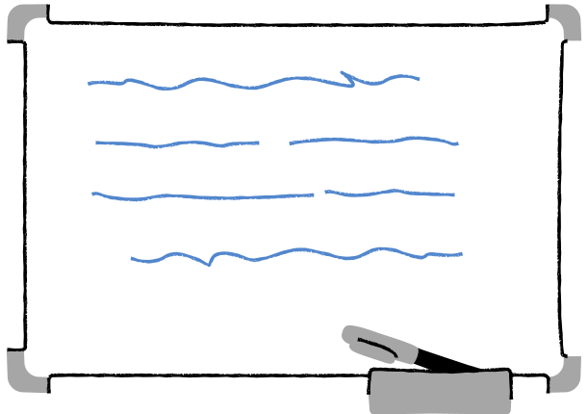

In This Lesson:
  What is the second conditional?
  How to form second conditional sentences.
  Second conditional example sentences
  Answer The Questions
www.Games4esl.com

Slide 3
  What Is The Second Conditional?
Second conditional sentences are used to talk about future things which are unlikely or impossible.
Example:
"If I won the lottery, I would buy a big house."
www.Games4esl.com

Slide 4
2. How To Form Second Conditional Sentences
Second conditional sentences are made up of an 'if clause' and a 'main clause'. The 'if clause' has a verb in the past simple tense. The 'main clause' has 'would' + an infinitive verb.
Example:
"If I won the lottery, I would buy a big house."
www.Games4esl.com

Slide 5


3. Example Sentences
If I had a million dollars, I would buy a sports car.
www.Games4esl.com

Slide 6


3. Example Sentences
If I had a rocket, I would fly to the moon.
www.Games4esl.com

Slide 7

3. Example Sentences
If the weather wasn't so bad, I would go to the park.
www.Games4esl.com

Slide 8

3. Example Sentences
If I could travel back in time, I would have a pet dinosaur.
www.Games4esl.com

Slide 9


3. Example Sentences
If I could travel anywhere, I would go to Korea.
www.Games4esl.com

Slide 10

Your Turn!
What would you do in the following situations?
www.Games4esl.com

Slide 11
What would you do if you had a million dollars?
If I had a million dollars, I would....
www.Games4esl.com

Slide 12
Where would you go if you could go anywhere?
If I could go anywhere, I would go to ....
www.Games4esl.com

Slide 13
What would you do if you found a talking dog?
If I found a talking dog, I would ...
www.Games4esl.com

Slide 14

GOOD JOB!
www.Games4esl.com

