Slide 1
Conversation class
Gap fillers

Slide 2
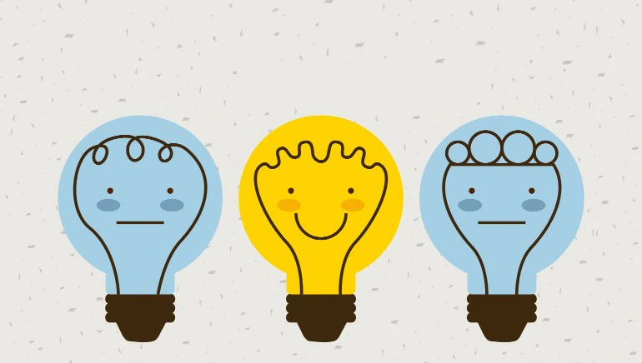
1. well
It can be used to show that you’re thinking.
Example: Well, I think 2o
dollars is a good price for
a pair of jeans.

Slide 3
2. Like
To show that something is not exact
Example: My neighbor has like ten dogs.
2. To figure out your next word
Example: Mt friend was like completely ready for the match.

Slide 4
3. Actually/ basically/ seriously
Actually: something you think Is true, but others disagree with you.
Example: Actually, bugs are really cute.
2. Basically: to summarize something
Example: Basically, the last batman movie
was really interesting.

Slide 5
4. You see/ know
You see
You know
To share a fact that you assume the listener doesn’t know.
Example: I was going to try the app, but you see I ran out of storage on my mobile.
To share a fact that you assume the listener knows.
Example: We stayed at that hotel you know the one down the street from Time’s square.

Slide 6
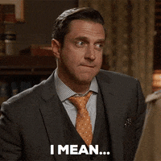
5. I mean
To clarify how you feel about something.
Example: I mean he’s a great guy, but I’m not sure
if he’s a doctor.
2. To correct yourself.
Example: The car is tow thousand – I mean – twenty thousand years old.

Slide 7
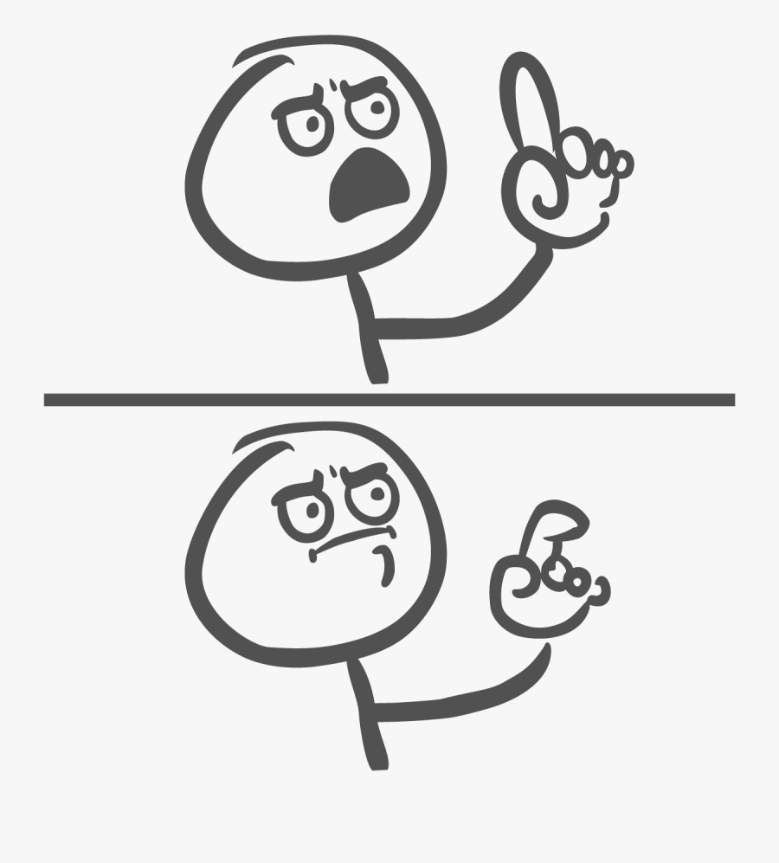
6. Or something
Not being exact.
Example: The cake needs two sticks of
butter and ten eggs or something
like that.

Slide 8
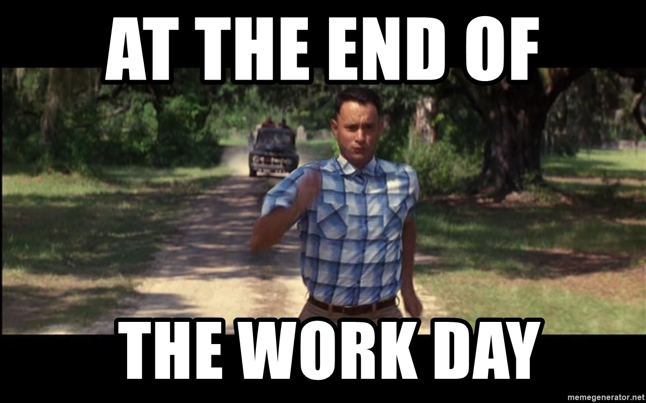
7. At the end of the day
To reach a conclusion.
Example: At the end of the
day, we’re al humans and
we all make mistakes.

