Slide 1
Adjectives
Unit 2B
Pages 16-17; 152
July 13, 2025

Slide 2

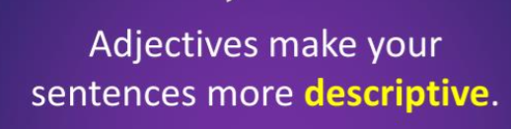
Adjectives

Slide 3
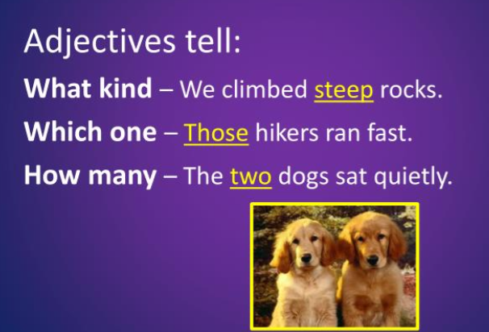

Slide 4
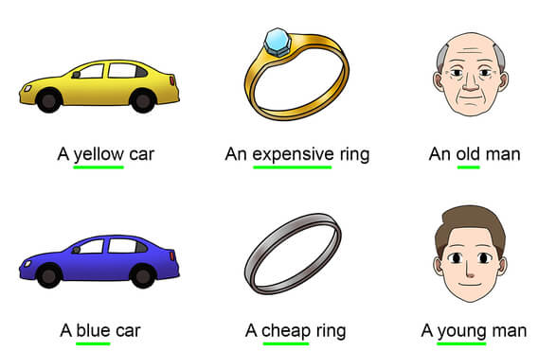

Slide 5

Position of Adjectives
An adjective comes before the noun.
An adjective can come after the verb “be.”

Slide 6

Modifiers really/very
.
She looked really beautiful in her dress.
The coffee is really hot!
It’s very cold outside.
The music is very loud.

Slide 7
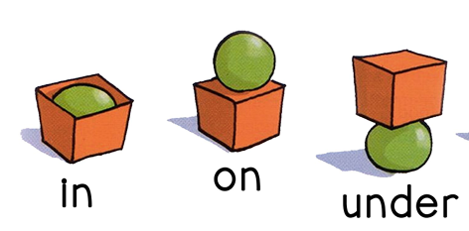
Prepositions
The green ball is…
in= something is inside a closed or mostly-closed space.
on=something on the surface of something else
the box.

Slide 8
Prepositions: in, on, at
Preposition | Used for Place | Example
IN | inside something | I live in Amman./She was in bed.
ON | On a surface | They were on a boat./We were on a train.
AT | Specific places or points | I was at home./ The flight was at 6PM.

Slide 9
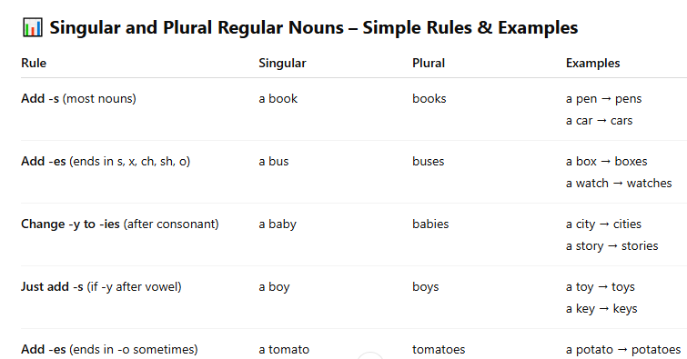
Singular and Plural Nouns

Slide 10
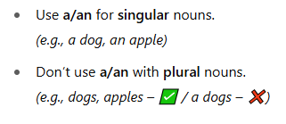
Singular and Plural Nouns

Slide 11
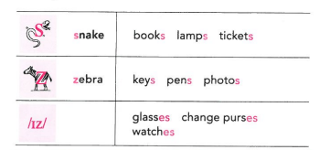

Pronunciation of final -s/-es

