Slide 1
Elementary 3- Unit 7
Session 1

Slide 2
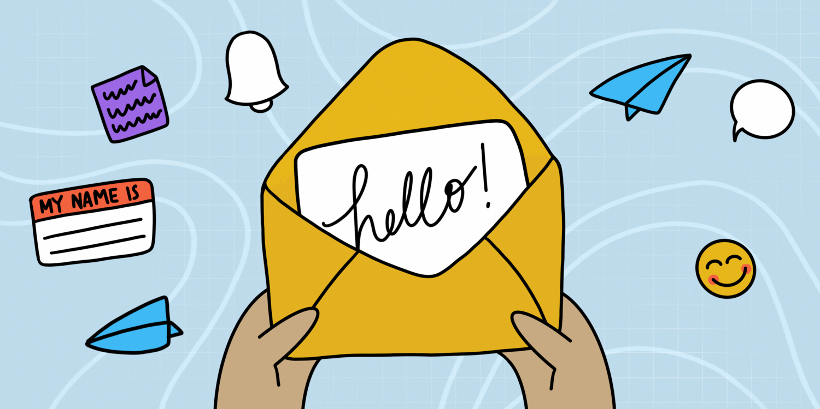
Introduce yourself
I work as...
I want to travel to…
I live in…
I want to learn English to…
I love …
I want to be a…
Notes:
10 min

Slide 3
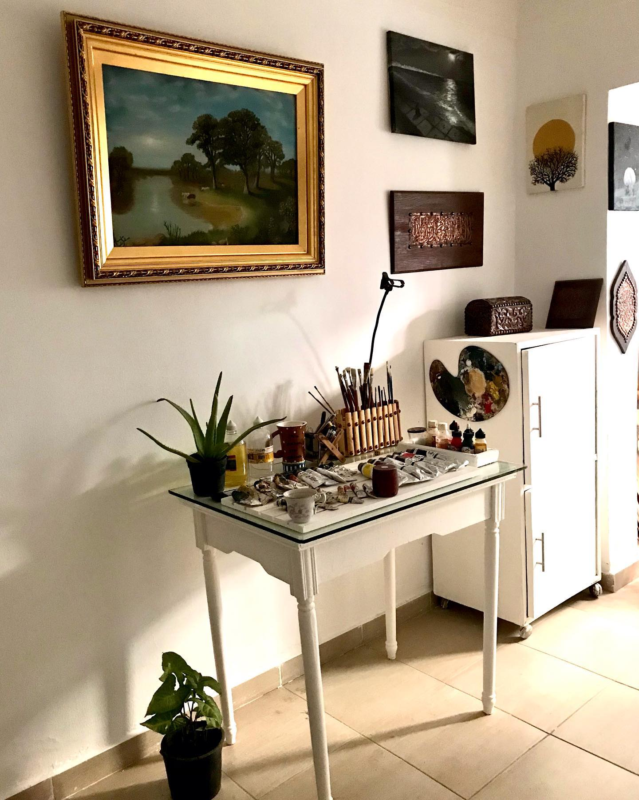
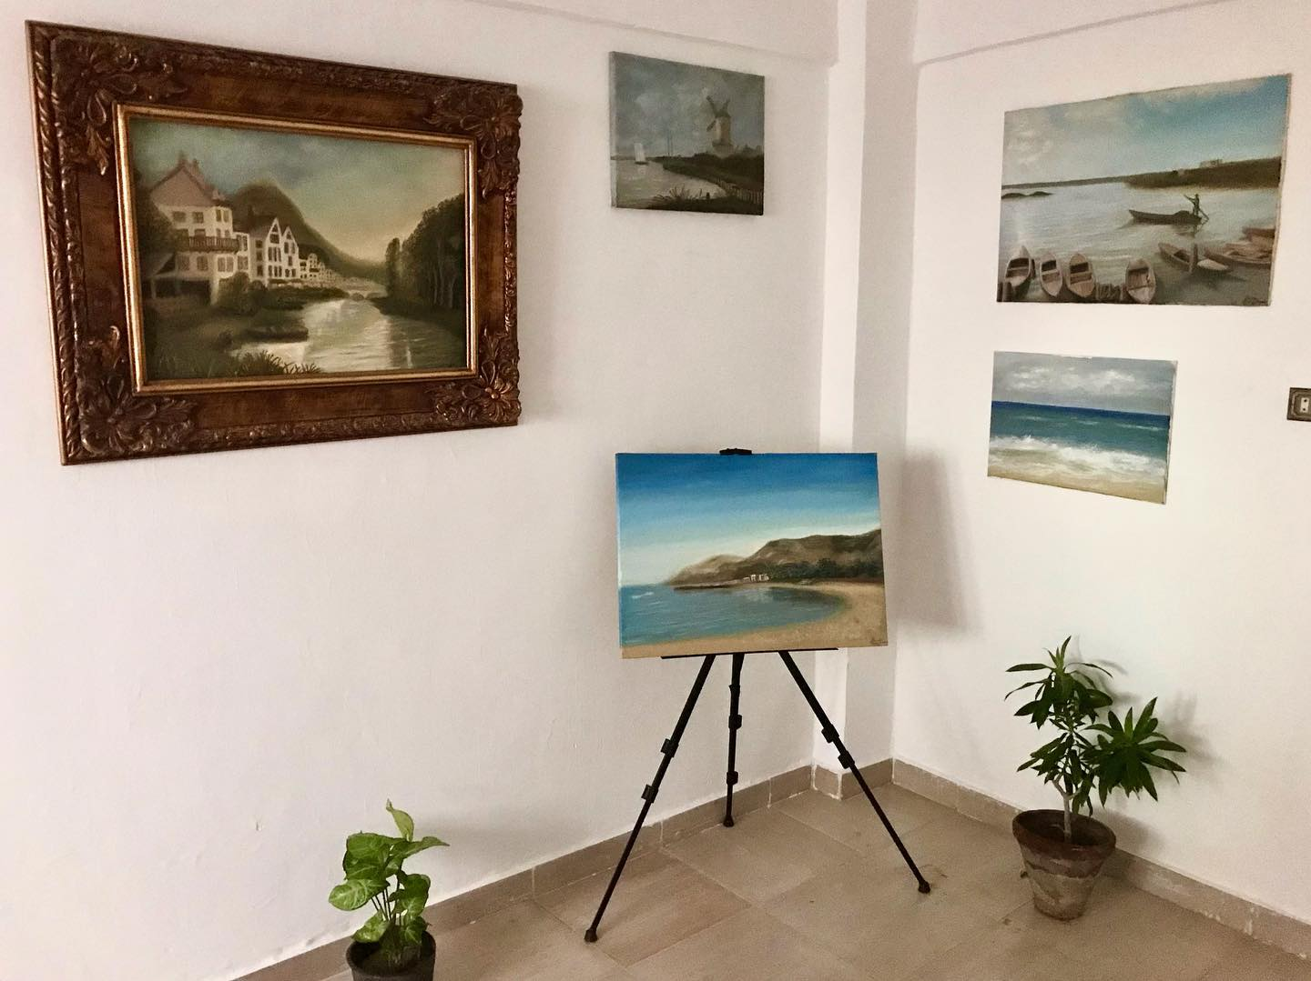
Tell us something interesting about you
I am a painter and I made my own art studio at home.
Notes:
7 min

Slide 4
Notes:
8

Slide 5
2 truths and a lie
I love painting and making hand crafts.
I always fix my car myself.
I hate orange juice.

Slide 6
Dates to remember
Do you remember any of the following which is important to you?
Birthdays
Anniversary
Graduation
What are the most important events that happened in the 20th century?
Notes:
3 min

Slide 7
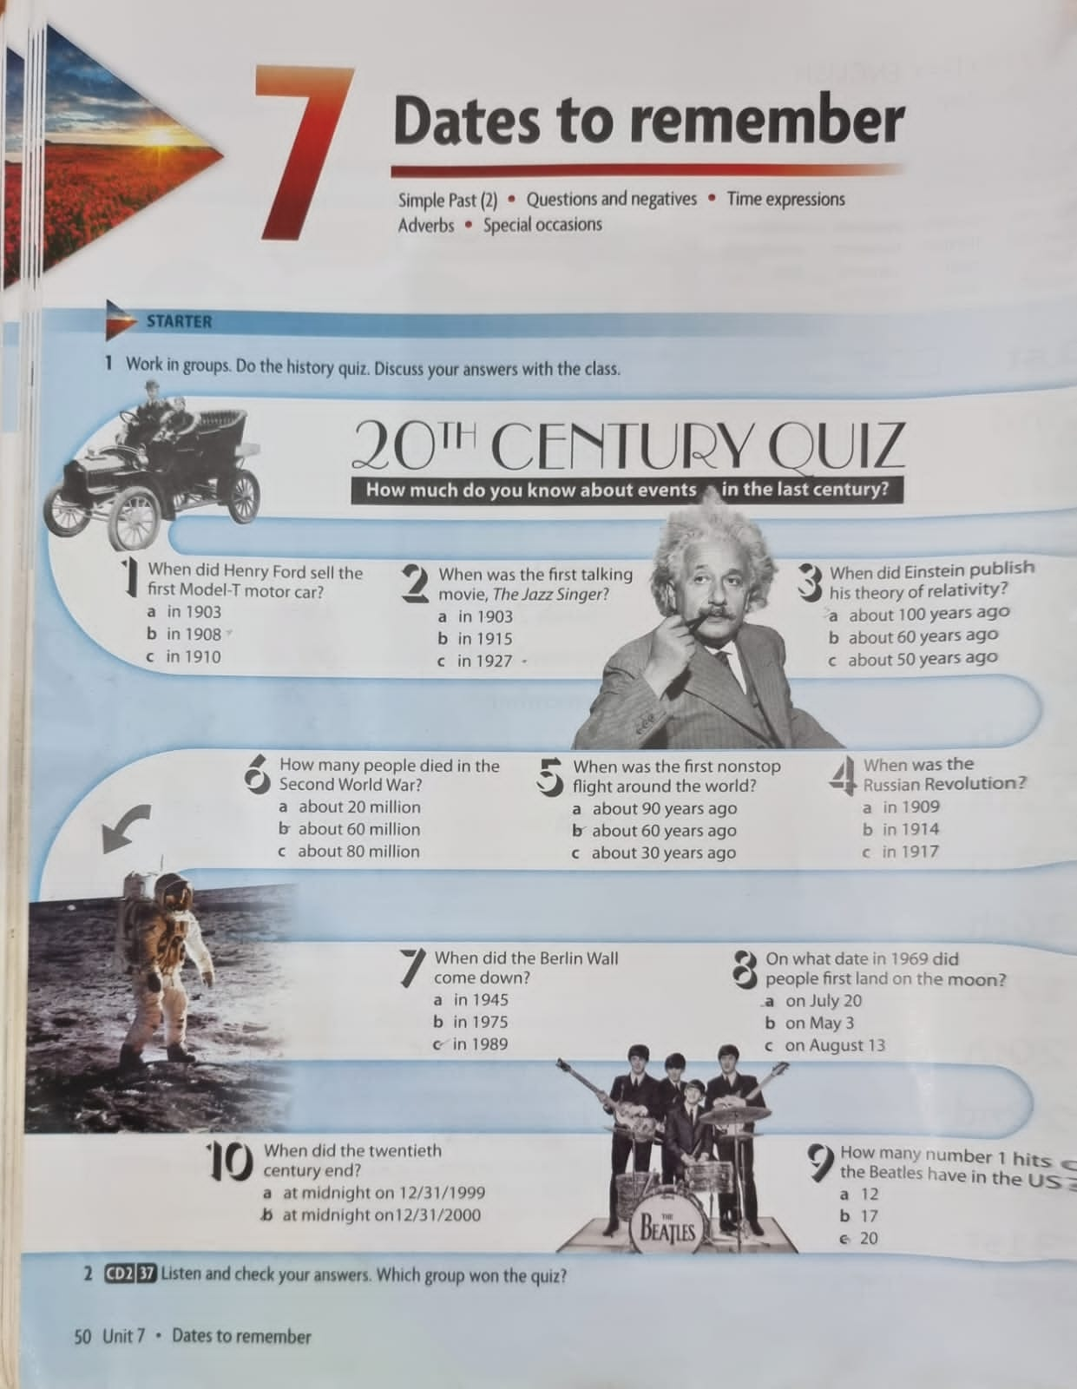
Listen to check the answers.
Notes:
8

Slide 8
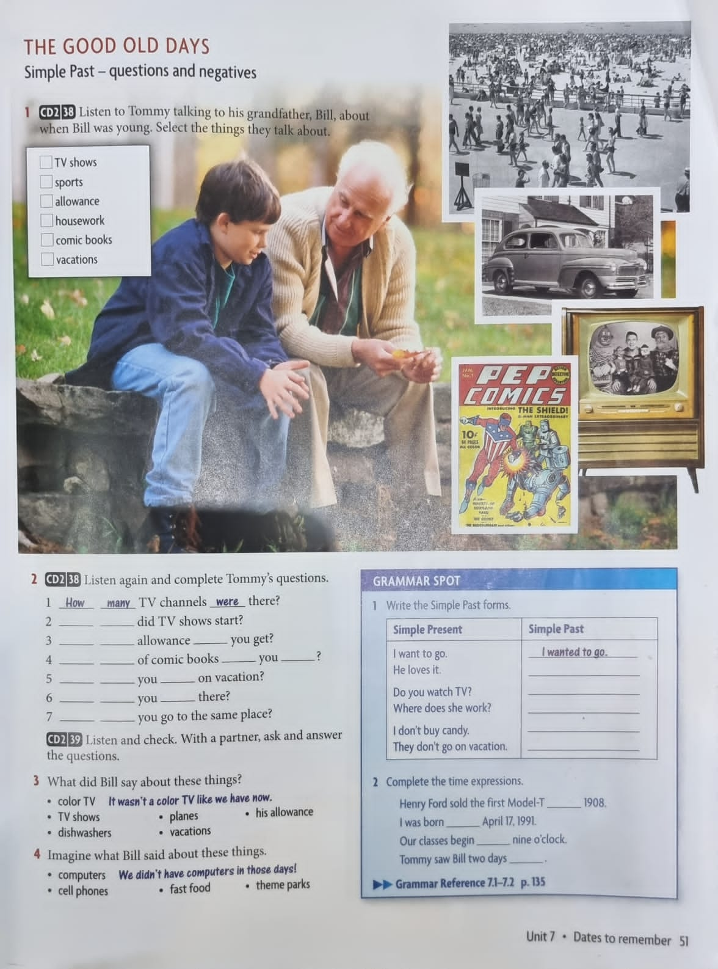
Notes:
5

Slide 9
What time
How much
did
What kind
did buy
Where did
go
How did
get
Why did
Notes:
8 min

Slide 10
Notes:
5 min

Slide 11
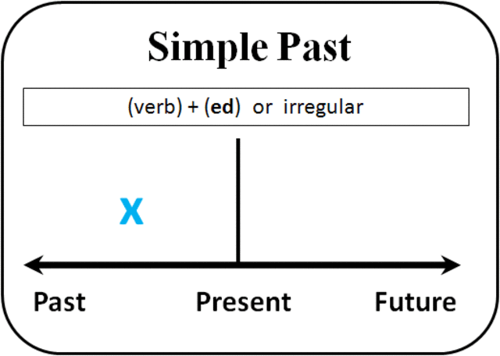
Where did Bill go when he was young?
He went to the beach.
Action
Habit
Notes:
4 min

Slide 12
I went to the beach.
.
subject
Verb (past simple)/ d-ed-ied or irregular
I didn’t go to the beach.
.
subject
did + not
Verb (infinitive)
Did I go to the beach?
Did
subject
Verb (infinitive)
?
Notes:
4 min

Slide 13
Notes:
3 min

Slide 14
Breakout rooms
Irregular verbs
Regular verbs
Hate
Love
Dance
Walk
Talk
Play
Stay
Cry
Try
Hated
Loved
Danced
Walked
Talked
Played
Stayed
Cried
Tried
Run
Speak
Do
Be
Go
swim
Sit
give
find
Ran
Spoke
Did
Was / were
went
swam
Sat
gave
found
Notes:
5 min breakout rooms
4 min feedback

Slide 15
Quiz
Notes:
6 – 8 min
https://quizizz.com/join/quiz/5ec354ce9d7e52001b72734d/start

Slide 16
Let’s watch this video
Notes:
3 min
https://learningenglish.voanews.com/a/learn-prepositions-in-on-at/3073753.html

Slide 17
Notes:
5 min

Slide 18
at
in
on
on
at
in
in
on
at
in
Notes:
5
3 min feedback

Slide 19
Breakout room
Notes:
5 mins

Slide 20
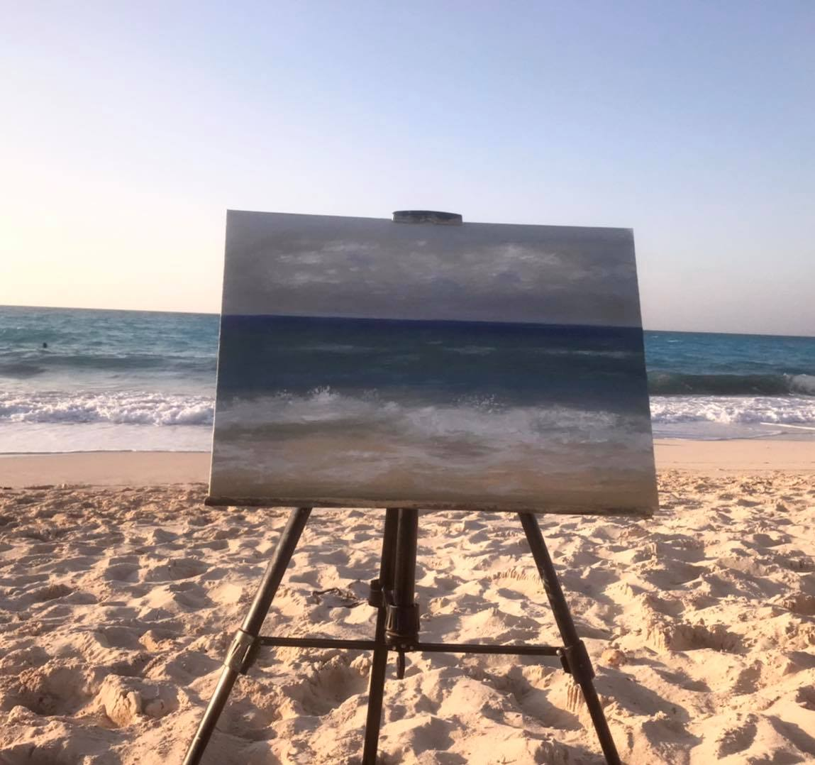
Tell us what you did last summer.
Last summer, my family and I went on a vacation to the north coast in August. I swam in the sea. I played racket ball with my nephews on the beach. In the afternoon, I painted a picture of the sea.
Notes:
10 min

Slide 21
Learn from our mistakes
Last vacation, I went to…
I played football
In the morning, I went to the beach
Rode bicycle
Went to lunch
Played with
Together
I swam
My family and I went on a picnic
There was a beautiful girl ….
Notes:
6 -7 min delayed error correction

