Slide 1
Elementary 3- Unit 8
Session 4

Slide 2
Oral quiz
Tell us about an interesting childhood memory (use past simple – time references – adverbs)

Slide 3
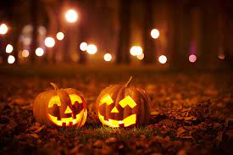
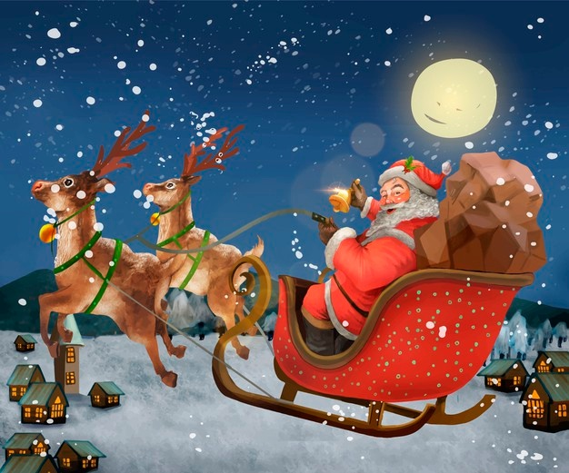
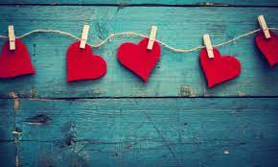
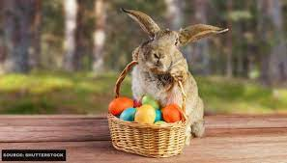

Slide 4
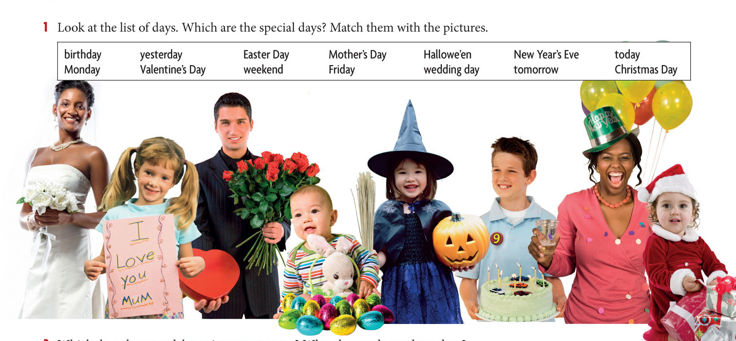
Breakout room
Wedding day
Mother’s day
Valentine’s day
Birthday
Halloween
New Year’s Eve
Easter day
Christmas day

Slide 5
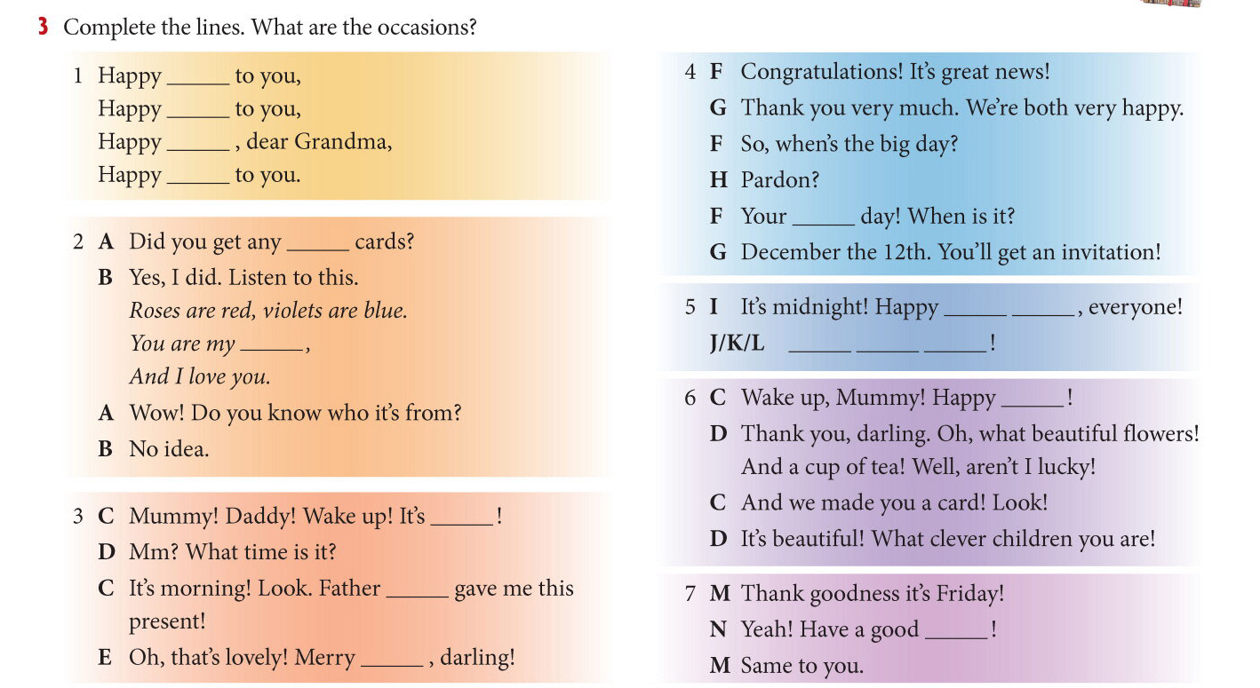
birthday
birthday
birthday
birthday
Wedding
Valentine
New Year
Valentine
Happy New Year
Mother’s Day
/Thursday!
graduation
Weekend

Slide 6
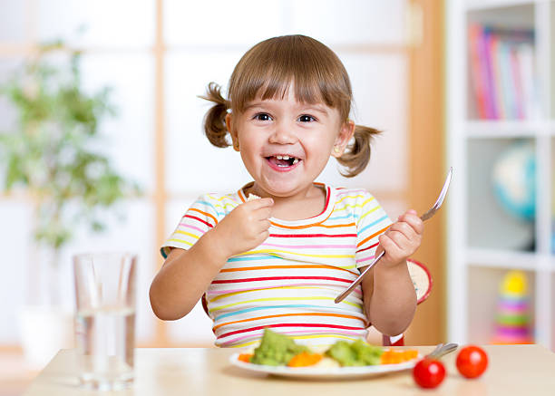
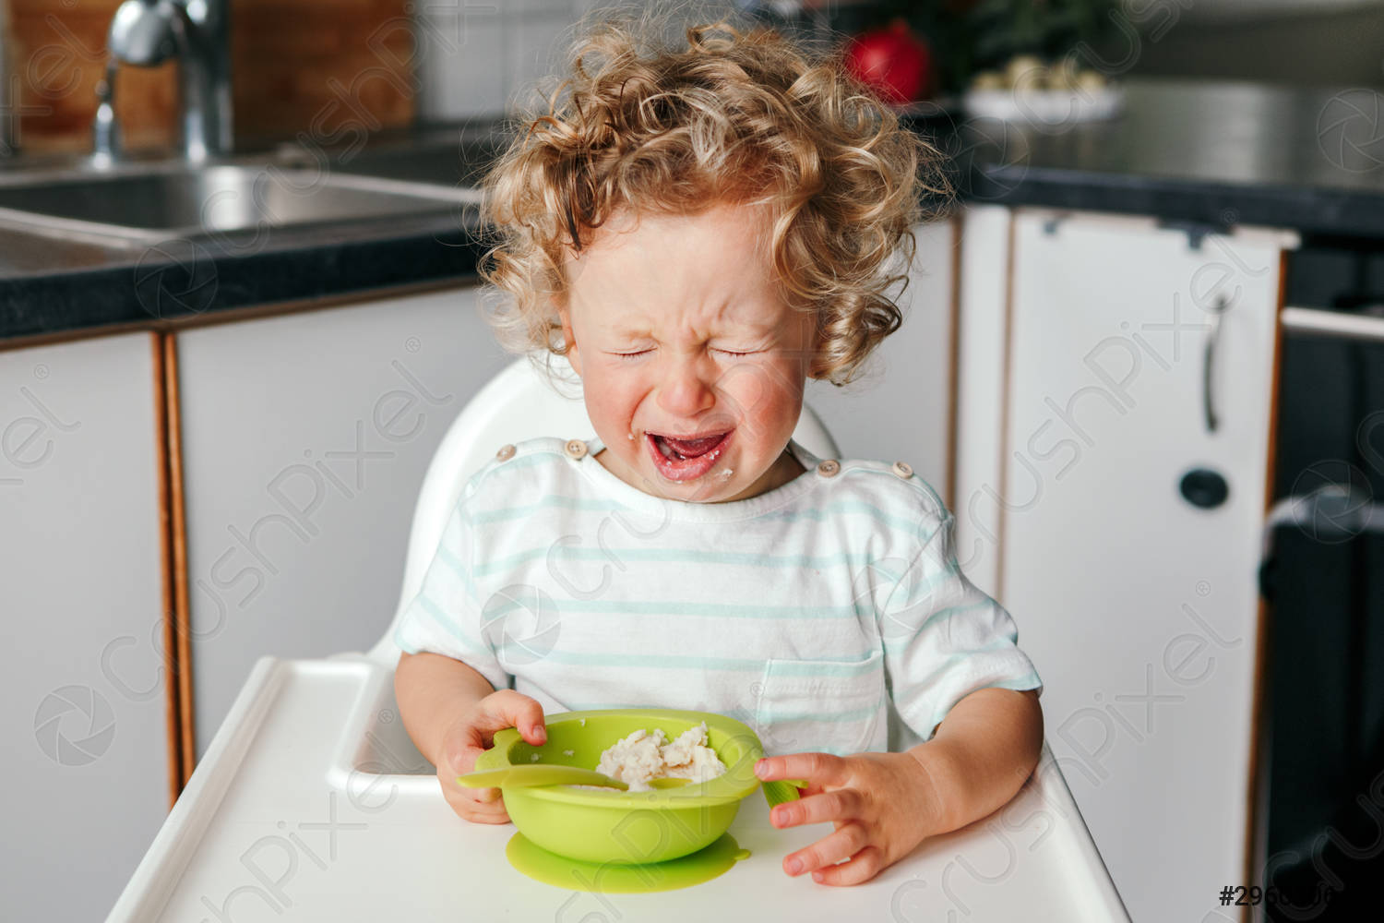
What is the difference between the 2 photos?

Slide 9
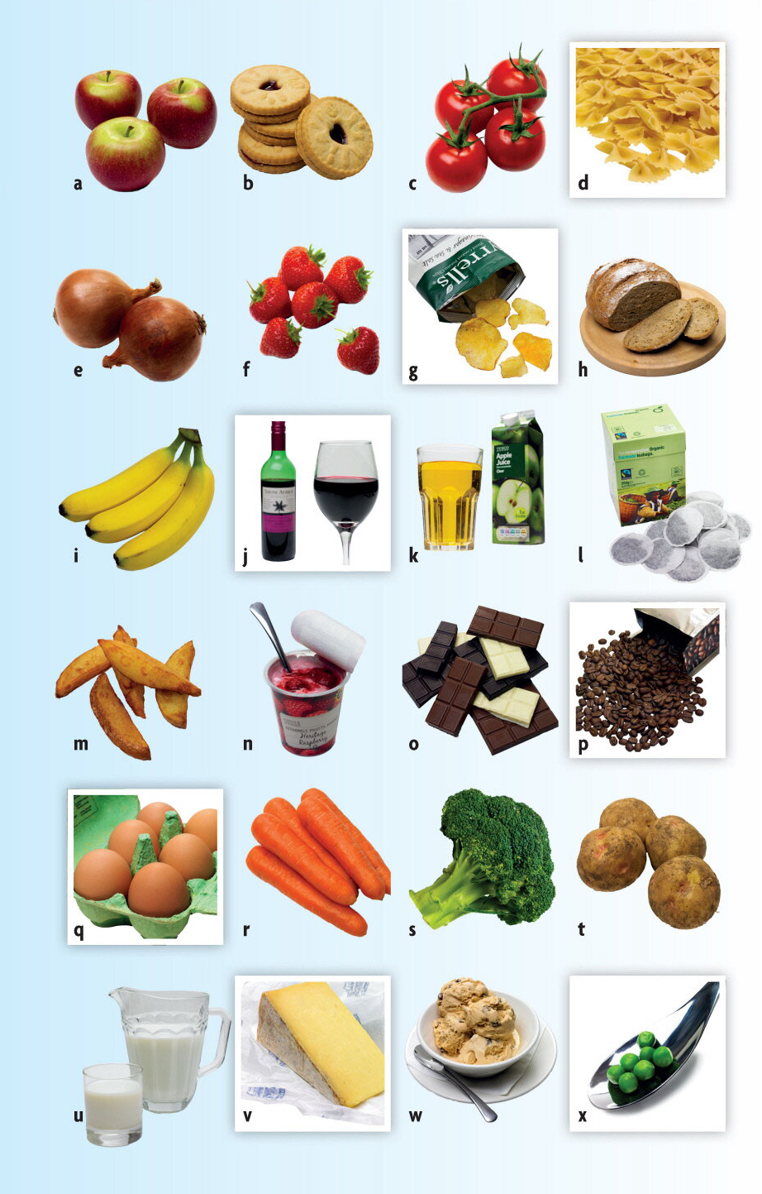
l
i
p
a
j
f
v
t
n
r
d
x
w
e
k
c
h
q
u
b
o
g
s
m

Slide 10
is
are
is
are

Slide 11
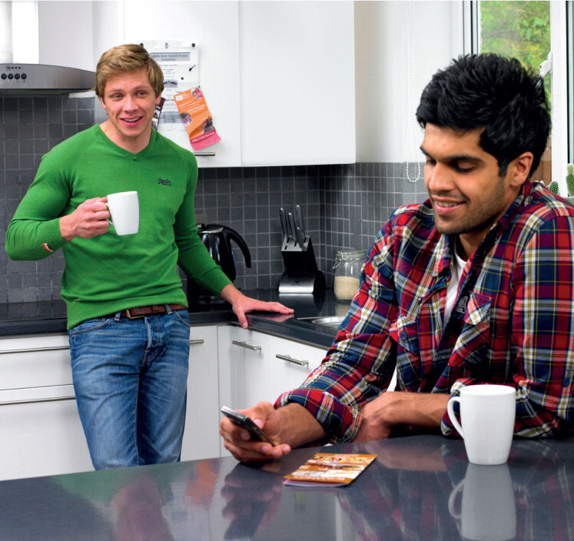

Slide 12
lot
any
any
some
lot
all

Slide 13
countable
uncountable
Negative/ uncountable
Negative/ countable
question/ uncountable
question/ countable

Slide 14
any – some - a lot of - all
any
There aren’t ________ parks in the center of Oxford.
Eating out is expensive here. There aren't’ ________ cheap restaurants.
Liverpool has ________ nightclubs..
We saw ________ beautiful places when we went to Austria.
There are ________ of shops near the university.
The house is empty. There aren’t ________ people here today.
There are ________ a lot of expensive new flats next to the river.
You don’t’ like travelling. Have you been to ________ countries?
We need to go to the grocery shop. There aren't ________ potatoes left.
We went to that hotel because we didn’t have ________ options
any
A lot of/ some
Some / a lot of
Some / a lot
any
Some / a lot of
any
any
any / a lot

Slide 17
quiz
https://quizizz.com/join/quiz/61be9f5c39218d001de6144f/start

Slide 20
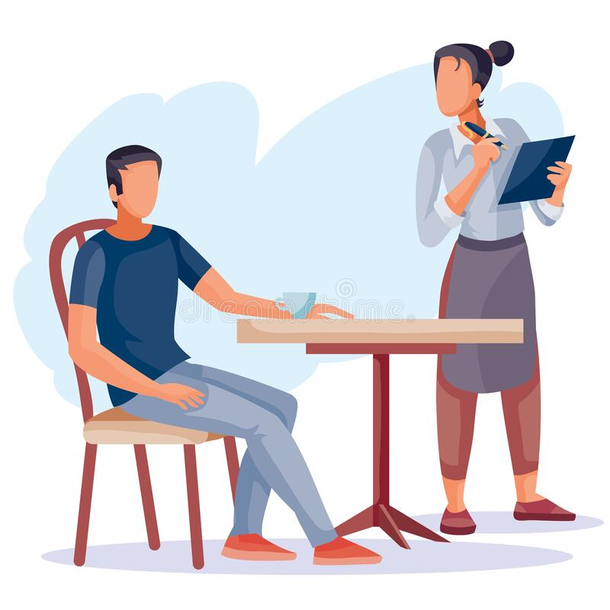
Work in pairs. You are in a restaurant and you would like to order.
Ask questions like: (can I help you?) (would you like…?)
Answer with phrases like: (I’d like…)

