Slide 1
Elementary 3- Unit 8
Session 5

Slide 2
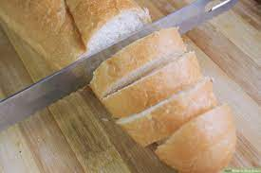
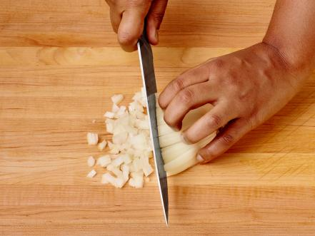
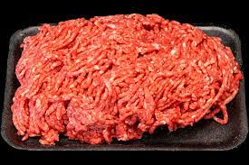
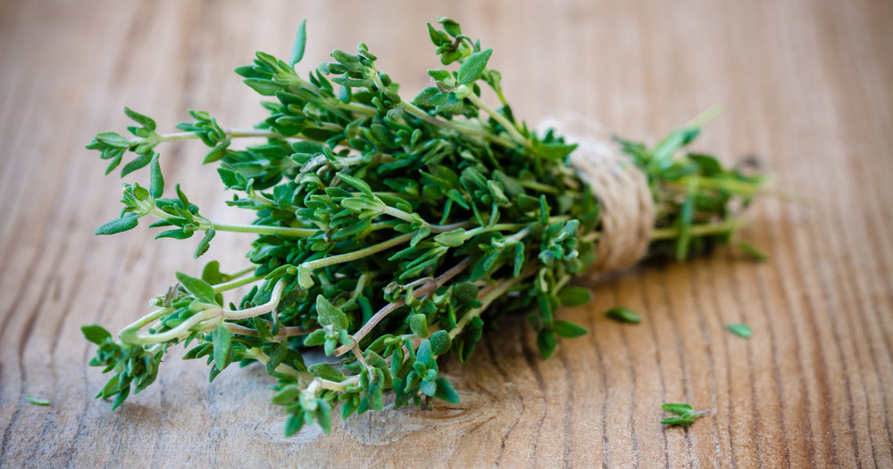
slice
chop
Thyme
Ground beef
Minced beef

Slide 3
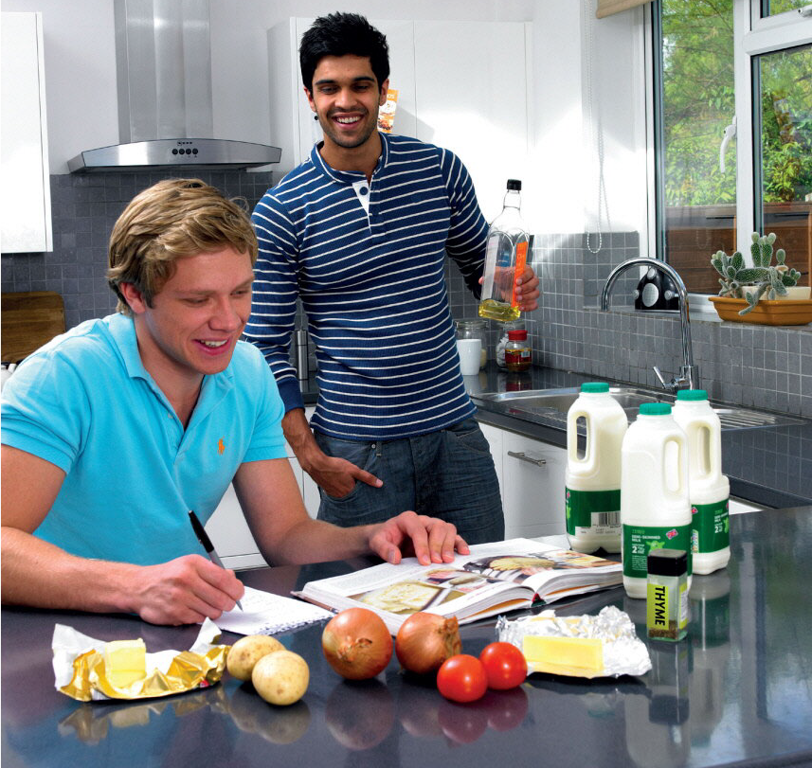

Slide 4
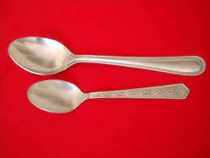
Much + (uncountable - singular) as (milk – water –money – salt - chocolate)
one bar of chocolate.
There is much chocolate.
There are many bars of chocolate.
I have a lot of money/ much money.
50 pounds 50 dollars.
Many + (countable - plural) as onions tomatoes – potatoes – bottle – bar – slice
Tea spoon
tsp
Table spoon tbsp

Slide 7
How many apples do you have? (countable noun) ?
How much (uncountable noun)?
There is much oil. (singular / uncountable noun)
There are many onions. (plural / countable noun)

Slide 10
quizizz
https://quizizz.com/join/quiz/5af95e8fb35286001a32a705/start

Slide 12
Notes:
Freer practice
Breakout rooms for 15 minutes

Slide 14
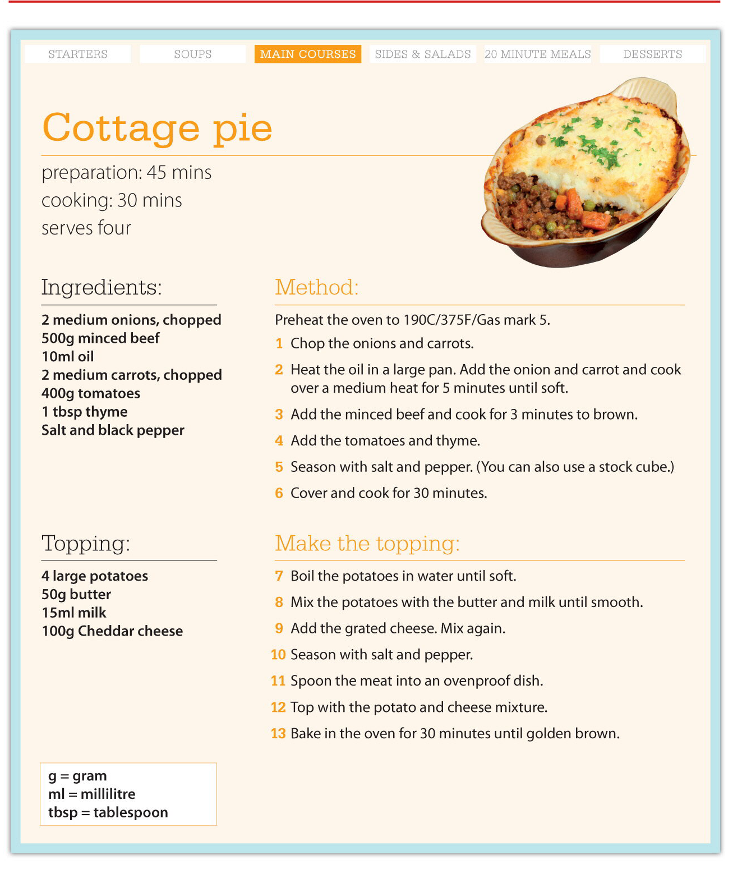

Slide 15
assignment

