Slide 1
Elementary 3- Unit 8
Session 6

Slide 2
assignment
Flour
Tea or table Spoon
Butter

Slide 3
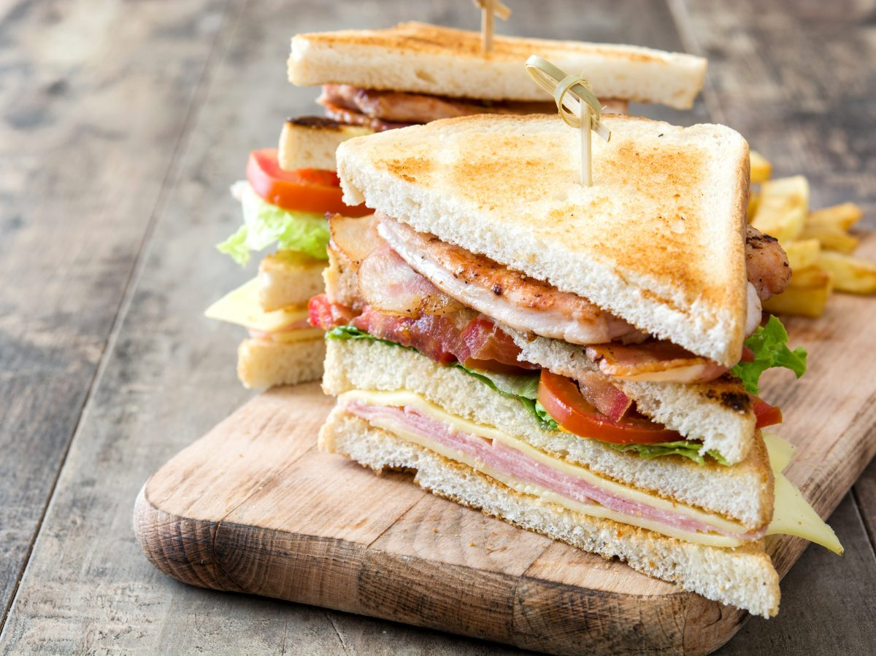

Slide 5
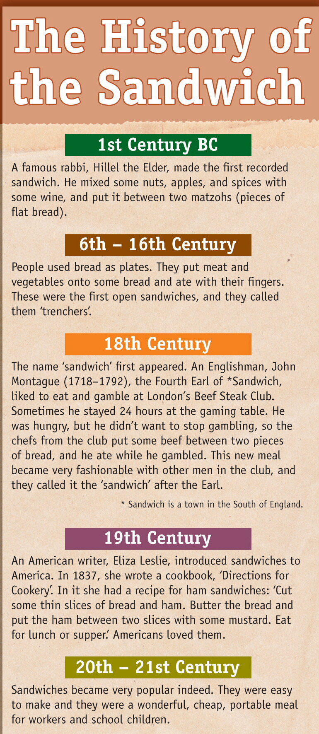
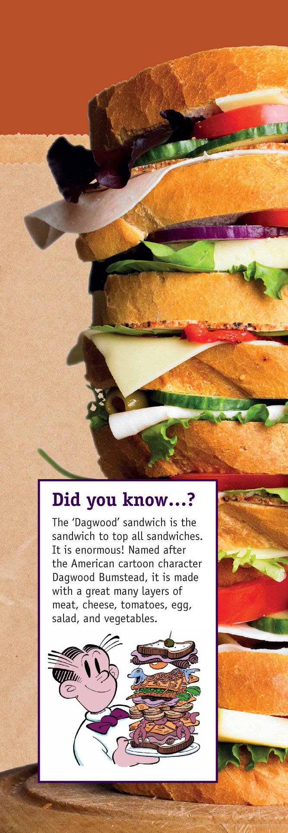

Slide 6
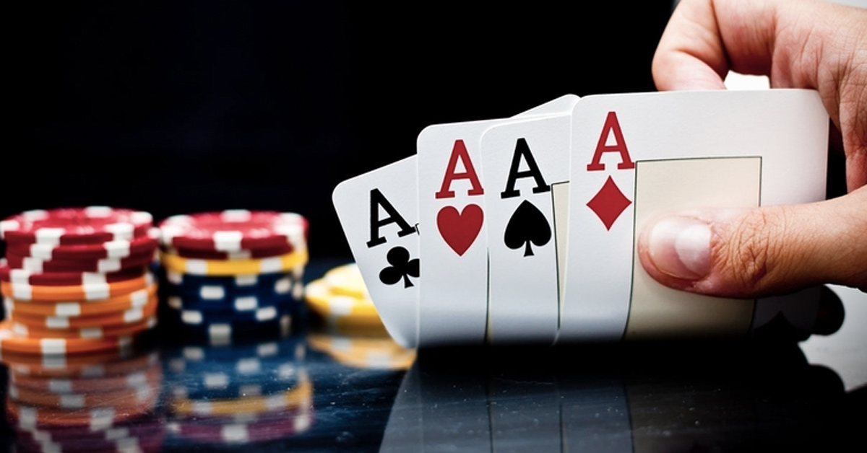

Slide 8
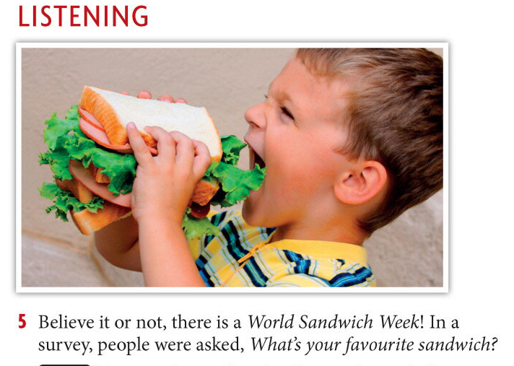

Slide 10
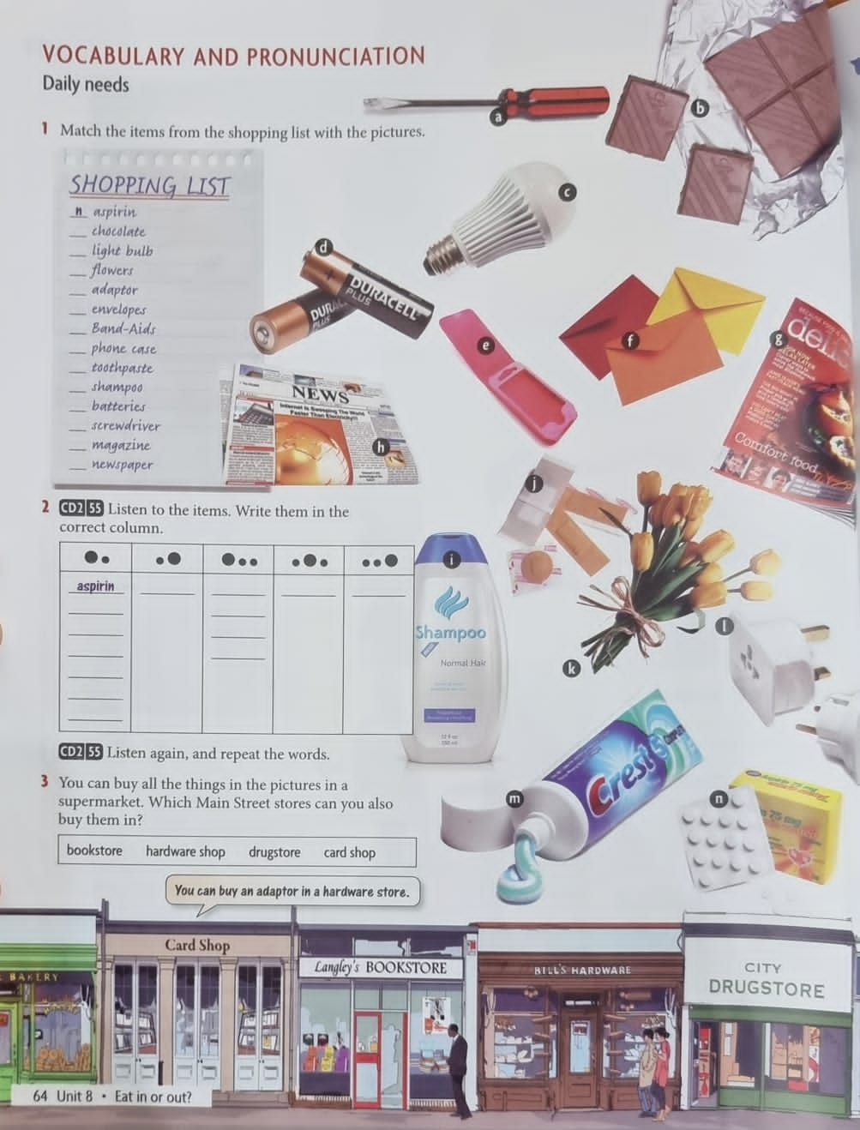
Breakout rooms

Slide 11
Aspirin
Chocolate
Light-bulb lighbulb
Flowers
Adaptor
Envelopes
Band aids
Phone case
Toothpaste
Shampoo
Batteries
Screwdriver
Magazine
newspaper
Listen to the items and write them.
Listen again and repeat

Slide 16
Role-play conversation
Work in pairs A and B
A is (seller/salesman) and B is (a costumer/client).
You went shopping and you want to buy some items for home.
Use the vocabulary for shopping.
Practice the phrases to ask for things politely.

