Slide 1
Elementary 3 – Unit 9

Slide 4
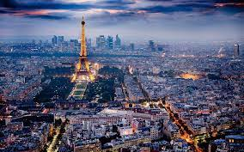
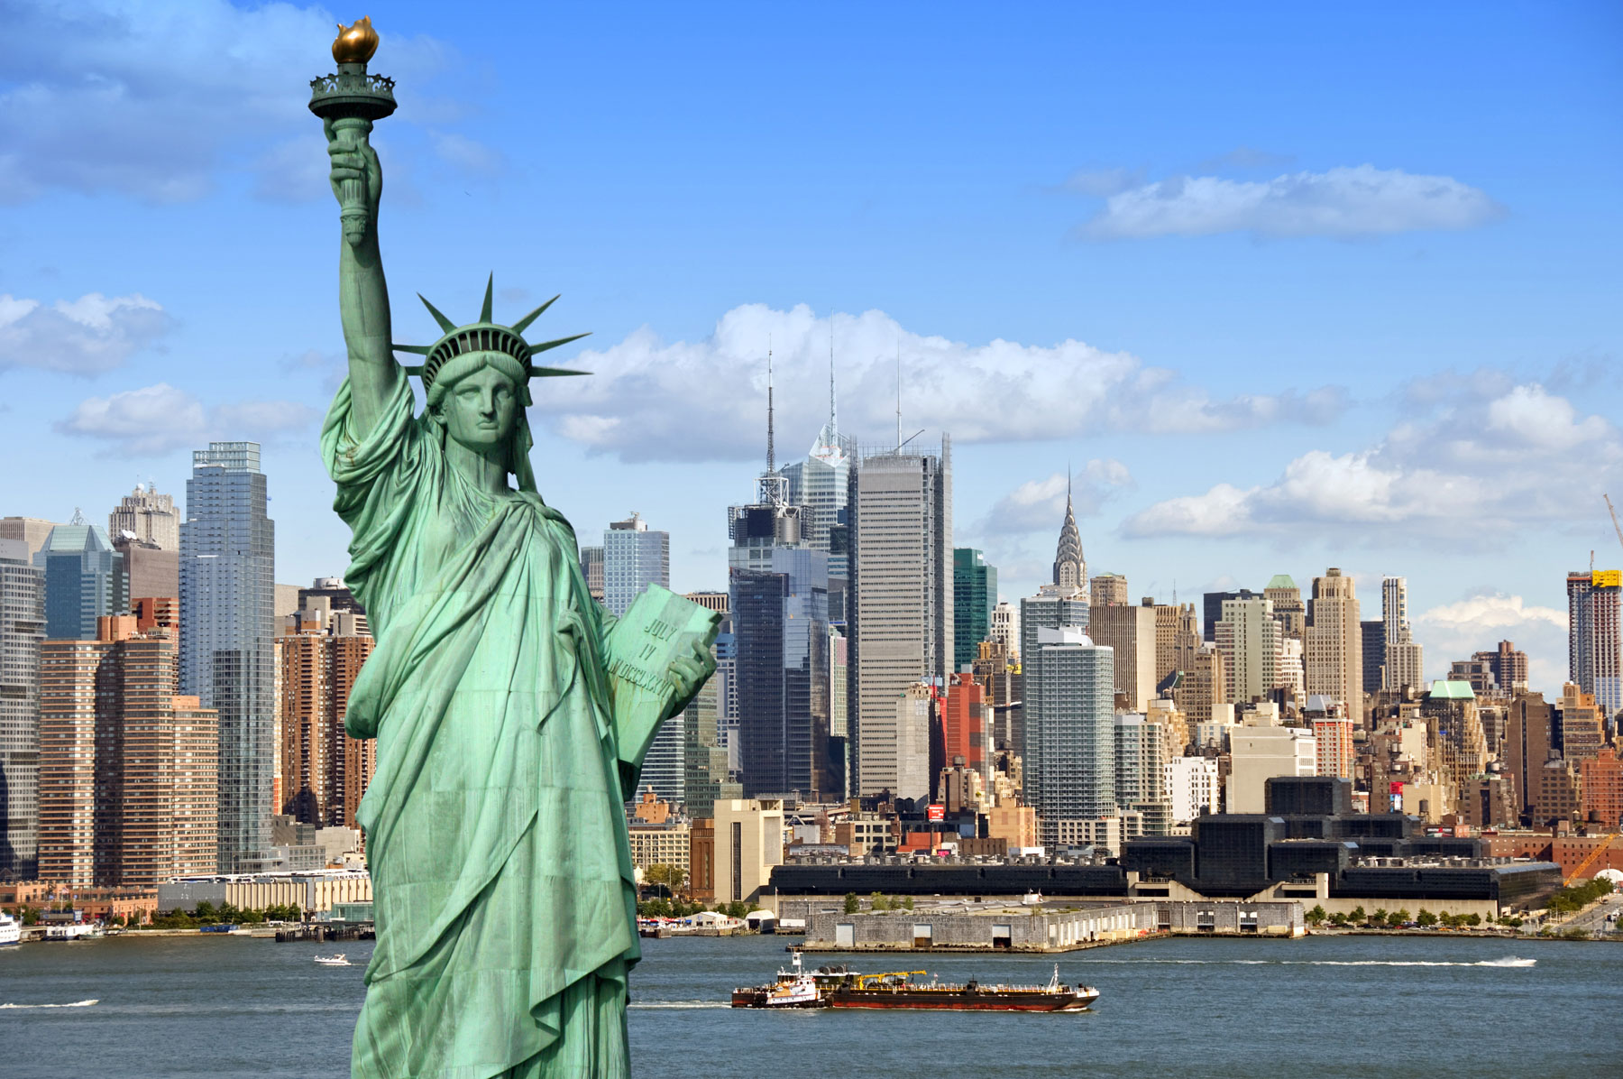

Slide 5
New York is bigger than Paris.
How many cities do we compare? 2 cities
Is New York the same area as Paris? no
Which city is small? Paris
New York is the biggest city.

Slide 6
worse

Slide 7
Vowel letters (e i a o u) consonants (b,c,d,f,….z)
New York is bigger than Paris.
Paris is smaller than New York.
Paris is more romantic.(ro/man/tic) (expensive)
The food is better. (bad – worse)
I think the weather in Paris is nicer than that of New York.
New York is noisier than Paris. (noisy)
Consonant + vowel + consonant
b + i + g
Consonant + vowel + (consonant x 2) + er
b + i + gg + er
Adjective + er + than
More + Long adjective (3 syllables)
Irregular adjective (good)
adjective ends in (e) + r
adjective ends in (y) -- (ier)

Slide 8
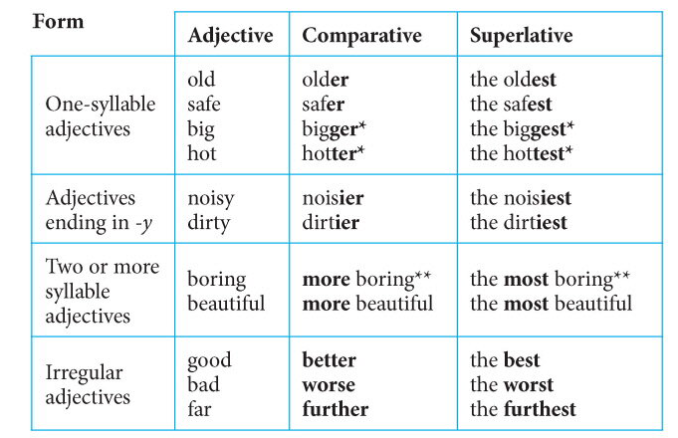

Slide 9
Quiz
https://quizizz.com/join/quiz/5ea498e85f1516001baa4764/start
Challenge each other:
https://quizizz.com/join?gc=664025

Slide 10
Hotter cheaper nice wetter warmer colder more polite more beautiful
Worse better
Notes:
Answers:
hotter – cheaper – nicer – wetter – warmer – colder – politer - more beautiful – worse - better

Slide 11
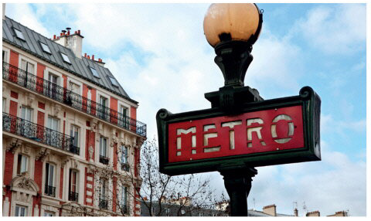
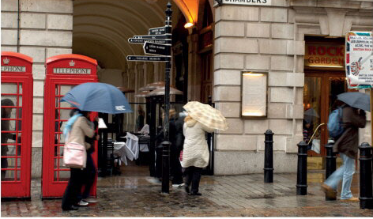
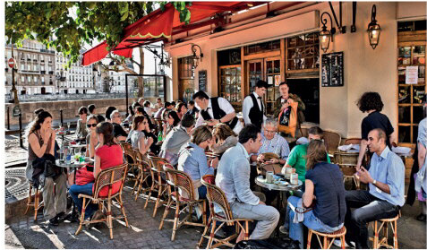

Slide 13
Cheaper than
More expensive
Bigger than
smaller
Safer than
More dangerous
Better than
worse

Slide 15
Work in small groups
Compare two cities you know.
Speak about (the weather, the area, safety, places to visit, people)
ex: Alexandria is smaller than Cairo.

Slide 16
mistakes
Istanbul is more crowded than Alexandria.
Cairo has more traffic jams / congestion than Alex.
Aswan is bigger than Ismailia.
Cairo is more expensive than Minya.
Cairo is hotter than Minya.

Slide 17
Oral quiz

