Slide 1
Elementary 3 – Unit 9

Slide 2
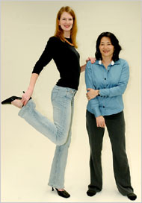
Let’s look at the picture and compare
Jessica - 32
Amy- 29
Adjectives
Height : Tall/ short
Hair length: ( long/short)
Color of clothes ( dark/light)
Weight: (thin)
Face shape : (round)
Age : (old/young)

Slide 3
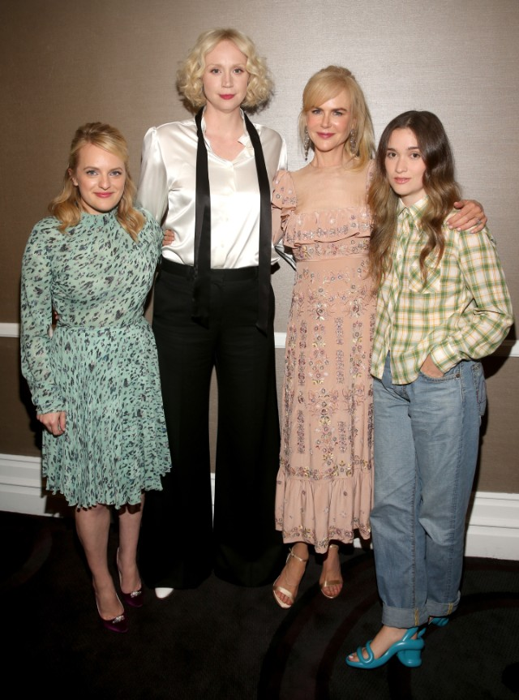
Let’s add more people to the picture
Jane- 40
Julia - 38
Betsy- 35
Lily - 33
Adjectives
Height : Tall/ short
Hair length: ( long/short)
Color of clothes ( dark/light)
Weight: (thin)
Face shape : (round)
Age : (old/young)

Slide 4
Tell the class….
Describe yourself to the class:
Height ( tall or short or average)
Hair length ( long or short or medium)
Color of eye / color of hair
Personality ( funny, talkative, adventurous, easy-going etc.)

Slide 5
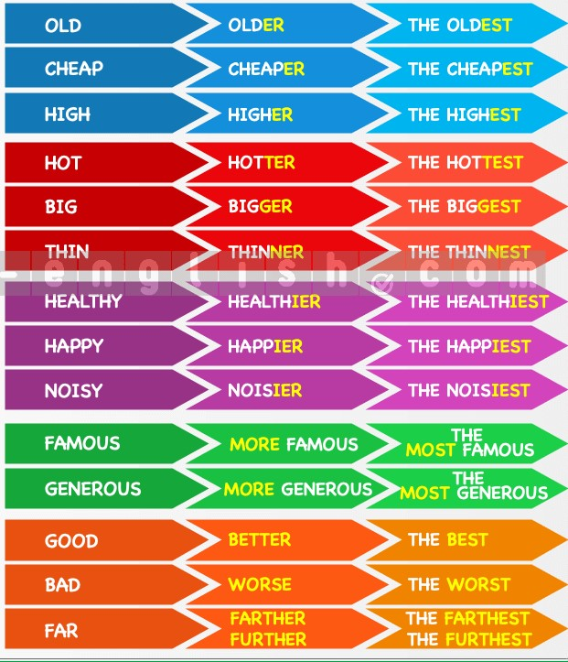
Let’s take a closer look! Comparative and Superlative adjectives
A comparative adjective is used to compare two things.
Structure = adjective + er + than
Or
More + adjective + than
A superlative adjective is used when you compare three or more things
Structure = the + adjective + est
Or
The + most + adjective

Slide 6
Let’s make these adjectives comparative or superlative
Adjective | Comparative | Superlative
Good
Big
Popular
Busy
Cheap
Small
Easy
Beautiful
Hot
Expensive
Bad
Far

Slide 7
Turn to page 69 …..Exercise 3: Choose the correct sentence
1.- Yesterday was more hot than today.
Yesterday was hotter than today.
2. -She’s taller than her brother.
-She’s taller that her brother.
3. I am the most young in the class.
I am the youngest in the class.
4. – This exercise is most difficult in the book.
This exercise is the most difficult in the book.
5.- This is the coldest day of the winter.
This is the most coldest day of the winter.
6.- What is the more beautiful park in the city?
-What is the most beautiful park in the city?
7. –That’s the most expensive restaurant in town.
- That’s the expensivest restaurant in town.

Slide 8
Choose the best answer
There are 10 houses on our street. Our house is the ________ one.
a. Biggest b. bigger
My brother sings better than I do, but I play guitar ________ than he does.
The best b. better
This is ________ song I have ever heard!
a. The best b. better
Tom is ________ than I am.
Stronger b. the strongest
Out of all the students in our class, I am ________.
the shortest b. shorter

Slide 9
Everyone says that my sister is ________ than I am.
the best looking b. better looking
She is ________ girl in our school.
the best looking b. better looking
This is boring. Let's do something ________.
the most interesting b. more interesting
This isn't ________ book I have ever read.
more interesting b. the most interesting
Your apartment is ________ than mine.
a. cleaner b. the cleanest

Slide 10
The circus
The Rodriguez Brothers Circus is in town! Every year, the circus arrives and stays for a week. Then they go to the next town.
There are not many animals in the circus. People told the circus that they didn't like seeing animals performing. There is an elephant called Jacob and two old lions, Hattie and Meg.
Most of the performers are human! There is Leopold, The Strongest Man In The World. His father also worked in the circus, but Leopold is stronger than him, he has bigger arms and bigger legs too! Leopold performs his act every night for the town's people who come to watch.
Another performer is Clara. She says she has the longest hair in the world. It's about 4 meters long! She also has a daughter who works in the circus. Her name is Sue-Ellen. Her hair is a lot shorter, but she wants to grow it as long as her mother's. Sue-Ellen helps look after the animals and she's also learning how to juggle.
The highlight of the circus are the three clowns, Pit, Pot and Pat. They all wear long red shoes, but Pat's shoes are the longest and sometimes, he falls over because they're so long! They perform for about twenty minutes and they are always the most popular act with the audience, especially the children.
Many people think Pit, Pot and Pat are three brothers, but Pat is older than the other two - he's their father! He's the oldest clown in the country, but he has a lot of energy.
Tomorrow will be the longest day because the circus is leaving town and everything must be packed away into big trucks.

Slide 11
True or False
The circus comes to the town twice a year.
There are not many animals in the circus.
People don't come to the circus because of the animals.
Leopold and his father work in the circus together.
Leopold's father is the strongest.
Clara's hair is longer than her daughter's hair.
Sue-Ellen wants to be a clown in the circus.
Pit is the father of the other two clowns.
The three clowns wear identical shoes.
Everyone is very tired on the day that the circus leaves town.

Slide 12
In groups: go back to the text and find the comparative and superlative adjectives

Slide 13
Let’s find some antonyms
Adjective | Antonym
Loud
Slow
Late
Far
Short
Easy

Slide 14
Try this ! Complete using an opposite comparative adjective…
The music here is too loud. Can we go somewhere _________?
The 10:00 train is too slow. Is the 11:30 train a __________one?
You’re late. Why weren’t you here ____________?
This apartment is too far from the center of town. I need somewhere ___________.
Five minutes is too short for a break. We need a ____________one.
This exercise is too easy. Can I do something ______________?

