Slide 1
Elementary 3 – unit 9

Slide 2
Let’s make these adjectives comparative or superlative
Adjective | Comparative | Superlative
Good
Big
Popular
Busy
Cheap
Small
Easy
Beautiful
Hot
Expensive
Bad
Far

Slide 3
Let’s listen to Cd 8 and complete the following ….
Q: Where do you live in New York?
C: Well, we’re renting an apartment in Chelsea. It’s probably the ________apartment in the city!
Q: What does your husband do?
C: He has a cheese shop in Chelsea Market….. He sells French cheese. I think it’s the ________ food at the market.
Q: Do you have a car?
C: No, I don’t The subway is the _________way to get around New York.

Slide 4
Chelsea Market
The neighborhood of Chelsea is the best place in New York City to have lunch. And Chelsea Market is
New York’s biggest and most popular Indoor food market. It has more than 35 food shops and restaurants.
It also has a bookstore, a clothing store, and a gift shop. There are usually a lot of people at the market,
but it’s busiest is lunchtime and on weekends.
Chelsea is one of New York’s ______(old) neighborhoods. Five to six million people a year visit Chelsea Market to shop, eat, and meet friends. The food is amazing but it isn’t the ____________(cheap) in the city. There’s candy, ice cream, soup, fresh seafood, New York’s ____________(delicious) brownies, and more!
People often buy food at the market and bring it to the High Line to eat. The High line is a Mile-long elevated park near Chelsea Market. It is New York’s ______(new) and ____________(unique) park. The High Line and Chelsea Market are very popular with both tourists and locals.
Chelsea Market even has a TV network. The Food Network films some of its TV cooking shows at Chelsea
Market. Try to get tickets to watch Iron Chef, one of the_______________(good) TV cooking shows!

Slide 5
Let’s find some antonyms
Adjective | Antonym
Loud
Slow
Late
Far
Short
Easy

Slide 6
Try this ! Complete using an opposite comparative adjective…
The music here is too loud. Can we go somewhere _________?
The 10:00 train is too slow. Is the 11:30 train a __________one?
You’re late. Why weren’t you here ____________?
This apartment is too far from the center of town. I need somewhere ___________.
Five minutes is too short for a break. We need a ____________one.
This exercise is too easy. Can I do something ______________?

Slide 7
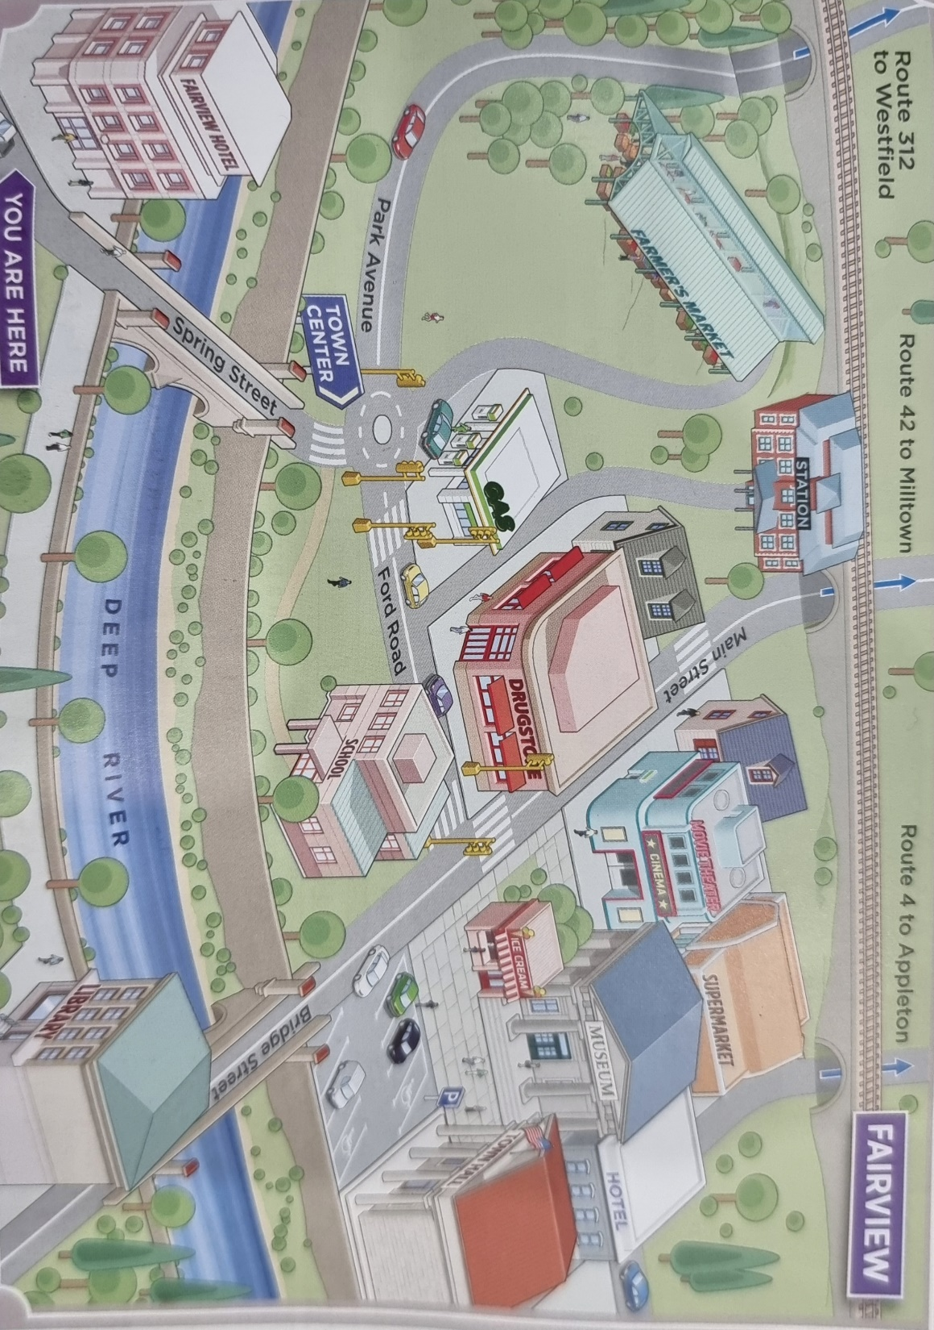

Slide 8
Complete the directions to Route 312 to Westfield. (over – along – past- around – up- down – through – under)
Go along Spring Street, past Fairview Hotel on your left, and over the bridge. At the traffic circle, turn left go up Park Avenue. Go around the corner, through the woods, and down the hill. Then go under the railroad bridge and your are on Route 312 to Westfield.

Slide 9
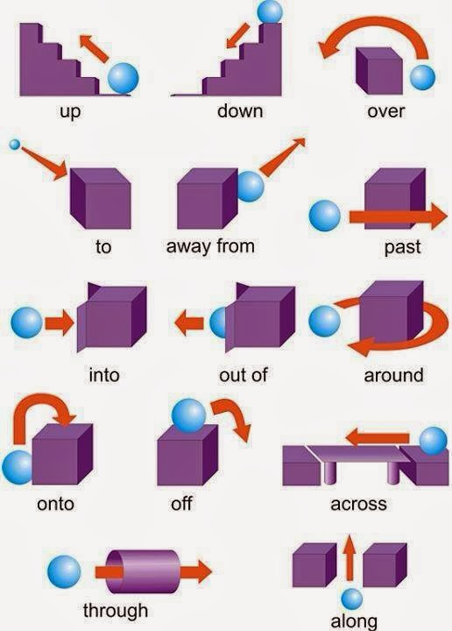
Prepositions and Verbs for giving directions…

Slide 11
Let’s play a game Listen to CD 13 and let’s see where we go.
1-
2-
3-

Slide 12
Work in pairs and ask to give directions:
Example:
-Excuse me!
Can you tell me how to get to the train station?
The train station
A supermarket
The town hall
The library
A drugstore
Parking lot
Route 42 to Milltown

Slide 13
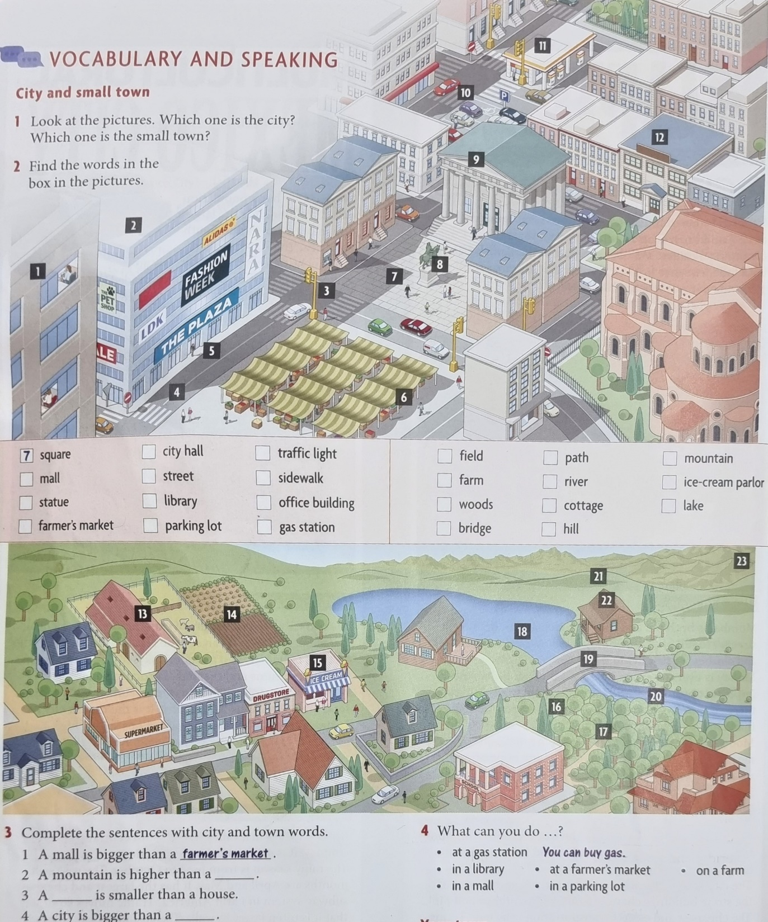

Slide 14
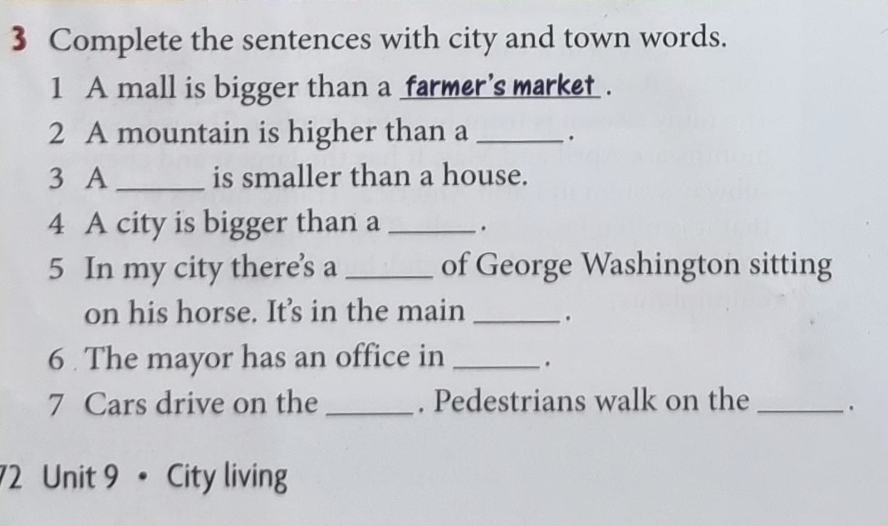
Based on the previous picture

Slide 15
Let’s listen to Cd 11
Names of People and Cities | The people in the city | The climate in the city | Transportation in the city | Things to do in the city
Makiko from Tokyo
Vimahl from Mumbai
Lourdes from Mexico City

Slide 16
Describe your city !
My hometown is a small city. It is both traditional and modern because of its beautiful sea, and the best fish, people come from all over Egypt to eat fish here. We have many different means of transportation, so people can move around easily. Alexandria has moderate weather, not too hot or too cold. The people here are very friendly and like to help each other. There are many activities here, like riding boats, visiting the citadel, and walking along the sea.

Slide 17
Now it’s your turn!
How are people in your city?
How is the climate?
What about the transportation?
What are some things to do?

Slide 18
Let’s put these in order based on your thoughts: 1- the biggest then let’s listen to CD 10 and check our answers….
Mumbai
Shanghai
Tokyo
New York
Mexico City
Delhi

Slide 19
Let’s read turn to page 70 and 71
What is population in this country?
What are the tourist attractions?
Mention one thing about its history.
Where is it located?
What is the weather like?

Slide 20
Oral quiz 3
Choose a city or country and compare it with your city or country.
OR
Compare and contrast between any two things of your choice use the adjectives mentioned in class.

