Slide 1
Work-balance life
Prepared by: Mr. Hossam Shokry

Slide 2
Speaking

Slide 3
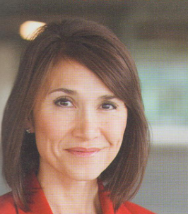
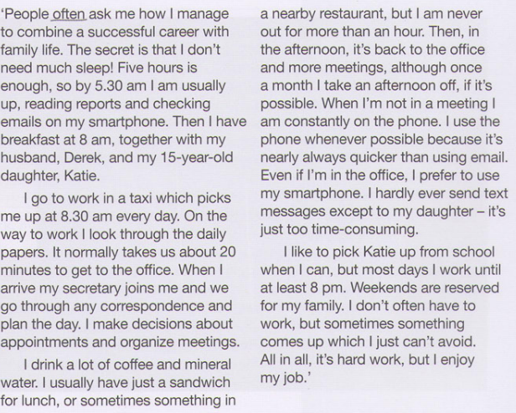
Reading
Correspondence (n)
Written letters or mails .
Choose the correct title :
Sally’s job.
Sally’s life .
Sally’s family .

Slide 4
Reading

Slide 5
Answer key
a 5.30 am .
b 8.50 am.
c Never more than an hour.
d Using the phone is nearly always quicker than using email .
e Only occasionally.

Slide 6
Grammar

Slide 7
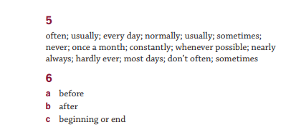
Answer Key
January
February
Mach
April
I usually have a sandwich for lunch. / I eat a sandwich once a week/ everyday.
Sub+ usually / sometimes etc.+ verb (inf) - Sub +verb+once/twice a week.
May
Exception: He is usually late. Sub+ v.be+ usually

Slide 8
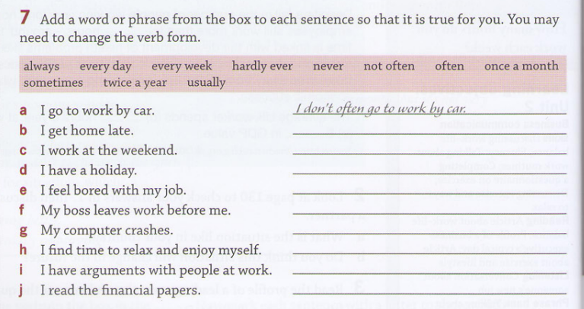
Practice

Slide 9
Speaking

Slide 10
Break time
30 minutes

Slide 11
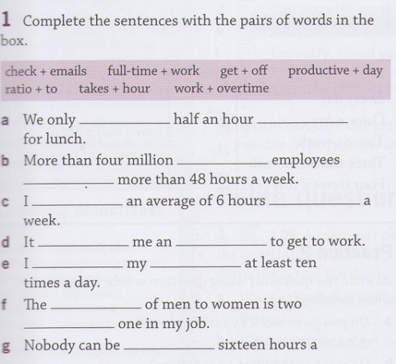
Vocabulary

Slide 12
Answer key

Slide 13
Vocabulary
Ratio
EX. For every man is born, there are 10 women are also born.
off
not on something, or removed from.
Productive
Someone does a lot for the work .

Slide 14
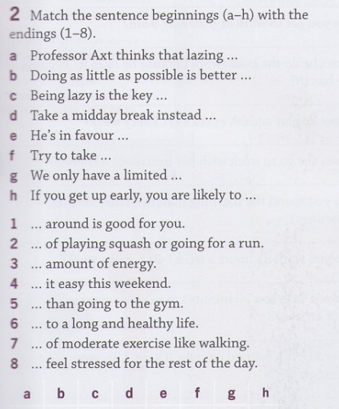
Vocabulary

Slide 15
Vocabulary
Laze (around)
you relax and enjoy yourself, not doing any work or anything else that requires effort.
Key (to)
Answer or solution.
In favour of
in order to show preference for something you like.
Limited
Something that is not there forever.
Likely to
Maybe you will do this.

Slide 16
Practice
Productive – Ratio – likely to- off -in favour of – limited- laze around – key to
1- It's …………..rain tomorrow.
2-On the weekend, I like to …………….and watch movies.
3-The …………of men to women at the conference was ten to one.
4-Some staff members are more ……………..than others.
5-Only a …………..number of students will be allowed in the class.
6-Many people are …………….stuffed rice ((محشي because it’s delicious.
7-:The …………..improving your English is practice.
8- The employees have a 17-day work without a day ………….in April.

Slide 17
Answers
1- It's likely to rain tomorrow.
2-On the weekend, I like to laze around and watch movies.
3-The ratio of men to women at the conference was ten to one.
4-Some staff members are more productive than others.
5-Only a limited number of students will be allowed in the class.
6-Many people are in favor of stuffed rice ((محشيbecause it’s delicious.
7-:The key to improving your English is practice.
8- The employees have a 17-day work without a day off in April.

Slide 18
Speaking
Is it better to work or have fun in life more? Why ?

Slide 19
Speaking
Is it better to work or have fun in life more? Why ?

