Slide 1
Work-balance life
Prepared by: Mr. Hossam Shokry

Slide 2
Speaking
Who has the best job in the world ? Why ?

Slide 3
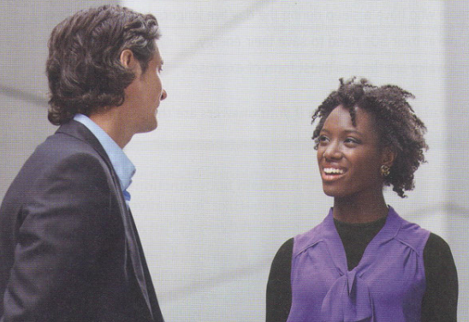
Listening
Choose the correct title:
1- New job.
2- old job.
3- Work life.

Slide 4
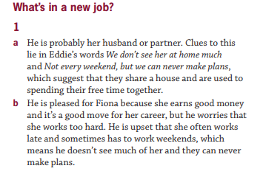
Answer Key

Slide 5
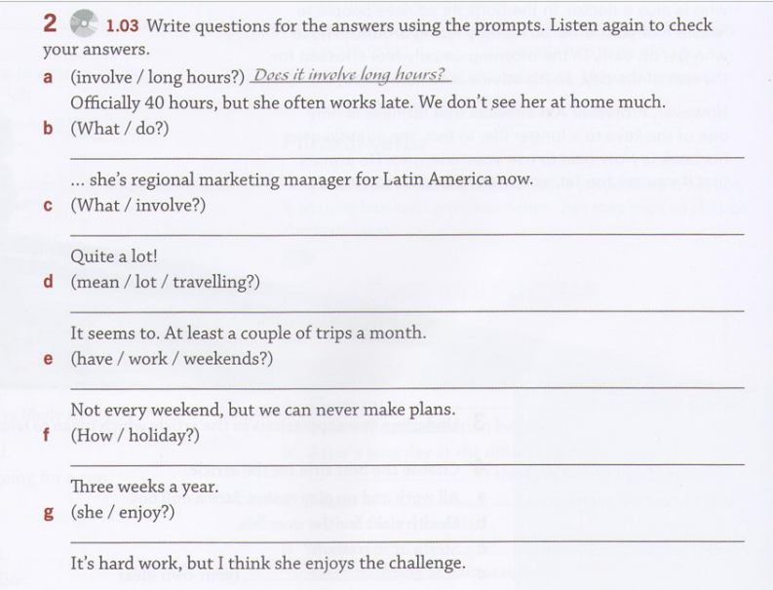
Grammar

Slide 6
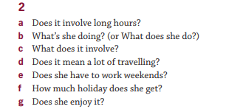
Answer Key
January
February
Mach
April
May

Slide 7
Grammar
Does+ (He-She-It)+ verb(inf) ?

Slide 8
Practice
Make a question: ( who-what-when-How often-why-do/does)
1- He uses his phone a lot.
2- She gets to work at 8 am.
3- He plays football everyday.
4- I visit my parents because I love them.
5- We travel with our manger every week.
6- Yes, He likes his dog very much.

Slide 9
Answer key
1- What does he use?
2- When does she get to work?
3- How often does he play football?
4- Why do you visit your parents?
5- Who do you travel with ?
6- Does he like his dog ?

Slide 10
Speaking
Think of 2 jobs and your partner tries to guess the jobs by asking questions in “present simple”.
Who is the winner ?

Slide 11
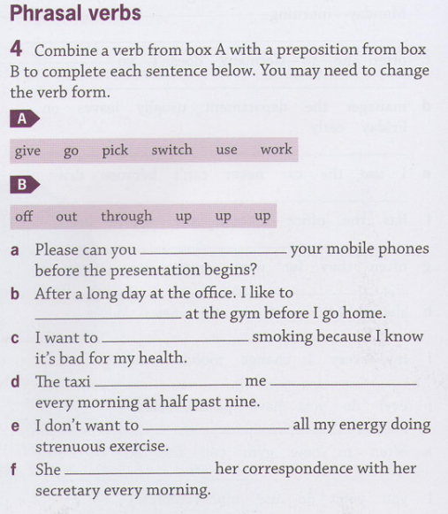
Vocabulary

Slide 12
Answer Key

Slide 13
Vocabulary
you go to the place where they are and take them with you.
pick up
Give up
you stop doing it or having it.
Use up
to finish (or) consume completely.
Work out
you do physical exercises in order to make your body fit and strong.
Go through
routine, procedure, or series of actions, they perform it in the way they usually do.

Slide 14
Practice
1-"I’m trying to ………………….the old paint in the garage before buying new ones.“
2-I have to …………… talking about others because it’s wrong.
3- We need to ……………………. Our mails and letters.
4- Please ………….. Your phone in the mosque “المسجد”.
5- Can you ……… me …….. After work ?
6- I’m fat. I need to …………… to be fit.

Slide 15
Break time
30 minutes

Slide 16
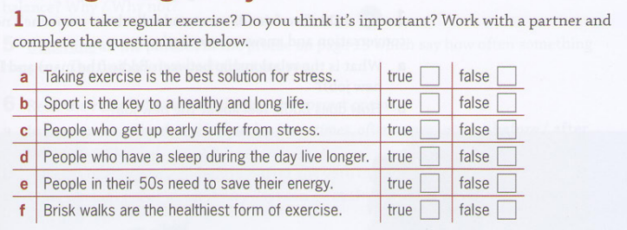
Speaking
means we are walking faster than we usually would do.

Slide 17
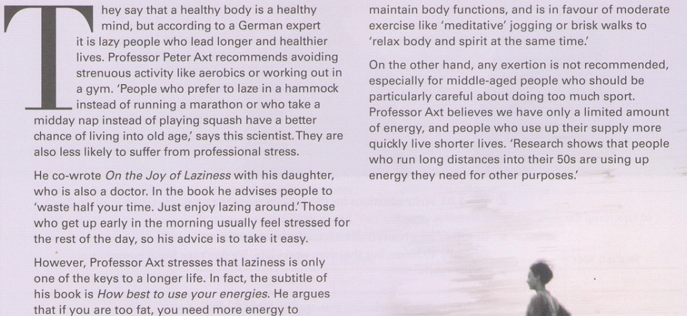
Reading

Slide 18
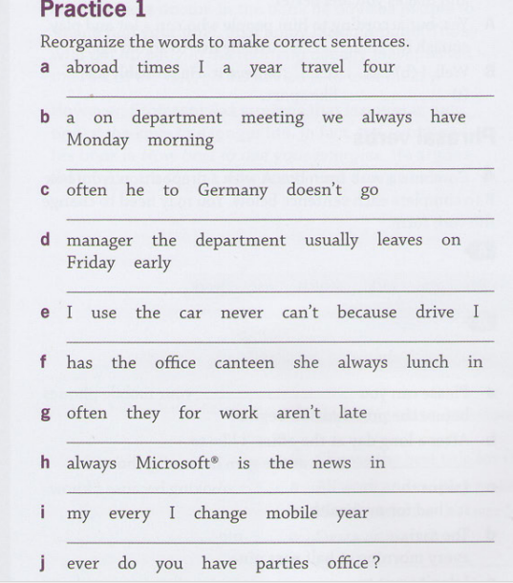
Extra practice

