Slide 1
Project DPro
Project Management for Development Professionals
Training Course

Slide 2
Your Instructor:
Dimah Barakat
Dimah is an international speaker, mentor, professional consultant, trainer and business coach with 25 years of experience.
She is a member of the Project Management Institute (PMI®), the PMI® Jordan Chapter, the International Coach Federation – ICF®, and Jordan Engineers Association.
She is Certified in PMP®, PMI-RMP®, and PMI-SP®.
She is also a certified Business Coach.
She is currently the vice president of the ICF Jordan Chapter.

Slide 3

SELF INTRODUCTIONS
Your Name
What is you Job Function?
When you plan to take the Project Dpro exam

Slide 4
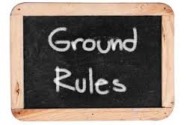
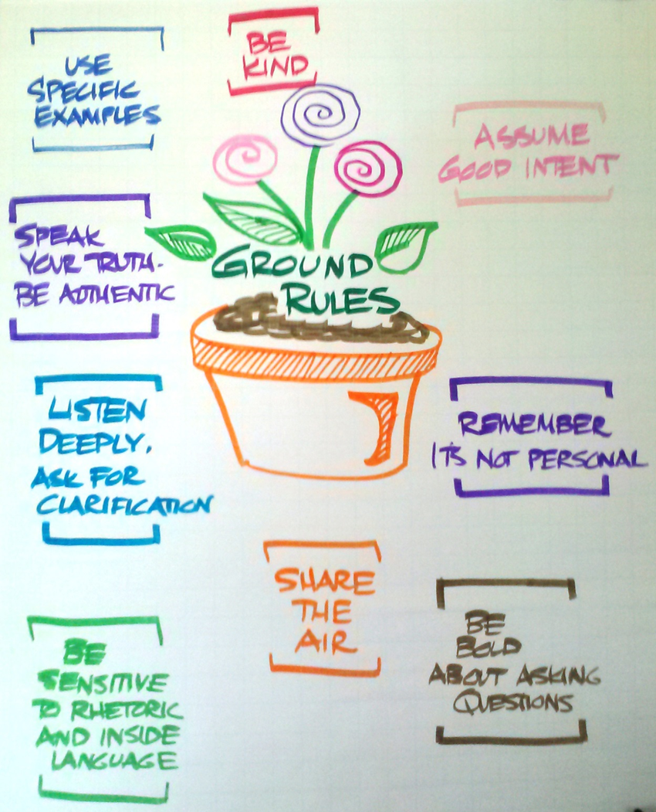
Use of Mobiles ? - Focus
Phone calls outside the room. Focus
Questions are welcomed at any time, but please raise your hand when having questions or wanting to answer one. Participate
Respect opinions other than yours.
Attendance Sheet. Discipline
Ask, Ask, Ask, Ask, Ask, Ask, Ask, Ask, Ask, Ask, Ask, Ask & Have Fun ☺
Please : Take your own study notes throughout the course
Keep your smile

Slide 5


Introduction to Project DPro
while millions of development workers change the world every day though activities in agriculture, health care, microfinance, conservation, affordable housing, education, infrastructure and human rights, they all share one thing in common
Changing the World Through Projects

Slide 6
HISTORY OF Project DPro
In early 2007, a group of several well-known INGOs – Save the Children, Oxfam, Care, World Vision, Habitat for Humanity, CRS, Plan International and Mercy Corps – got together and asked LINGOs (a capacity building and training organization) to help develop learning materials to enhance the way that development organizations manage projects.
The result was Project DPro, a project management approach that has been specifically designed with NGOs to improve and standardize organizational processes.
Owned by PM4NGOs, it is appropriate, accessible, and affordable for project managers to develop the skills they need to deliver effective projects, and improve their accountability to donors and communities to meet the challenges of the 21st century development

Slide 7

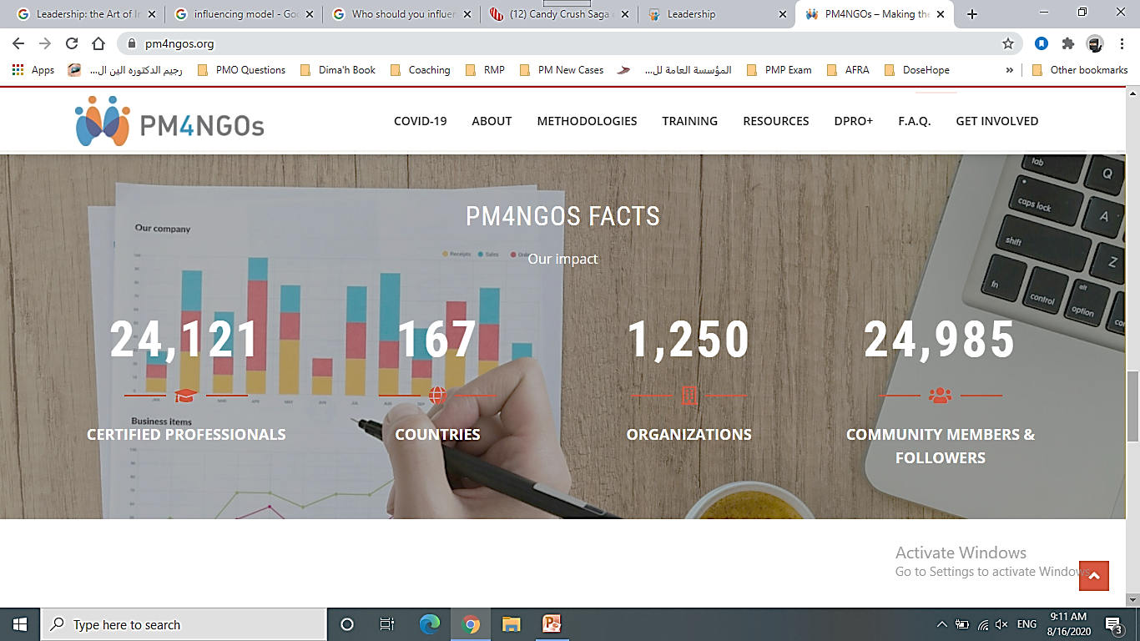
Project DPro Statistics
1,250+ organizations
167 countries.
22,700 certified project managers

Slide 8
Project DPro or PMD Pro?
The second version of the PMD Pro has been rebranded to Project DPro to align the terminology with the Program DPro and other best practices and methodologies that have been developed by partner organizations – the DPro family.
You will continue to find references, documents, and tools using the PMD Pro term, as it has been adopted by numerous organizations and professionals.
PMD Pro Level 1 certificates remain valid and they are lifetime valid. If you are already a PMD Pro certified professional (level 1), you do not need to re-certify or request an updated certificate.
PM4NGOs will permanently recognize and confirm the validity of your PMD Pro certificate.

Slide 9
PROJECT DPRO PRINCIPLES
Well-governed – have clear lines and authorities in place for the project manager ensuring that decisions are made within a specific framework outlined in the governance structure.
Participatory – Include a variety of stakeholders in the identification, design, planning, implementation and monitoring of the project helps to ensure transparency, improve quality, increase human capacity and strengthen buy-in at all levels.
Comprehensive – Project management disciplines should be applied to manage consistently and deliberately all the work of the project through the entire life of the project.
Integrated – All aspects of project management should be aligned and coordinated as a means to ensure that all elements of project design, planning. monitoring and implementation run smoothly.
Adaptive – means the ability of the project manager, team, and stakeholders to analyze the environment and responds as necessary. Flexibility and agility are paramount to the Adaptive principle, providing a framework within which the project can respond to the changing environment.
Read SECTION 3. PROJECT DPRO PRINCIPLES page 166

Slide 10
Agile Project Management
Agile Project Management is the umbrella under which a variety of different tools fall that allows for a more adaptive approach to project management.
In Agile Project Management:
  Time is fixed by dividing the project into short fixed time iterations (stages is the terminology used in the Project DPro); •
  Cost of resources is fixed;
  Scope is variable. It focuses on the highest priority requirements, with the expectation that the scope will evolve as the project progresses.
There is a decision gate at the end of each iteration to re-prioritize existing requirements, to consider any new ones as the project moves forward, and to plan the next iteration. It’s a form of rolling-wave planning.
The aim is to deliver the most important requirements within the budgeted cost and time, but maybe not all the requirements. For this process to work, it has to be highly collaborative. It’s essential that project stakeholders are closely involved, particularly users.

Slide 11
Agile Project Management
With this approach, donors and stakeholders will be more confident approving the project because costs and schedules are defined up front and the overall risk is lower.
The essential element of the Agile process is to be able to prioritize the project’s requirements into four categories of importance:
Must have – these requirements are guaranteed to be delivered;
Should have;
Could have;
Won't have at this time.
Agile focuses on small incremental changes. The challenge can be that the bigger picture can become lost and create uncertainty amongst stakeholders. Building consensus takes time and challenges many norms and expectations.

Slide 12
Project Management and Development
Social goals
Complex problems
Challenging contexts
Complex relationships
Participatory approach
Transfer of learning

Slide 13

Managing Projects is Challenging!

Slide 15
Why Don’t all Projects Succeed?
Inadequate planning
Inadequate resources
Unrealistic expectations
Inadequate risk management
Failure to learn from mistakes
Incomplete requirements and specifications;
Lack of contingency planning for managing risks; and
Failure to learn from mistakes.
End of day 1

Slide 16
Challenging issues for projects in the development sector
Development projects are responsible not only for delivering tangible outputs, but also for delivering less tangible outcomes related to promoting social change and/or behavior change.
Development projects are less likely to focus on delivering concrete products as the ultimate goal of the project. Instead, they consider these products as a means that leads to improvements in the well-being of the project’s target populations.
Development projects aim to address complex problems of poverty, inequality and injustice.
Development projects tend to operate in exceptionally challenging contexts (limited resources, high risks, complex procurement networks, unstable political/financial environments, unsafe conditions).
Project implementation is often managed through a complex array of stakeholder relationships (partner agencies, government ministries, community-based organizations, contractors, global consortia).
The project approach is often as important as the outcomes themselves (including a high priority placed on participation, rights-based approaches).
Transferring knowledge and learning to the target population is a priority during each and every phase of the project.

Slide 17
You are not alone

Slide 18
Research…
A study of 5,400 large scale IT projects (projects with initial budgets greater than $15m) finds that the well known problems with IT Project Management are persisting. Among the key findings quoted from the report:
  17%of large IT projects go so badly that they can threaten the very existence of the company
  On average, large IT projects run 45%over budget and 7% over time, while delivering 56% less value than predicted.
Source : McKinsey & Company in conjunction with the University of Oxford.
Type of survey : Study on large scale IT Projects.
Date : 2012.

Slide 19
Defining Terms

Slide 20

Project / Project Management & Manager?
A project is a temporary endeavor undertaken to create a unique product, service, or result.
Based on this definition, the purpose of project management is to plan, organize and manage resources to bring about the successful completion of specific project goals, outcomes and outputs.
The project manager is responsible for ensuring the overall success of the project.
the responsibility of the project manager is to work closely with an array of stakeholders to complete the work of the project

Slide 21
Project Management Constraints
Cost/Resources – What money, materials and effort are available to deliver the project product/services and to complete the comprehensive work of the project?
Scope/Quality – What are the products/services that the project will produce and what is the work required to produce these deliverables?
Time/Schedule – What is the amount of time required to complete the components of the project?

Slide 22
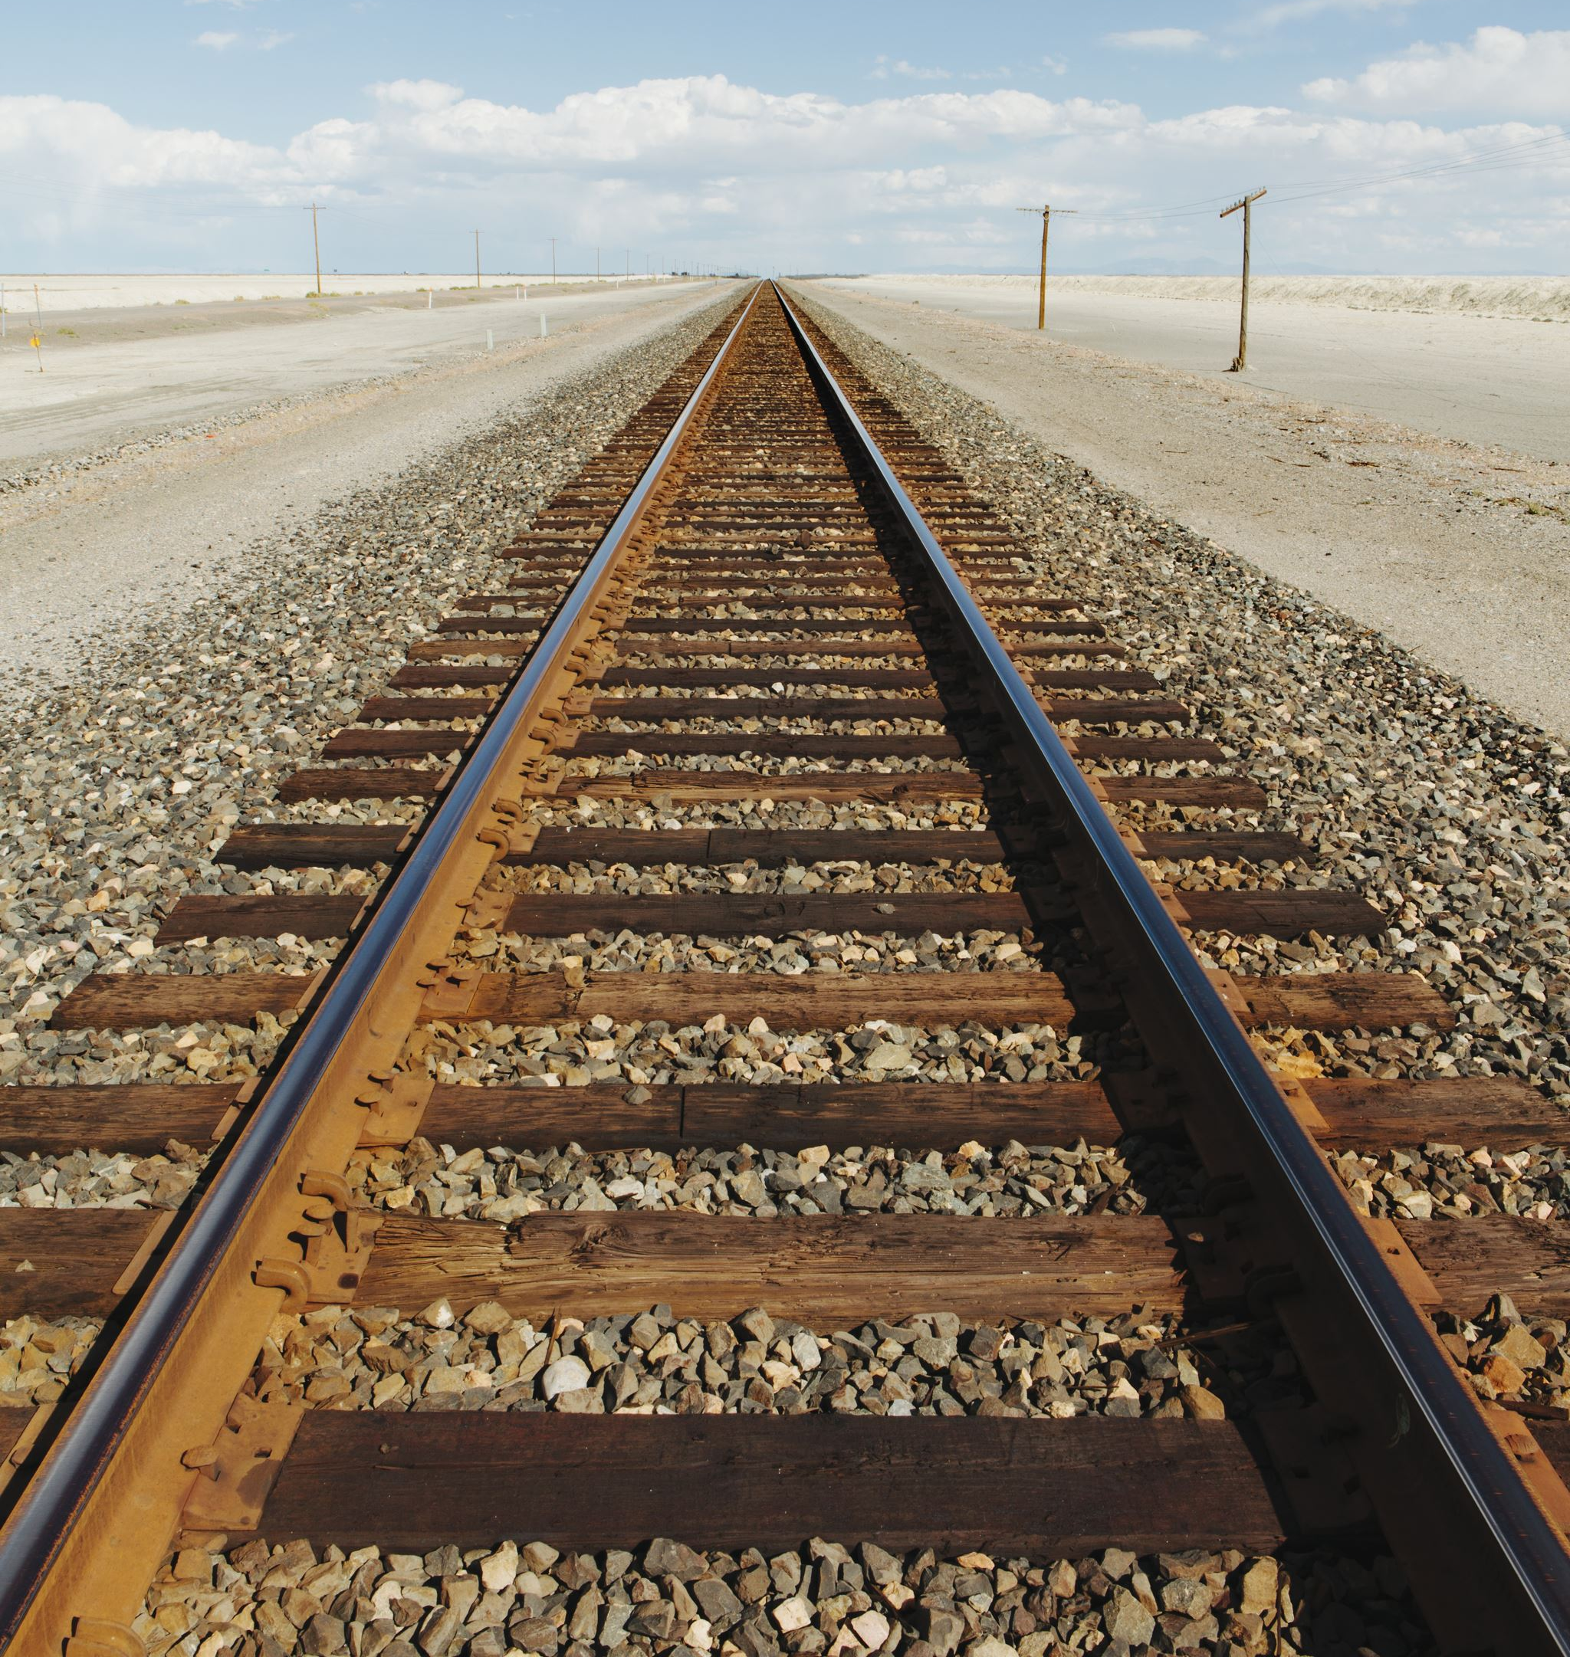

classifications of the constraints
Inflexible – indicating that the constraint is critical and must be constrained
Adaptable – indicating that the constraint is negotiable, but should be optimized as much as possible
May concede – indicates a constraint where trade-offs can be made in order to manage the inflexible constraint or optimize the adaptable constraint
ACTIVITY: examples on constraints

Slide 23

ACTIVITY: Examples on constrains ?
Objectives : To understand the differences between types of constraints
Breakout session:
Instructions:
Work with your team to give one example on each type of constraints ?
Duration: 4 minutes
Notes:
23

Slide 24
Projects, Programs and Portfolios
Project management is the discipline of planning, organizing and managing resources to bring about the successful delivery of specific project goals, outcomes and outputs..
Program management is the process of managing a group of related projects in a coordinated way to obtain benefits and control not available through managing them individually.
Portfolio management oversees the performance of the organization’s collection of project and programs. Portfolios are generally managed by a senior team at the highest level of an organization or by a specific unit of an organization (regional office or headquarters).

Slide 25
Project – Program - portfolio

Slide 26
Project, Program, and Portfolio Management Summary
FYI

Slide 27
ACTIVITY: The Art and Science of Project Management - Case study?
Objectives : To understand the art and science of PM
Breakout session:
Instructions:
Read the and discuss the case study on Page 30 from the study guide?
Duration: 3 minutes
Notes:
27

Slide 28

The Art and Science of Project Management
The art of project management focuses on the people elements of a project.
The art of project management requires skills that enable project managers to lead, enable, motivate and communicate.
The science of project management focuses on the planning, estimating, measuring and controlling of work.
The science encompasses the who-does-what-when questions?

Slide 29
Where do projects come from?
INGO/Implementing Partner
Stand-Alone Project
Grants
Projects under programs

Slide 30
Competencies of Project Managers
Technical skills (the focus of this course)
Leadership ability
Personal and Self-Management
Development Sector Specific
Please refer to Annex I: Project DPro Competencies page 190

Slide 31
Phases in The Life of a Development Project
Balanced Project Management Through the Project Life

Slide 32
Project life cycle
By grouping activities into a project life cycle sequence, the project manager and the core team can:
  Define the phases that connect the beginning of a project to its end
  Identify the processes that project teams must implement as they move through the phases of the project life cycle
  Illustrate how the project management life cycle can be used to model the management of projects

Slide 33
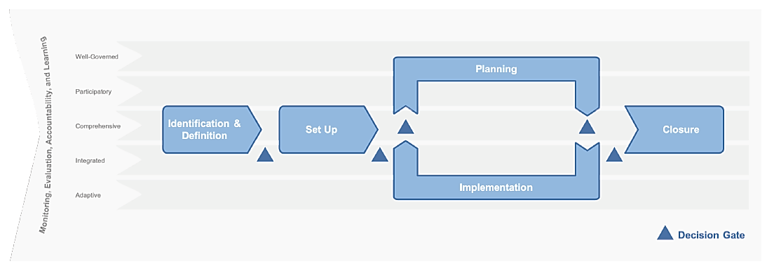
Phases of Project Management

Slide 34
How the Phases are Organized
Introduction: Highlights the importance of the phase and provides a general overview of the key components to consider during this phase.
Key Output: For each phase, there is a specific output that should be produced based upon the tools and processes highlighted.
What Does this Mean in Practice: Summarizes the linkage from the previous phase to the current phase and incorporates any additional considerations you need to make during the phase.
Inputs: Outlines all of the documents and tools that will be helpful in completing the processes for the phase.
Processes: Defines and provides examples of all of the processes and tools to achieve the phase output.

Slide 35
the Project Dpro Phase Model (1/2)
Identification and Definition: It is during this phase that the project teams define needs, explore opportunities, analyze the project environment, and design alternatives for defining the project. The decisions made during the Project Identification and Definition Phase set the strategic and operational framework within which the project will subsequently operate..
Project Setup: It is during this phase that the project is officially authorized, and the overall parameters of the project are defined and communicated to the main project stakeholders. It is also during this phase that the project team establishes the high-level project governance structure.
Project Planning: Starting from the documents developed in earlier phases of the project, during the planning phase the team develops a comprehensive and detailed implementation plan and supplementary plans (Monitoring, Evaluation, Accountability, and Learning – MEAL, Supply Chain, etc.) that provides a model for all the work of the project. These plans are revisited throughout the life of the project and updated to reflect the changing contexts of the project.

Slide 36
the Project Dpro Phase Model (2/2)
Project Implementation: The day-to-day work of project implementation is to lead and manage the application of the project implementation plan: leading the team, dealing with issues, managing the project team and creatively integrating the different elements of the project plan.
Monitoring, Evaluation, Accountability, and Learning–In this version, the MEC has been expanded to include Accountability and Learning and has been incorporated into each of the phases of the project, providing guidance and tools on MEAL activities that should be done in each of the phases. This, more integrated approach, more clearly articulates how MEAL and project management need to work together to bring about the outputs and outcomes of the project.
Project Closure: This phase includes implementing all closure activities that need to occur at the end of a project, including (but not limited to): confirming the deliverables with beneficiaries, collecting lessons learned, and completing the administrative, financial and contractual closure activities

Slide 37
Decision gates
Decision gates are critically important to effectively managing projects.
Decision gates are checkpoints in the project where you will justify that the project should move forward as is, make changes based upon information available, or stop the project altogether.
Think about it this way, you are going to ask yourself: “are we still doing the right project and are we still doing it in the right way?”
Decision gates can take several different forms and the number of formal decision gates will depend on the length and complexity of the project and the environment in which the project is operating
Activity

Slide 38
ACTIVITY: Decision Gates – Perfected BUT Rejected Scenario Example?
Objectives : To understand the importance of decision
Breakout session:
Instructions:
Read the and discuss the case study on Page 38 from the study guide?
Duration: 3 minutes
Notes:
38

Slide 39
I want to
design a project

Slide 40
During the Project Identification and Definition Phase
Time/resources/effort are invested to define needs, explore opportunities, analyze the project environment, cultivate relationships, build trust, develop partnerships and design alternatives for project design.
The decisions made during the Project Identification and Definition connect to existing strategies and determine the overall framework within which the project will subsequently evolve.

Slide 41
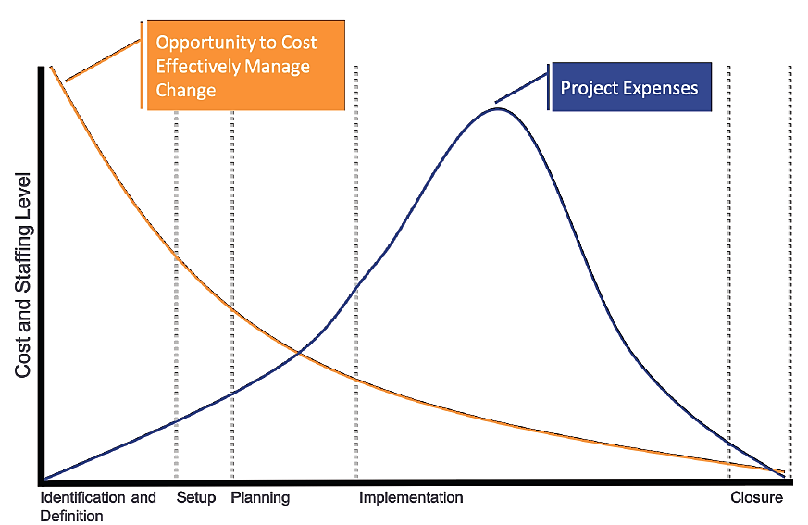
Opportunity to Cost Effectively Manage Change

Slide 42
work completed during this phase can be rolled up into the following categories:
Identifying and defining the needs
Types of Data and Data Collection
Bradshaw’s 4 Categories of Social Needs
Stakeholder Identification and Analysis using the Venn Diagram
Problem and Objectives Trees
Current State and Future State Analysis
The Logical Frame

Slide 43
Key Outputs
Stakeholder Analysis
Project Logical Frame
Project Proposal
High-Level Project Charter

Slide 44
Key Inputs
Project concept/idea
Terms of Reference from a request for proposal
Lessons learned from previous, similar projects
Program Theory of Change

Slide 45
Theory of Change
A Theory of Change is most often done at a program level, not at a project level.
However, the project manager and team should be aware of their how project progresses
Please refer to Figure 22: Delta River Program Theory of Change Page 75
Homework

Slide 46
MEAL in Identification and Definition
(Monitoring, Evaluation, Accountability, and Learning)
Engagement of the MEAL team (or focal point) in this phase is critically important.
The project manager will be working in close collaboration with the MEAL team throughout the project, but specifically during this phase there will be a lot of analyses conducted that will require the assistance and input of the MEAL team.
This is particularly important as needs assessments and validation are conducted and a proposal developed.
The MEAL team will also be involved in helping to develop the logical frame – validating indicators, ensuring that the logic is sound, helping to test assumptions, and ensuring that the means of verification are practical.
End of day 2

Slide 47
Decision Gates
Needs Assessment: Validates that the need exists and is a priority for the community, stakeholders, and beneficiaries. Informs the parameters of the project through data and feedback from stakeholders.
Concept Note: Presents a high-level project concept in which stakeholders (the organization, program team, and/or donor) determine if the project meets the criteria for moving forward to the project proposal.
Project Proposal: Outlines the high-level elements of the project including: scope of work, budget, timeframe, risks, stakeholders, intervention logic, and resource requirements. Intended to obtain funding.

Slide 48
I want to
design a project
by collecting and analyzing Data

Slide 49
The purpose of this data collection is
to broadly explore a wide number and variety of issues,
providing information which, when analyzed, will inform priorities and identify interventions that will address the challenges in a target area
Key concept: stay open minded!

Slide 50
Identifying Project Needs
The project team will need to collect data that identifies community needs in the potential intervention area.
However, the data should not be limited solely to examining issues related to community needs.
Other topics to explore
should include:
The present state of service provision
The existing strengths within the community,
Examination of stakeholders present in the intervention area.

Slide 51
challenges in collecting data it can be highly subjective
An approach to limit the subjectivity of problem definition and to work through differing perspectives of “real” needs is through the triangulation of assessment data.
Triangulation is a powerful technique that facilitates validation of data through cross verification from more than two sources
Triangulating approaches increases the confidence and validity of study results.
By combining multiple perspectives and methods, researchers can hope to overcome the weakness or intrinsic biases and the problems that come from single method or a single observer perspective
Thereby increasing the credibility and validity of results.

Slide 52
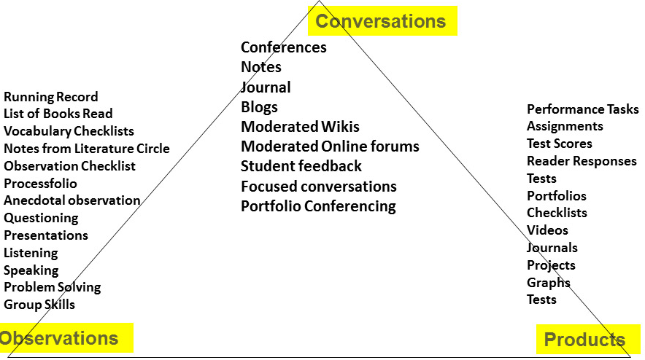
riangulation of assessment data
Refers to the practice of using multiple sources of data or multiple approaches to analyzing data to enhance the credibility of a research study.
Investigator triangulation
involves employing several evaluators to engage in observations or analyze participant responses
Sources of Evidence

Slide 53
Collecting Data
The data that you collect during this phase will not be limited to the needs and priorities of the targeted community or beneficiaries.
There will be other information that you should obtain at this point in the project so that you have a more comprehensive understanding of the context.
Some of that data might include:
Legal and regulatory environment
Social and cultural conditions and norms
Infrastructure available and required
Community strengths, opportunities, and vision
Biological/physical environment
Organizational networks
Successes and capacity

Slide 54
ACTIVITY: types of data?
Homework
Objectives : To understand the types of data
Breakout session:
Instructions:
Read the and discuss the case study on Page 48 from the study guide?
Duration: 4 minutes
Notes:
54

Slide 55
Identifying Needs: Triangulation
Felt needs: thoughts, dreams, “wants” of the community
Expressed needs: identified through observation
Comparative needs: compare to others’ situation
Normative needs: evaluation based on professional standards

Slide 56
project team will need to collect data regarding a number of areas related to the project environment
Project stakeholders
Community strengths, opportunities and vision
Successes and capacity
Biological/physical environment
Organizational networks
Infrastructure
Legal, policy and political institutions
Social and cultural conditions

Slide 57
Types of Data
Secondary data
Information available through published and unpublished sources, including literature reviews, surveys, evaluations, assessments, reports from NGOs, UN agencies, international organizations and government offices
Primary Quantitative data
In situations where secondary sources do not provide sufficient assessment information, organizations can collect data via quantitative assessment approaches
Primary Qualitative data
In contrast to quantitative data approaches, qualitative approaches seek to capture participants’ experiences using words, pictures and objects

Slide 58
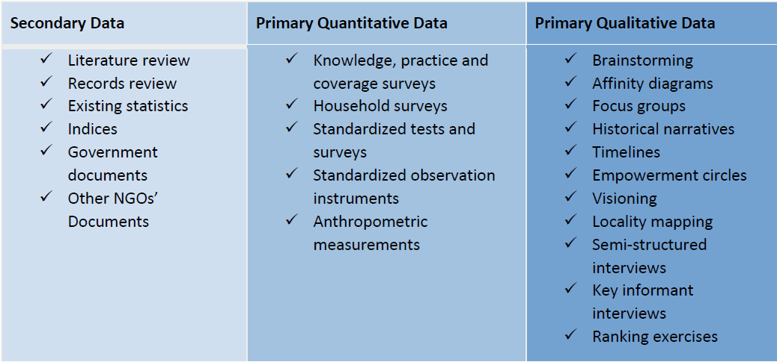
Tools for Data Collection

Slide 59
Tools for Data Collection
A semi-structured interview:
  is a meeting in which the interviewer does not strictly follow a formalized list of questions. Instead, they will ask more open-ended questions, allowing for a discussion with the interviewee rather than a straightforward question and answer format.
Key informant reviews:
  Are qualitative in-depth interviews with people who know what is going on in the community.
Locality mapping:
  Serves as a tool to provide a visual representation of information in a particular geographical context. It is based on a stakeholder’s perception with the focus on a certain issue of interest.

Slide 60
Analyzing Data
End of day 3
The purpose of data collection is to broadly explore a wide number and variety of issues,
The purpose of data analysis is to order and organize the raw data so that useful information can be extracted from it.
Development projects tend to focus on two broad categories of analysis:
Current State Analysis
Future State
Analysis

Slide 61
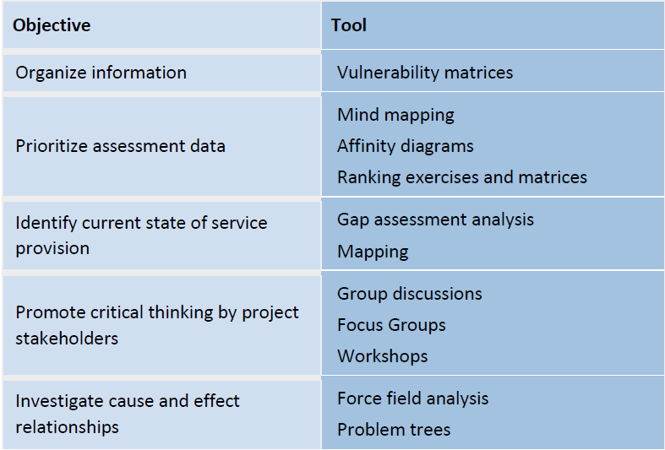
Data Analysis: Current State
Homework
What is happening now?
Tools

Slide 62


Future State Analysis
Future state analysis helps to develop a picture or description of where the project will lead:
What will be different in the future if this project is successful at meeting expectations?
What will project beneficiaries be able to do that you can’t do now?
What social change will be enabled?
At this point, the development organization should consider three critical strategic questions:
Which elements will be included in the project intervention?
Which elements will not be included in the scope of the project?
What are the criteria which will be used to make these decisions?

Slide 63
Criteria for Determining what is Included in Project Interventions

Slide 64
Project Management is
Iterative!
While collecting and analyzing data is normally associated with the Identification and Design Phase, these activities can/should be conducted in multiple phases of the project. For example, the collection and analysis tools are especially useful when:
  Expanding or changing the scope of an existing project;
  Conducting MEAL activities;
  Completing learning activities during the End of Project Transition phase.

Slide 65

Stakeholder Analysis
Stakeholder is any individuals, group or organization, community, with an interest in the outcome of a programme/project.
Purpose: To identify:
  The needs and interest of stakeholders
  The organizations, groups that should be encouraged to participate in different stages of the project;
  Potential risks that could put at risk programme;
  Opportunities in implementing a programme;

Slide 66
Stakeholder management
To succeed, the project team needs to develop the discipline to manage these stakeholder relationships.
Team members need to
understand the reality and the complexity of interests and relations;
evaluate and predict project impacts (both positive and negative) on all stakeholder groups;
design and implement engagement plans that encourage project participation and strong communication
Components of a strong stakeholder management system include:
1. Stakeholder Identification (Identification and Definition)
2. Stakeholder Analysis (Identification and Definition)
3. Stakeholder Engagement (Project Setup)
4. Stakeholder Communications (Project Planning)
5. Revision and Analysis (Continuously)

Slide 67
six categories of stakeholders
Users are the people who will directly benefit from the products and/or services of the project.
Governance Stakeholders are the people or groups of people who have an interest in how things are managed on the project
Providers are the individuals who actively participate in the work of the project.
Influencers are the people who have the ability to change the direction (positively or negatively) of the project
Dependents are those who want something from the project other than the planned final product or service.
Sustainers are groups responsible for supporting the product after the project is completed

Slide 68



Some considerations to keep in mind when classifying stakeholders into categories include:
Recognize when user categories overlap. There are many instances where an individual or a group would fall into more than one category. For example, communities could be both users and sustainers.
Consider breaking down the categories. The categories can be broken down into sub-categories if helpful. The governance stakeholder's category, for example is already broken into three sub-categories. Similarly, it might be especially useful to break down the user category into further sub-groups.
Recognize that project stakeholders change with time. New stakeholders can enter the intervention area while others lose their influence or interest. Stakeholder identification is therefore an on-going process should be revisited at intervals throughout the life of the project.

Slide 69


Stakeholder Analysis
Exploring the stakeholders’ interests. What might they gain or lose through the project? What are the stakeholders’ expectations (both positive and/or negative)? What resources can they commit? What are potential roles for stakeholders? What capacities do they hold? Are they supporters or blockers?
Mapping the stakeholders’ influence. Influence refers to the power that stakeholders have over a project such as their decision-making authority or their ability to influence project activities or stakeholders in a positive or negative way. What is the extent of co-operation or conflict in relationships between stakeholders? Who has the power to make change happen for immediate problems, underlying issues and root causes?

Slide 70
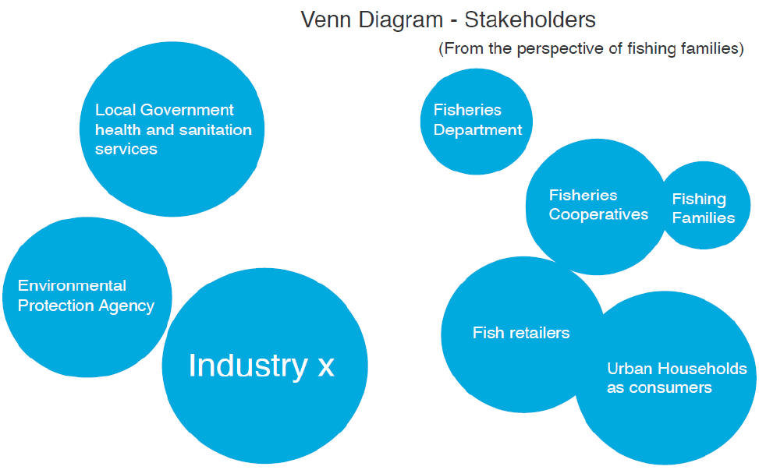

Slide 71
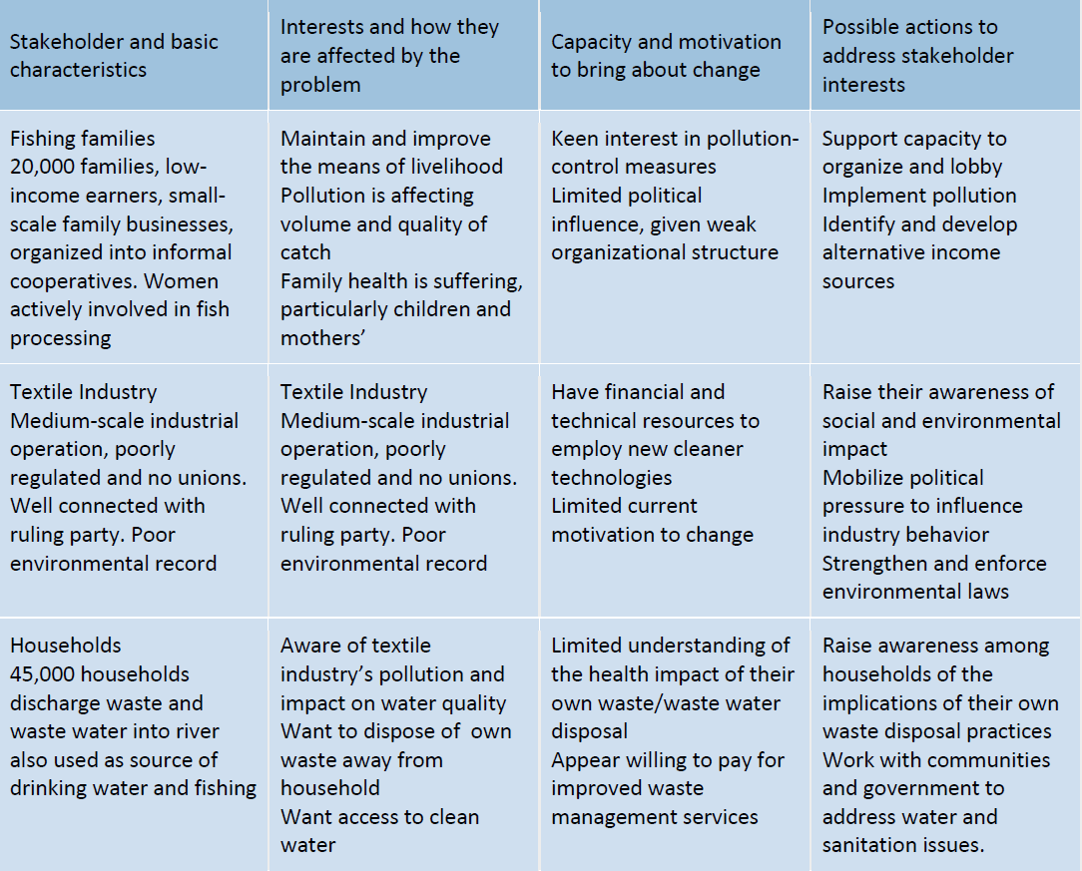

Slide 72
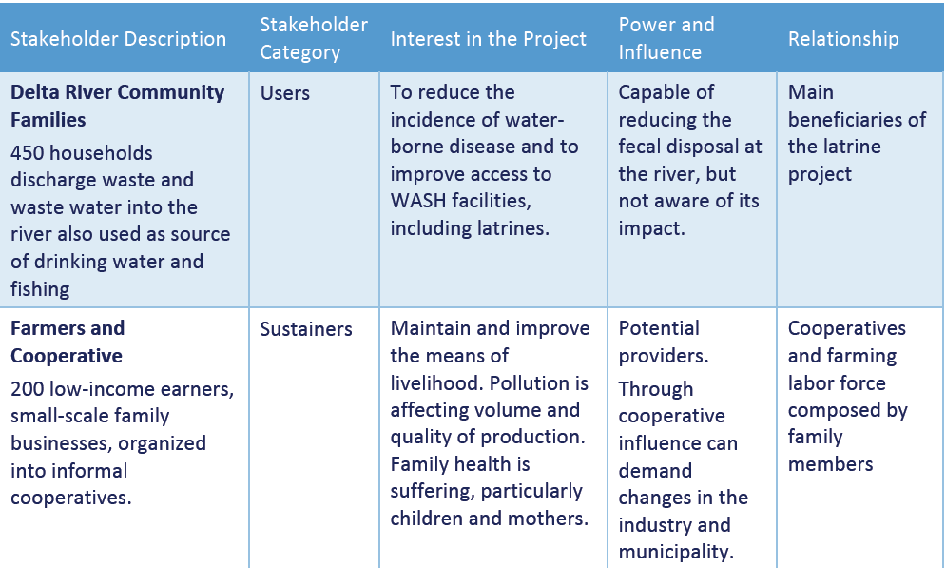
Stakeholder Analysis Matrix

Slide 73
Stakeholder Communications - Communications Plan

Slide 74
Logical Framework
I want to
design a project
by planning out the logic
of the intervention

Slide 75


Project Justification Management
Projects are undertaken for a variety of reasons, but, in the end, the investments are made because of the potential value the project will provide to the stakeholders involved. For example:
The donor organization needs to be convinced that an investment in this activity will be a worthwhile investment;
The community where the project will work needs to perceive that its participation will result in concrete benefits;
The leadership of the development organization needs to be assured that the success of the project will contribute to its larger program (or portfolio) goals.
Successful project managers need to have the skills and competencies to:
Identify the justification for their projects;
Communicate the justification to a larger audience;
Track the project‘s progress in achieving the value that justified its existence.

Slide 76
Problem-based Versus Assets-based Approach
Problem-based Approach
Define the problem
Fix what is broken
Focus on the negative
Asset-based Approach
Search for solutions/assets that already exist
Reinforce what is working
Focus on the positive

Slide 77

Features of Logical Framework Approach
Stakeholder Involvement
Needs-based Approach
Logical Intervention Approach
Framework For Assessing Relevance, Feasibility And Sustainability
Results-oriented – Not Activity Driven
Logically Sets Objectives And Their Causal Relationships
Shows Whether Objectives Have Been Achieved: Indicators (For M&e)
Describes External Factors That Influence The Project’s Success: Assumptions And Risks

Slide 78
LFA Key Main steps
  Stakeholder Analysis
  SWOT Analysis
  Problem Tree Analysis
  Objective Tree Analysis
  Logical Framework Matrix
  Monitoring and evaluation

Slide 79
Strengths - the positive internal attributes of the organization
Weaknesses - the negative internal attributes of the organization
Opportunities - external factors which could improve the organization's prospects
Threats - external factors which could undermine the organization's prospects
SWOT Analysis

Slide 80

I want to
design a project
End of day 4
by analyzing the causes of problems, and their effects
Problem Tree

Slide 81
What is an Objective Tree Analysis
An Objective Tree is a Problem Tree that is transformed into a set of future solutions to the problems. Each negative problem is converted into an objective by rewriting it as a positive future statement.
As the Objective Tree is transformed from the Problem Tree: the analysis of problems in the Problem Tree from Problem/Project Identification (PPI) is the basis and starting point for the Objective Tree analysis.
The positive statements are in fact objective statements that can be presented in a diagram showing a means – ends hierarchy, the objective tree.
Problem Statements | Objective Statements
Low agricultural production | High agricultural production
Lack of medical staff in rural areas | The number of medical staff in rural areas has increased

Slide 82
The analysis of objective tree aims:
Provide a clear overview of the desired future situation once problems have been identified and reformulate into objectives;
Verify the hierarchy of objectives;
Illustrate the means-ends relationships in a diagram.

Slide 83

What is an Objective Tree Analysis
Problem Tree
Objective Tree
Effects
Ends
Causes
Means
Negative Statements
Positive Statements

Slide 84
Reformulating Problem Statements into Objective Statements
Reformulating the problems into objectives has to be done very carefully.
If a statement makes no sense after rewording, write a replacement objective, or delete it, or leave the problem unchanged.
It is important to review the formulated objectives and the resulting objective tree.

Slide 85


Exercise

Slide 86
Reformulating Problem Statements into Objective Statements
Example
Problem statement: “river water quality is deteriorating” can be reformulated into “quality of river water is improved”.
Problem statement: “loss of confidence in public services” can be transformed into “people’s confidence in public services is restored”.
Problem statement: “public transportation is in bad condition” can be reformulated into “public transportation is kept in good condition”.
Problem statement: “lack of adequate rain levels” cannot be transformed into “adequate rain levels available” because it is an unrealistic objective. We cannot intervene into the natural phenomenon by predicting or hoping that there will be adequate rain. This problem, however, could be rewritten as “irrigation system established and operational” which sounds more realistic and can be intervened.

Slide 87
Formulate the following problem statements into objective statements
Problem Statements
a. Farmers lack know-how in organic farming
b. Community members are not aware of HIV/AIDS prevention
c. High rate of alcohol consumption
d. High illiteracy rate of children from poor family background
e. Youth do not participate in community activities
f. Local community do not understand their roles and responsibilities in natural resources management
g. People do not save money for use in health care or emergency situation
h. Youth do not like to read
i. Community members do not want to buy health insurance

Slide 88
Steps in Formulating an Objective Tree
Step 1
Reformulate all negative situations of the problems analysis into positive situations that are desirable and/or realistically achievable
Step 2
Step 3
If necessary: revise statements; add new objectives if these seem to be relevant and necessary to achieve the objective at the next higher level; or delete objectives which do not seem suitable or necessary
Check the means-ends relationships to ensure validity and completeness of the hierarchy; cause-effect relationships in the problem tree are turned into means-ends linkages in the objective tree

Slide 89
Steps in Formulating an Objective Tree
The following diagram illustrates a transformation of a problem tree into an objective tree which uses “high staff turnover” as the main problem.
Problem Tree
Objective Tree
Delay in project delivery
High rate of recurring recruitment
Unstable team members
Project delivery meets the deadline
Low rate of recurring recruitment
Stable team members
High staff turnover
Reduced staff turnover
Unattractive salary package
Very high workload
Authoritarian managers
Better salary package
Reduced workload
Less Authoritarian managers

Slide 90
Summary of Formulating an Objective Tree from a Problem Tree
Problem Tree |  | Objective Tree
Relationship: Causes-Effects | Negative statements are rewritten into positive statements | Relationship: Means-Ends
Branches: Effects |  | Ends: Objectives
Trunk: Main problem |  | Trunk: Purpose/Objective/Outcome
Roots: Causes |  | Means: Methods

Slide 91
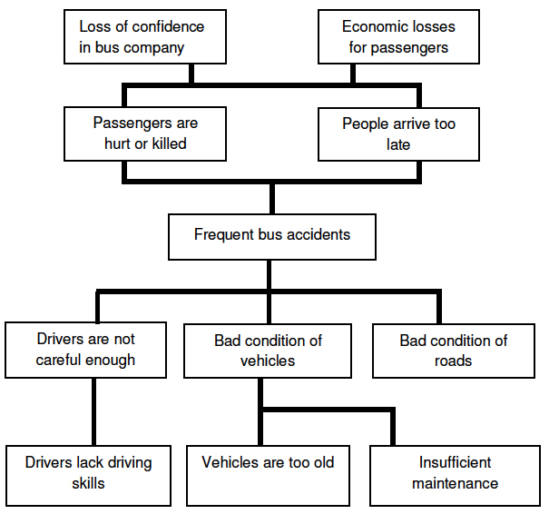
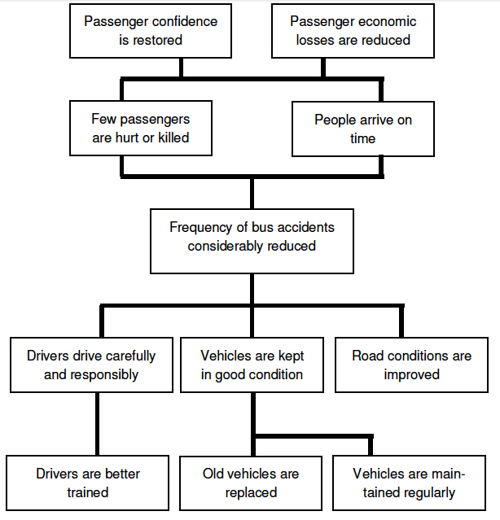
Examples of Objective Tree
An Example of Bus Accident
Effects → Goals
Problem Tree
Objective Tree
Effects → Goals
Main Problem → Purpose
Causes → Results
Causes → Activities

Slide 92
Strategy Analysis
The aim of strategy analysis is division of the objectives tree into more consistent smaller sub-units that may, compose the core for a project.
Each of the sub-units of the objective tree can represent an alternative strategy for the future project.
The project objectives set the framework for the strategy of the project.

Slide 93
Criteria for selection of the project strategy:
RELEVANCE: the strategy corresponds to the needs of the stakeholders.
EFFECTIVENESS: the lower level objectives of the strategy will contribute to achievement of the project purpose
EFFICIENCY: cost-effectiveness of the strategy in transforming the means into results.
CONSISTENT with development policies
SUSTAINABILITY of the project
ASSUMPTIONS and RISKS

Slide 94
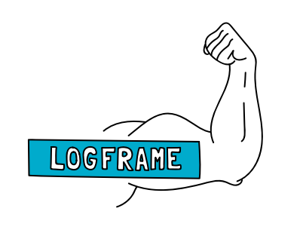
What is a logframe and why should I use it?
A Systematic Tool for organizing the project thinking and identifying relationships between resources, activities, and project results
A Visual Communication Tool to present and share the project intervention logic
A Monitoring Tool to measuring progress through indicators and sources of verification
A Risk Management Tool to identify and assess the risks that will influence implementation
Notes:
Thank the participants for their explanations and clarify that - Logical frameworks (logframes) are the principal tool used to establish the logic of the intervention.
It is an analytical tool used to plan, monitor and evaluate projects. While there are variations between logical framework models with regard to the terms and their structure, they are all intended to serve the same underlying purposes:
(1) a systematic tool for organizing the project thinking and identifying relationships between resources, activities, and project results; (2) a visual way of presenting and sharing the project intervention logic; and (3) a tool for measuring progress through indicators and sources of verification. 4 explaining that Risk management, as we will talk about in other phases, has its origins in the logframe.
The assumptions column serves as the beginning of this risk register. (we will cover the risk register later) Almost every assumption will be converted into a risk – and actively managed during implementation.

Slide 95
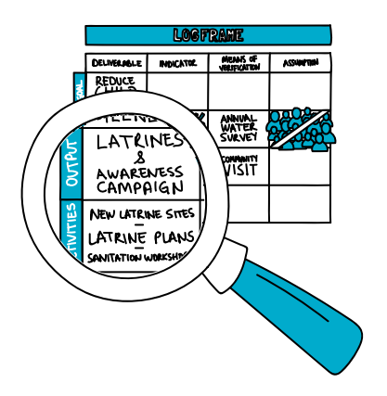
Logframes: Means of Verfication
Do appropriate external sources already exist (reports, stats etc.)?
Are these sources specific enough?
Are they reliable and accessible?
Are the costs in obtaining the information reasonable?
Should other sources be created?

Slide 96
The Project DPro Logframe
Project Description | Indicators | Means of Verification | Assumptions
Goal
Outcome(s)
Outputs
Activities

Slide 97
The Vertical Logic
Project Description
Goal
Outcome(s)
Outputs
Activities
If the OUTCOMES occur;
Then this should contribute to the GOAL
4
If the OUTPUTS are produced;
Then the OUTCOMES will occur
3
If the ACTIVITIES are conducted;
Then OUPUTS can be produced
2
If adequate RESOURCES/INPUTS are provided;
Then the ACTIVITIES can be conducted
1
Notes:
The four levels of the Project DPro logframe are activities, outputs, outcomes and the goal. This is call the ‘vertical’ logic. Starting from the bottom, the vertical logic reads something like this:
if adequate resources/inputs are provided;
then the activities can be conducted. If the activities are conducted;
then the outputs can be produced.
If the outputs are produced; then the outcomes will occur.
If the outcomes occur; then this should contribute to the goal.

Slide 98
The Horizontal Logic
Project Description | Indicators | Means of Verification | Assumptions
Goal
Outcome(s)
Outputs
Activities
End of day 5
If I achieve my outputs AND the assumptions are true, I should be able to achieve my outcomes.
If I achieve my activities AND the assumptions are true, I should be able to achieve my outputs.

Slide 99
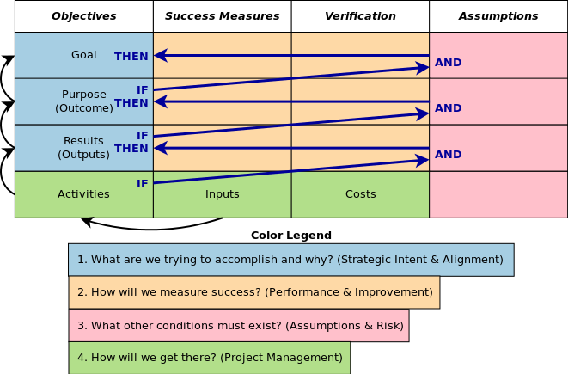
The logframe Logic
A practical project design tool
Consists of 3 directional logics – vertical, horizontal and zigzag
A Systematic Tool to identify relationships between resources, activities, and results
A Visual Communication Tool
A Monitoring Tool to measure progress through indicators and sources of verification
A Risk Management Tool to identify and assess risks

Slide 100
Exercise

Slide 101
Can you find 1 or 2 major weaknesses in the logic of these Objective Statements?
Project Description
Goal | To contribute to improved health, particularly of under 5s and the general health of the river ecosystem.
Outcome(s) | Improved quality of river water.
Outputs | 1.1 Reduced volume of fecal waste discharged into river 1.2 Reduced volume of household refuse directly dumped into the river system
Activities | 1.1.1 Conduct baseline survey of households 1.1.2 Prepare and deliver public awareness campaign 1.1.3 Prepare engineering specifications for latrines and expanded sewage network.
4
3
2
1
Notes:
Ask the participants to study the hierarchy of objectives that is on this slide. (Note that it is just a summary version and not the complete project description.)
In small groups, discuss your observations about this hierarchy of objectives. Try to find one or two major weaknesses in the logic of these objective statements (or logic gaps).
There are at least three or four problems that your keen minds might be able to detect. If you have time, then discuss improvements that could strengthen the logic. Appoint one person from your small group to be the spokesperson for sharing your results.
When giving the reports, don’t repeat anything that has already been mentioned by another group.

Slide 102
Project Description
Goal | To contribute to improved health, particularly of under 5s and the general health of the river ecosystem.
Outcome(s) | Improved quality of river water.
Outputs | 1.1 Reduced volume of fecal waste discharged into river 1.2 Reduced volume of household refuse directly dumped into the river system
Activities | 1.1.1 Conduct baseline survey of households 1.1.2 Prepare and deliver public awareness campaign 1.1.3 Prepare engineering specifications for latrines and expanded sewage network.
4
3
2
1
Notes:
In the blue box at the outputs level.
The objectives (reduced volume of fecal waste and household refuse) are not appropriate for the output level. They are not “tangible” products or services. Rather, they describe higher level change that would be more appropriate at the outcome level.
Another major weakness is that the statement "improved quality of River water” is too aspirational/high-level for the outcome level. It should most likely be shifted up to the project goal level.
The statement at the goal level is too complex. It actually contains 2 goals that need to be separated. Contributing to improved health of under 5s is quite different from improving the river ecosystem.
Also, these changes are most likely program goals that will require multiple project interventions and contributions.

Slide 103
Assumptions
Describe necessary internal and external conditions in order to ensure that the activities will produce results
Assumptions are not risks, they lead to identifying risk, which can jeopardize the success of the project
Are worded positively, i.e. they describe circumstances required to achieve certain objectives
Should be relevant and probable
If an assumption is not important or almost certain: Do not include
If an assumption is unlikely to occur (since it is positive) : Killer assumption – abandon project

Slide 104
Indicators measure to verify to what extant the results are achieved.
Specify how the achievement of an objective can be verified or demonstrated
Provide a basis for Monitoring and Evaluation
3 Dimensions of Indicators
  Quantity
  Quality
  Time
Indicators

Slide 105
Logframes: Indicators should be SMART
Specific | Does the indicator measure change for the objective?
Measurable | Will the indicator assess objectively and independently?
Achievable | Is it possible for the objective to accomplish what is being measured by the indicator?
Relevant | Is the indicator applicable to the context? Is it practical and cost-effective to use?
Time-bound | When will the indicator be achieved -- and can the indicator be achieved within the specified time frame?

Slide 106
Indicator Disaggregation
Disaggregation of indicators is when you break the indicators into categories for a more robust analysis. Some examples of how indicators can be disaggregated are by: gender, geographic location, socio-economic status, and age group.
Keep in mind that the disaggregation is intended to provide a better understanding of the changes happening at the level of each category.
The disaggregation will depend on the indicator and what kind of information is required for a deeper analysis.
  Note: Take our Delta River Latrine Building project as an example,

Slide 107
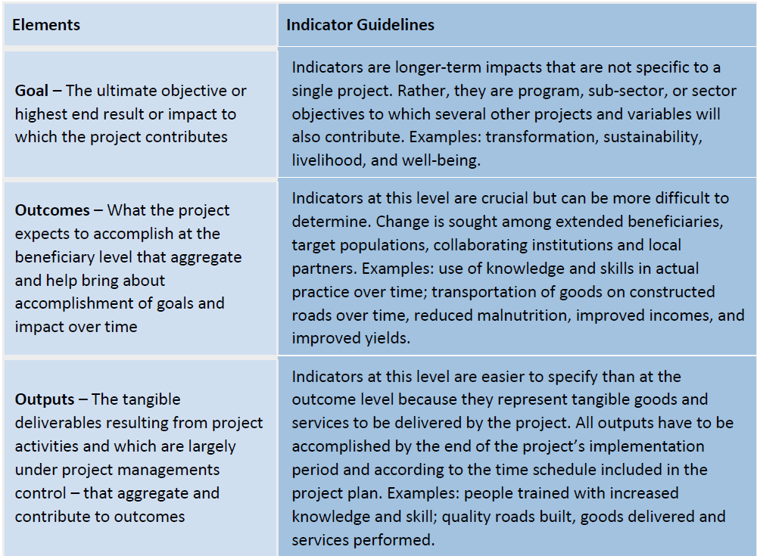
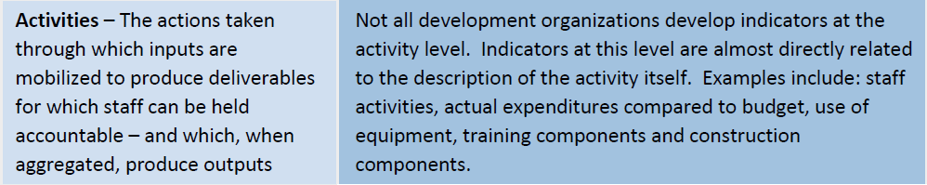
Indicators (ii)

Slide 108
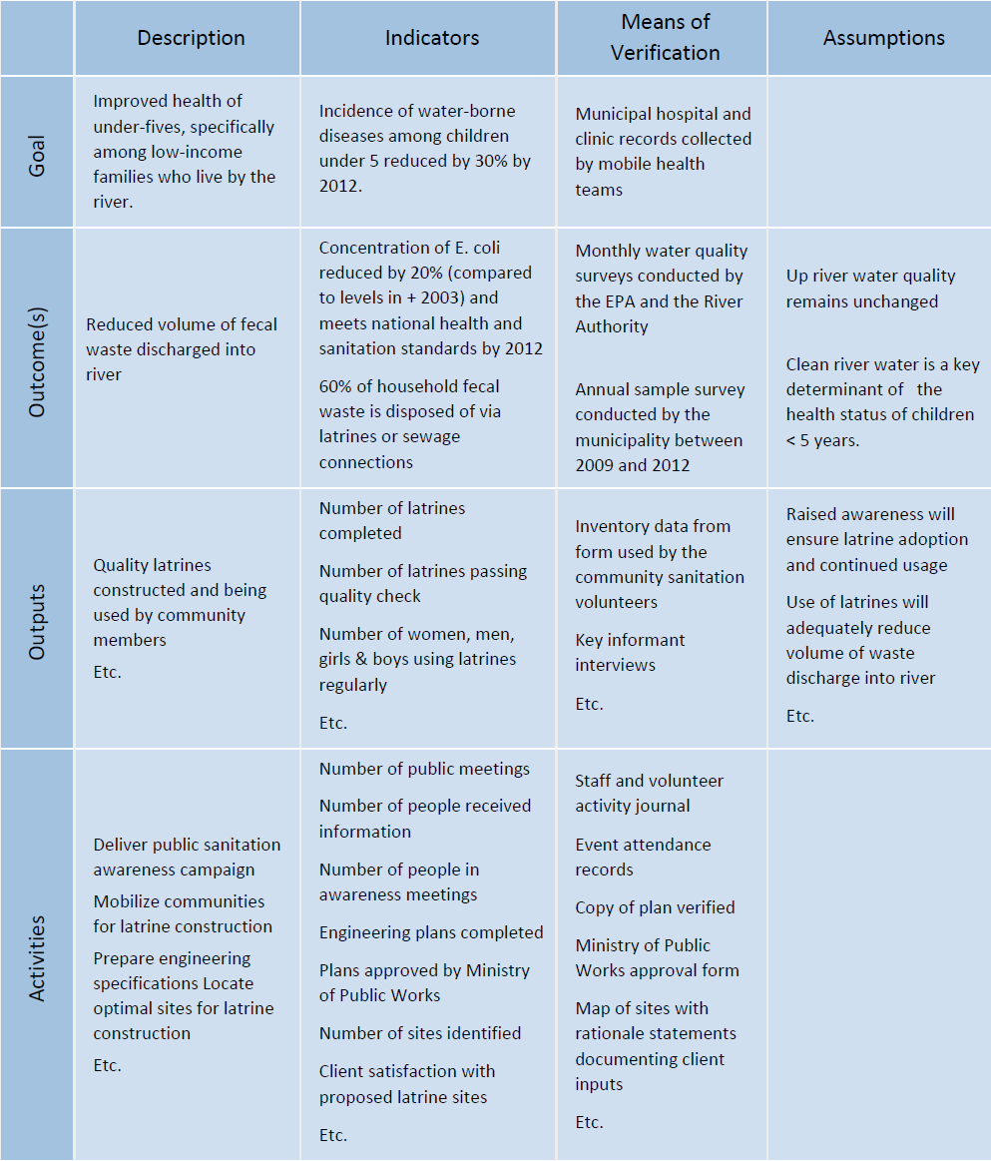

Slide 109
High-Level Analyses (Estimations)
During the Identification and Definition phase, it will be beneficial to include high-level (estimations) analyses to support the definition of the intervention as well as to help in the proposal writing process – if that is required.
At minimum, the following analyses should be conducted: stakeholder, risk, human resources, supply chain, and sustainability.
Whenever you are conducting an analysis, you should involve a variety of stakeholders in the process to better ensure a more robust analysis.
For example, if examining the human resource needs for the project, involve a focal point in the Human Resource Department within your organization. Including these stakeholders early sets the tone for their involvement and participation for the rest of the project

Slide 110
Project Setup
Project governance
Project launch

Slide 111
Key Outputs
Project Charter
Comprehensive Risk Register
Stakeholder Engagement Strategy
Project Launch

Slide 112
Key Inputs
Initial Risk Assessment
Initial Stakeholder Assessment
Project Concept Note and/or Proposal
High-Level Project Team Capacity Assessment
High-Level Resource (Human, Budget, and Supply Chain) Assessment
Project Logical Frame

Slide 113
Project Governance
Governance defines the management framework within which project decisions are made.
A robust governance structure clarifies:
Accountability
Organizational commitment and accountability
Project advocates
Support network for project manager
Authority
Identify decision making authority of project manager
Identify other decision makers
Identify procedures to terminate project

Slide 114
Project Board/Project Sponsor
Ensure organizational commitment and accountability for the project;
Decide on proposed project changes (scope, budget, calendar or others) that extend beyond the project manager’s agreed tolerances;
Oversee the project, providing resources, direction and insight as necessary;
Monitor the ongoing viability of the project, making decisions to terminate the project if necessary;
Support and advise the Project Manager on the management of the project, especially on issues that extend beyond the span of control of a project manager.
Advocate for necessary organizational support and resources for the project;
Ensure that the organization “owns” the process and results of the project.

Slide 115
Board members should represent the following distinct knowledge/ management/ experience perspectives
An Executive perspective - assessing whether the project is providing value as a whole, and providing the funding and resources necessary to obtain that value. There is only one representative with Executive Perspective on the Board.
A Senior User perspective - establishing that the project is meeting the needs of the people who will be directly working with the project's outputs. There can be more than one representative with Senior User Perspective on the Board. Another alternative would be to establish a “senior user group” for the project, which in turn identifies a single representative on the board to represent the opinions of all group members.
A Senior Supplier perspective - providing confidence that the project's outputs (from which value will be derived) can be achieved with available resources, and at the required level of quality. There can be more than one representative with Senior Supplier Perspective on the Board. Another alternative would be to establish a “senior supplier group” for the project, which in turn identifies a single representative on the board to represent the opinions of all group members.

Slide 116
Project Board responsibilities
Decide on
proposed project changes (scope, budget, calendar or others) that extend beyond the project manager’s agreed tolerances;
Oversee
the project, providing resources, direction and insight as necessary;
Monitor
the ongoing viability of the project, making decisions to terminate the project if necessary;
Represent
the interest of the perspective they represent;
Support and advise
the Project Manager on the management of the project, especially on issues that extend beyond the span of control of a project manager; and
Advocate
for necessary support and resources for the project.
End of day 6

Slide 117
Board Composition Examples

Slide 118
Project Charter
I want to
design a project
by getting authorization to start project activities

Slide 119
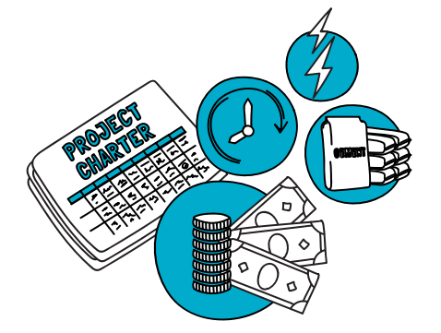
How does a Project Charter help?
It can formally authorizes a project.
It can gives the project manager the authority to proceed and apply resources to a project.
It can be shared with all stakeholders and can help make sure they are all on the ‘same page’.
It serves as a record of changes and approval processes.
Notes:
Have quick discussion about the benefits – the participants should under stand this very well now.
>> click – debrief across the 5 points
The charter may have many different names and the process may be unique depending on the context and culture of the organization. The project charter serves as the set-up deliverable upon which the formal decision to authorize the project is made. Whatever format the signed project charter, it serves the important purpose of allowing the project to begin allocation of project resources; and begin implementing the project.
It identifies. documents and communicates the constraints (scope, time, cost) of the project and generally serves to ensure that there is shared understanding of, and commitment to, the project among key project stakeholders and sponsors (both internally and externally).

Slide 120
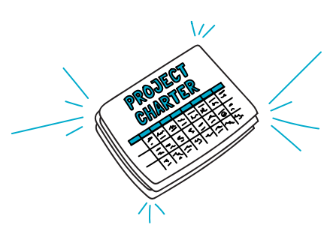
What is it and why should I use it?
A summary document that describes the project at a high level, without a lot of detail.
Not long or complicated, perhaps 3-5 pages maximum length.
A living document that will be updated during implementation to reflect changes.

Slide 121
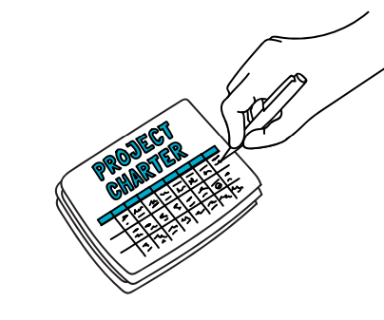
Possible Contents of a Project Charter
Project Purpose – including a statement of the need the project will address.
Project Deliverables – articulating the scope of the project, including the project goal, outcomes, and major outputs.
High-level Project Estimates – including a high-level statement of:
  The project activities;
  The project schedule;
  The project budget; and
  A preliminary list of the roles and skills required to perform the necessary work.
Project Risks – identifying potential problems/risks that the project might encounter.
Project Tolerances – articulating project tolerances regarding project deliverables, schedule, cost and risk.
Project Change Control – establishing an exception handling process for when the project exceeds a tolerance in any of these areas.
Notes:
The contents of the Project Charter can vary its all about what would work for you and your agency, but usually includes statements regarding the
Project Purpose – including a statement of the need the project will address;
Project Deliverables – describing the scope of the project, including the project goal, outcomes, and major outputs;
High-level Project Estimates – including a high-level statement of the project activities, schedule, budget and a preliminary list of the roles and skills required to perform the necessary work;
Project Risks – identifying potential problems and/or risks that the project might encounter;
Project Tolerances – describing tolerances regarding deliverables, schedule, cost and decisions; and
Project Change Control – establishing an exception handling or escalation process for when the project exceeds a tolerance in any of these areas.
Each organization or project team must decide on their own requirements. At times, the purpose of a project charter may be incorporated into existing documents. In general, the Project DPro Guide does not always recommend adoption of a new tool in every situation but, rather, encourages ‘tailoring’, adaptation and incorporation of PM tools into existing processes where possible.

Slide 122
The Project Charter
The Charter documents the following:
    Project Purpose or Justification.
    Measurable Objectives and related Success Criteria.
    High-level Requirements.
    High-level project description, and key deliverables.
    Overall project risk / high-level Risks.
    Summary Milestone Schedule.
    Preapproved financial resources / budget.
    Key stakeholder list.
    Approval Requirements.
    Assigned Project Manager, responsibility, authority level.
    Name and authority of sponsor or steering committee.

Slide 123
Exercise

Slide 124
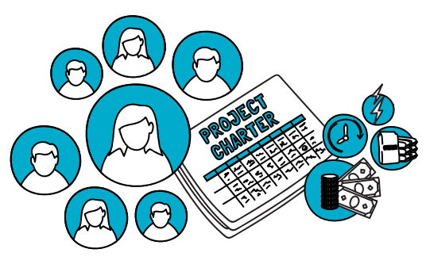
Discuss:
Do you have something like a charter?
How would it help?
What would it include?

Slide 125
Launching the Project: Communication
Formally acknowledge the project launch
Introduce stakeholders to project
Ensure stakeholder understanding

Slide 126

MEAL in Identification and Definition
Engagement of the MEAL team (or focal point) in this phase is critically important.
The project manager will be working in close collaboration with the MEAL team throughout the project, but specifically during this phase there will be a lot of analyses conducted that will require the assistance and input of the MEAL team.
This is particularly important as needs assessments and validation are conducted and a proposal developed.
The MEAL team will also be involved in helping to develop the logical frame – validating indicators, ensuring that the logic is sound, helping to test assumptions, and ensuring that the means of verification are practical

Slide 127

I want to
plan a project
by developing a comprehensive map for project implementation

Slide 128
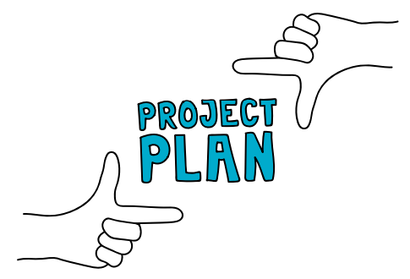
Any of these elements (and more) might require supplementary plans
Communication
Plans
Supply
Plans
Recruitment Plans
Capacity Building Plan
MEAL
Plan
Risk Management

Slide 129
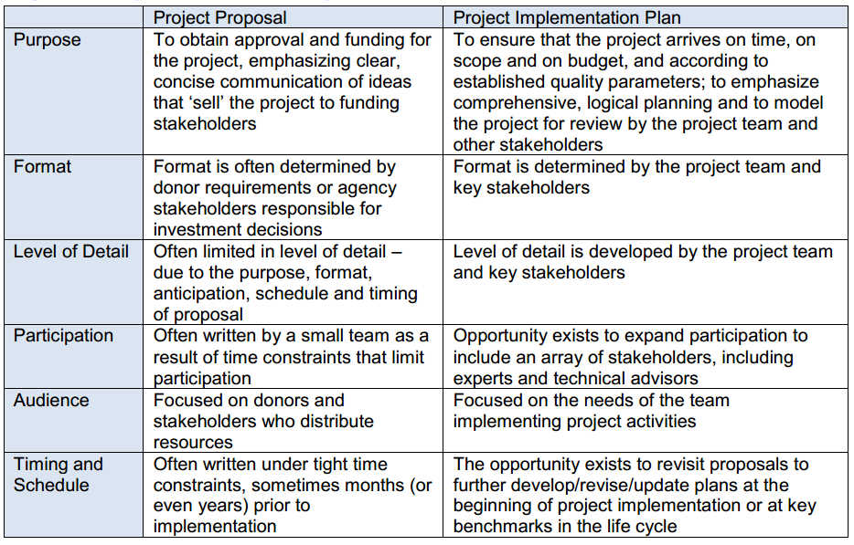
Project Implementation Plan Vs. Proposals
Notes:
Thank the participants for their explanations and clarify that - Logical frameworks (logframes) are the principal tool used to establish the logic of the intervention.
It is an analytical tool used to plan, monitor and evaluate projects. While there are variations between logical framework models with regard to the terms and their structure, they are all intended to serve the same underlying purposes:
(1) a systematic tool for organizing the project thinking and identifying relationships between resources, activities, and project results; (2) a visual way of presenting and sharing the project intervention logic; and (3) a tool for measuring progress through indicators and sources of verification. 4 explaining that Risk management, as we will talk about in other phases, has its origins in the logframe.
The assumptions column serves as the beginning of this risk register. (we will cover the risk register later) Almost every assumption will be converted into a risk – and actively managed during implementation.

Slide 130
all project implementation should address the Project DPro’s Principles of Project Management:
Implementation Planning is well-governed !
Implementation Planning is Comprehensive!
Implementation Planning is Integrated!
Project Management is Participatory!
Project Management is Adaptive!

Slide 131
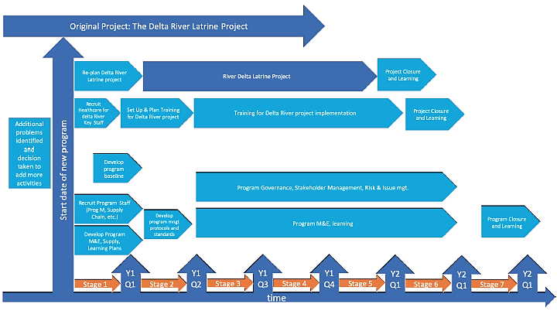
Planning Framework
Project Length
Tools and Processes
Cross-Cutting Components
  Gender:
  Protection:
  Ability (Disability):

Slide 132
Key Output - Implementation Plan
Schedule Plan: This plan consists of a series of steps and tools that are used to develop a comprehensive and accurate project schedule plan. Included in this plan is the scope of work, timeframe for the project, and budget.
Risk Plan: This plan was first developed in the Setup phase, during planning, you will further detail and revisit the risks, ensuring that response strategies and owners are in place and still relevant.
Using the Proposal as a Plan While the project manager may be tempted to think that the documents developed during the Identification and Definition and Setup phases (logical framework, project proposal, etc.) are sufficient to define the scope of the project, this is seldom the case!
MEAL Plan: In collaboration with the schedule plan, the MEAL plan should be finalized during this phase, done in coordination with the MEAL department or counterpoint.
Communication and Stakeholder Engagement Plans: Taking the stakeholder engagement strategy from the Setup phase, the project team will develop plans for the engagement of stakeholders as well as communication during this phase.
RACI Chart: The RACI (Responsible, Accountable, Consulted, Informed) is a tool that outlines roles and responsibilities for activities and tasks.
Supply Chain Plan: Building on the high-level estimates done in previous phases, this plan will outline in detail all the assets, procurement, and logistical components of the project.
Human Resource Plan: Also building upon the high-level analysis done in previous phases, the human resource plan will expand on precisely who will be required (and with what expertise and when as well as a plan for managing people during the remainder of the project

Slide 133
Key input
Logical Framework
Project Proposal
Project Charter
Comprehensive Risk Register
Stakeholder Analysis and Engagement Strategy
Stage Map
End of day 7

Slide 134
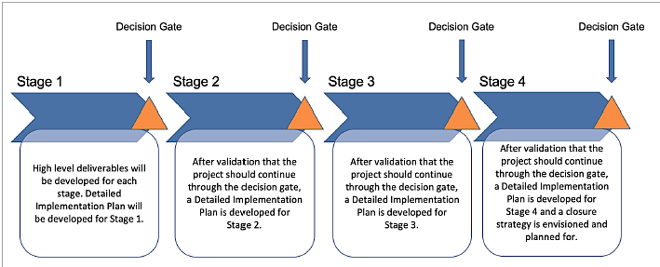




Stage Plans
Throughout the project, it is important to treat the implementation plan as a ‘living’ document, not one that is static and unchangeable.
If the project is longer term or complex in nature, scope planning using stages may be more appropriate.
For each stage in the project, a comprehensive scope of work is identified
Stage planning for longer term projects provides the team with the opportunity to revisit, revalidate, and justify the project activities, timeline, and budget for upcoming stages, making the implementation plan living and more relevant

Slide 135
MEAL Framework
Real-time evaluations follow the programme over a long period of time
Monitoring should take place throughout the entire life of the project, providing essential feedback for the project manager and team about the project – Is it on time? Scope? Quality?
  Framework for Monitoring: You should be able to develop a framework for your monitoring based upon the information in the logical frame – essentially your indicators will guide the monitoring of your project
  Framework for Evaluation: Evaluations can be costly and require substantial time and resources. At this point in the project, it is beneficial to outline what kind of evaluations (real time, final, ex-post) you anticipate for the project.
  (ex ante means we look at future events based on possible predictions. ... ex post is Latin for after the event. ex post means we look at results and events after they have occurred, Real-time evaluations follow the programme over a long period of time)
  Framework for Accountability and Learning: Accountability and learning are often incorporated into the monitoring and evaluation through the MEAL methodology
Real-time evaluations follow the programme over a long period of time
Real-time evaluations follow the programme over a long period of time

Slide 136
Project Launch
To formally acknowledge the beginning of the project;
To ensure that key stakeholders have a consistent understanding of the project;
To introduce stakeholders to the project

Slide 137
Sustainability Planning
Sustainability in projects has become paramount for donors and stakeholders.
The efficacy of the sustainability in a project is only as good as the planning for it.
This process will go hand-in-hand with the closure planning process. The sustainability plan may not be absolute or clear until part-way through the project. It may even change at some point, depending on the context.
It is critical that the sustainability planning be revisited and revised (decision gates may be good points to revisit these plans) as the project moves forward.
Planning for closure is essential to ensuring the sustainability of the project.
Refer to the tool in page 129

Slide 138

Work Breakdown Structure
I want to plan a project
by organizing project work into manageable components

Slide 139
Scope Management
Product scope
Description of products and services to be delivered
Customer-oriented
Project scope
Description of work to be completed
Provider-oriented

Slide 140
the project manager should review the definition of scope for the following:
Completeness – does the team know exactly what it is being asked to deliver?
Ambiguity – will different stakeholders have the same understanding of what is being asked for?
Resources – are the resource requirements understood and defined?
Agreement – has the team agreed the deliverables?
Viability – is the team capable of producing the agreed deliverable?
Acceptance – has everyone (team and stakeholders) agreed what constitutes an acceptable product?

Slide 141
A well-constructed WBS can be used to:
Guide the process of activity identification and sequencing;
Provide a basis for: o accurate estimates of project duration;
accurate estimates of project cost;
accurate resource estimates (vehicles, people, supplies, building materials);
Identify required departmental, subcontracting, supplier services;
Communicate and agree the product and project scope with the project’s stakeholders;
Show the hierarchy of work needed to complete a project and indicate the interfaces between them;
Delegate the work packages to project team members, implementing partners or suppliers

Slide 142

What is it and why should I use it?
A hierarchical list of “work packages” and tasks
A WBS is a way to break down work into smaller pieces to make it easier to manage.
It should describe all the work of the project including any and all supporting work.
Each descending level represents an increasingly detailed description of the work.
Benefits of WBS
  Guidance for sequencing
  Basis for accurate resource usage estimates
  Identification of required services
  Clarification of work hierarchy and interfaces
  Help with delegation of tasks
Notes:
Work breakdown structure is defined as a deliverable-oriented grouping of project elements which organizes and defines the total scope of the project.
It is usually represented as a hierarchy with each descending, or lower, level representing increased detail and definition of the project activities, tasks, subtasks – or as many descending levels that are necessary to represent 100% of the work needed to accomplish the project. The WBS is the decomposition project work – the word “decompose” simply means to break apart into smaller pieces. Put simply, the work breakdown structure organizes the project scope into “work packages” that become the foundation of every other scheduling tool that we will talk about today. The WBS can be used as a basis for more accurate estimates of activity sequencing, project duration, project cost and estimation of numerous other resources such as vehicles, people, supplies, building materials and so on.

Slide 143
Work Breakdown Structure Tasks
Work tasks directly related to project
Indirect work tasks
Planning and control
Stakeholder training
Communications and reporting
Procurement
End of project transition

Slide 144
Work Breakdown Structure Example
Source: Project DPro Guide

Slide 145
Example of a WBS:
Latrines
Quality Latrine
Communities prepared to use latrines
Training WASH committee
Design engineering specification
Procurement
Construct latrine
Dig hole
Prepare and install latrine cap
Build structure and inspect
Obtain hole specifications
Arrange for diggers
Schedule digging
Notes:
Another possible format is the graphical representation. This format is good for showing levels of work - and how smaller components at lower levels of the project graph roll-up/contribute to larger activities or products. For presentation purposes, the graphical format is preferred. Again, it is the decomposing to the level of detail needed to successfully complete the work that is most important.
Make sure that…
Ask the participants-
Is this comprehensive enough?
Is it detailed enough? What would you add

Slide 146
Exercise

Slide 147
Your turn!
Prepare a WBS for one of your projects.
Outcome #1
Output #1
Output #2
Activity #1
Activity #2
Activity #3
Task #1
Task #2
Task #3
Sub Task #1
Sub Task #2
Sub Task #3
Sub Task #4

Slide 148
I want to
plan a project
Budget
by determining how much money
is needed, and when

Slide 149
Project Manager will need to develop skills in these three areas:
Developing Budgets
Identifying Cost Estimates
Monitoring Budgets and Expenditures

Slide 150
The six areas of coordination and collaboration in finance
• Accessing historical data for financial reports
• Explaining budget variances
• Issuing checks
• Authorizing expenditures
• Managing cash balances
• Implementing purchasing policies

Slide 151
What is budget
A plan developed in a participatory way will probably be more accurate and realistic
This will lead to more accurate budgeting
If you have a detailed breakdown of activities – from the WBS, Network Diagram, Critical Path and Gantt Chart – then you are in a good position to develop an activity based budget.
Estimate how much each activity will cost
End of day 8

Slide 152
Developing Budgets
A budget is a description of the project’s financial plan that includes a list of project cost estimates. As is the case for all components of the project plan, the key to accurate budgets is assuring that they are comprehensive and detailed.
Comprehensive Budgets – All budget items required to deliver the products and services must be included.
As a first step, the project team needs to identify expenses required to deliver project products and services including direct, indirect cost , shared services
Detailed Budgets –While high-level budgets are helpful to communicate the general parameters of the project to various stakeholders, the project team requires a more accurate and specific identification of project costs in order to implement activities successfully

Slide 153


approaches to managing budget time schedules:
Life-of-project budget (or multi-year budget) – Here the global budget for the entire life of the project is developed and serves as the official financial document that accompanies the project plan.
Annual project budgets – Some projects adopt the norm of revisiting the life-of-project budget on a regular basis and requiring that a project team submit a one-year budget upon the completion of each project year.
While multi-year budgets tend to be the standard in the development sector, requiring an annual project budget lowers the risk that budget estimates based on multi-year horizons will be inaccurate, will suffer from price variability, or will not be flexible enough to adjust to shifts in the field operating environment.

Slide 154
Activity Based Budgeting
Activity based budgeting focuses on identifying costs of activities that take place in every area of a project and determining how those activities relate to one another – including direct and indirect work.
If a Project Manager is able to develop a complete (both comprehensive and decomposed) list of activities along with cost estimates for activities, then a budget will prove accurate.
Activity based budgeting also offers more opportunity for line staff to get involved, making it more likely that a budget will be accurate.
While there are a number of possible activity-based budget formats that add details such as account codes, donor codes, and unit costs -- they all have two similar requirements:
1) Develop a complete list of activities during scope planning.
2) Work out what will be needed to achieve each activity and estimate how much each will cost.

Slide 155
Activity-Based Budgets
Activates |  |  | Cost per Quarter |  |  |  | Total | Activity Total
 |  |  | Q1 | Q2 | Q3 | Q4
1.1 | Establish Planning unit
1.1.1 | Equipment
 |  | Computers | 2000 | 2000 |  |  | 4000
 |  | Modems | 500 |  |  |  | 500
 |  | Office furniture | 3000 |  |  |  | 3000
1.1.2 | Recruitment
 |  | Counterparts | 800 | 800 | 800 | 800 | 3200
 |  | Office staff | 200 | 300 | 300 | 300 | 1100 | 11800
1.2 | Establish link with government
1.2.1 | Liaison Meetings
 |  | Prepare presentations materials |  | 500 |  | 500 | 500
 |  | Prepare video | 1000 | 1000 | 4000 |  | 6000
 |  | Stationary |  |  | 200 | 200 | 400
 |  | Refreshments |  |  | 100 | 100 | 200 | 7100
Notes:
Where do the activities come from – there is direct and indirect work here? ----WBS
It focuses on identifying costs of activities that take place in every area of a project and determining how those activities relate to one another – including direct and indirect work.
It builds on the foundation of WBS. While there are a number of possible formats that add details such as account codes, donor codes and unit cost – they all have two similar requirements: 1. Develop a complete list of activities during scope planning and 2. Work out what will be needed to achieve each activity and estimate how much each will cost. This can be especially useful for monitoring purposes. The example of an activity based budget seen on this slide was taken from the Project DPro guide.

Slide 156
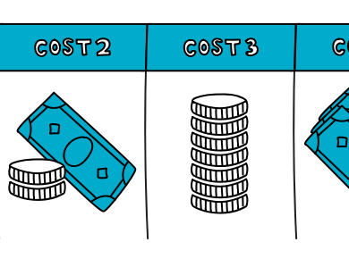
Problems can include:
Inaccurate estimates of time, cost, scope.
Poor/weak/no monitoring of expenditure.
Inflation and/or currency variation.
Weak capacity to manage finance.
Changes in funding.
Notes:
The contents of the Project Charter can vary its all about what would work for you and your agency, but usually includes statements regarding the
Project Purpose – including a statement of the need the project will address;
Project Deliverables – describing the scope of the project, including the project goal, outcomes, and major outputs;
High-level Project Estimates – including a high-level statement of the project activities, schedule, budget and a preliminary list of the roles and skills required to perform the necessary work;
Project Risks – identifying potential problems and/or risks that the project might encounter;
Project Tolerances – describing tolerances regarding deliverables, schedule, cost and decisions; and
Project Change Control – establishing an exception handling or escalation process for when the project exceeds a tolerance in any of these areas.
Each organization or project team must decide on their own requirements. At times, the purpose of a project charter may be incorporated into existing documents. In general, the Project DPro Guide does not always recommend adoption of a new tool in every situation but, rather, encourages ‘tailoring’, adaptation and incorporation of PM tools into existing processes where possible.

Slide 157
These are three approaches to estimating:
Top-Down Estimation
Management defines the time to complete an activity
Bottom Up Estimation
People doing the work are consulted for time estimates
Based on judgment and experience
Can be dangerous in projects new to the organization
People closest to work are apt to have a more accurate idea of actual effort required
Parametric Estimation
Relies less on people and more on statistics
Based on historical data – what happened before

Slide 158
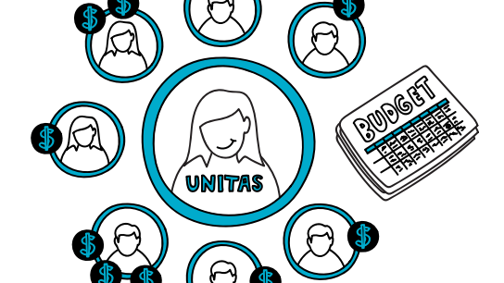
Discussion
What challenges and/or opportunities have you experienced with your budgeting approaches?
Notes:
Are any of you currently required to develop Project Charters in your projects?
I won’t be surprised if the project charter is not a part of your current systems. I’d like you to give it some serious thought as it could be one of the most important tools for improving your performance.
The Project Charter describes the project at a higher level – without a lot of detail. It is a summary document that is not supposed to long or complicated. Typically it will be in the 3-5 page range – the length and format are totally depending on the project, organizational requirements and management style. Despite what some of you may be thinking, the project charter is NOT the same as an grant award letter, an Memorandum of Agreement or Understanding (MoA or MoU).
Perhaps most importantly, it is a living document that will be updated to record changes as the implementation process continues.

Slide 159
Exercise

Slide 160
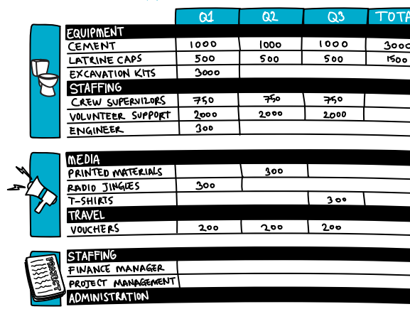
Activity: Look at one of your project budgets
Is it activity based?
How could you make it more accurate?

Slide 161
Network Diagram
I want to
plan a project
by accurately estimating how long activities will take

Slide 162
steps in the schedule planning process:
Activity Definition –Comprehensively identifying the activities that need to be performed to produce the project deliverables.
Activity Sequencing – Identifying the relationships that exist among the various schedule activities.
Activity Resource Estimating – Allocating the type and quantity of resources available/required to perform each schedule activity.
Activity Duration Estimating – Estimating the time required to complete project activities.
Schedule Development – Creating a project schedule based on activities, sequences, durations, resources and schedule constraints.

Slide 163
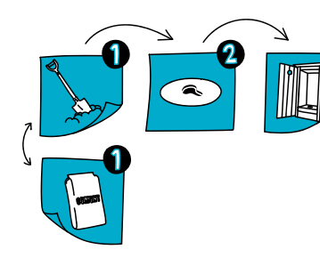
What is it and why should I use it?
A network diagram is a graphical tool to help you decide the sequence of tasks.
You can see which tasks go first, which come second, which can be done in parallel – and which tasks must be finished before another task can begin.

Slide 164
Exercise

Slide 165
Practice: Complete this Network Diagram by placing the tasks in the correct spaces
Dig Hole
Train
Community
start
START
END
Build Latrine Slab/Cap
Train WASH Committee
Install Latrine Slab/Cap
Quality Audit
Build Structure

Slide 166
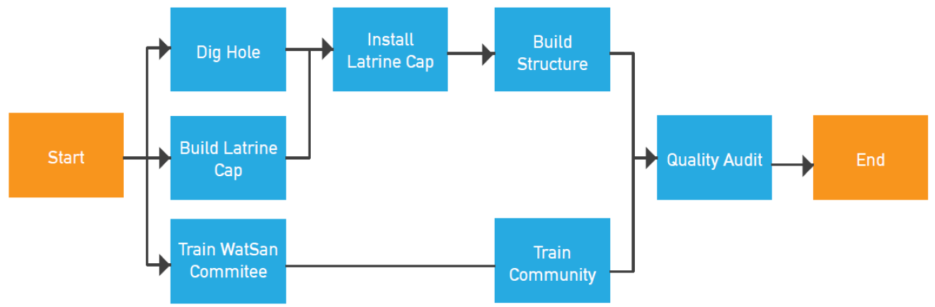

Slide 167
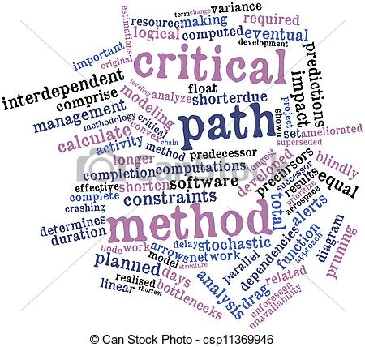
DETERMINE THE CRITICAL PATH

Slide 168
THE CRITICAL PATH
Once the network diagram is completed, it is time to find out how long the project will take.
This is the critical path:
It is the longest duration path through the network
It indicates the shortest time needed to complete
the project
Activities on this path usually have no float

Slide 169

FIND THE CRITICAL PATH
9
4
2
7
E
G
H
C
4
D
8
4
End
Start
F
B
3
A

Slide 170
Exercise

Slide 171
Network Diagram with Critical Path
Source: Project DPro Guide

Slide 172
Sequence Activities Process: Precedence Relationships
Finish-to-Start
(most common)
Finish-to-Finish
Start-to-Start
Start-to-Finish
(rarely used)
A
B
Design
Construction
A
Testing
B
Documentation
A
Design (IT)
B
Coding
A
Flusher Blinks
B
Fuel Finishes
R U L E
Activity (A) should __________, before activity (B) can __________.

Slide 173
Sequence Activities Process: Types Of Dependencies
AKA: logical relationships
A dependency between two project schedule activities, or between a project schedule activity and a schedule milestone.
  Mandatory dependencies: hard logic or hard dependencies.
  ex:
  Discretionary dependencies: preferred logic or soft logic.
  ex:
  External dependencies: are external to the project.
  ex:
  Internal dependencies: are internal, usually resource related.
  ex:

Slide 174
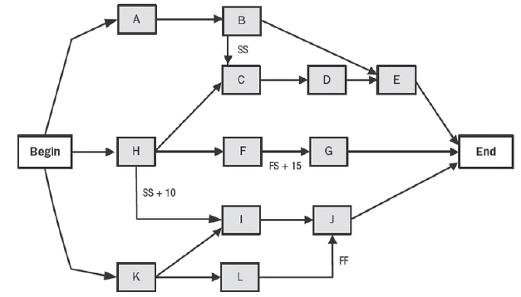
6.3 Sequence Activities Process
Precedence Diagramming Method PDM:
  A technique used for constructing a schedule model in which activities are represented by nodes and are graphically linked by one or more logical relationships to show the sequence in which the activities are to be performed.
Aka: Activity on Node PDM = AoN.

Slide 175
6.3 Sequence Activities Process
Lag:
  The amount of time whereby a successor activity is required to be delayed with respect to predecessor activity.
Lead
  The amount of time whereby a successor activity can be advanced with respect to predecessor activity.
A
B
C
A
B
Lag time (-ve)
C
A
B
C
A
B
Lead time (+ve)
C

Slide 176
Slack OR Float
Free float
1 day
A
B
  Free Float (FF) OR Slack: the amount of time that a schedule activity can be delayed without delaying the early start of any successor or violating a schedule constraint.
  Total Float (TF): the total amount of time that a schedule activity can be delayed or extended from its early start date without delaying the project finish date, or violating a schedule constraint.
  Free Float = LS – ES OR
  LF – EF.
  LS: late start, ES: early start, LF: late finish and EF: early finish.
C
A
B
1 day
C
2 days
A
B
X
A
B
1 day
X
Total float
1 day

Slide 177
The Forward and Backward Passes
Forward Pass:
  A critical path method
  technique for calculating
  the early start and early finish dates by working forward through the schedule model from the project start date or a given point in time.
Backward Pass:
  A critical path method technique for calculating the late start and late finish dates by working back-ward through the schedule model from the project end date.
F
A
B
C
D
E
G
H
F
A
B
C
D
E
G
H

Slide 178
The Critical Path
The Critical Path:
  The sequence of activities that represents the longest path through a project, which determines the shortest possible duration a project.
The Critical Path Method – CPM:
  A method used to estimate the minimum project duration and determine the amount of schedule flexibility on the logical network paths within the schedule model.
F
A
B
C
D
E
G
H

Slide 179
Network Diagram Exercise 1
Draw the network diagram.
What is the critical path?
What is the project duration?
Activity | Predecessors | Duration
A | None | 2
B | A | 5
C | B | 6
D | C | 4
E | A | 5
F | E | 7
G | D, F, J | 4
H | G | 4
I | E | 1
J | I | 5
K | H | 0

Slide 180
End of day 9

Slide 181
Factors for estimating resources
Time – If there is a very tight timeframe, the project may choose to dedicate high levels of staff, materials and capital equipment to meet time constraints.
Budget – If money is in short supply, the project might choose to invest in a ‘low cost’ resource mix.
Regulations and Organizational Policies – Often projects are constrained by labor laws and/or internal organizational policies that limit work schedules (hours per day, days per week, holidays per year, family leave policies).
Other Factors that Influence Resource Availability –
Weather Constraints impede an agricultural project where community participation is impossible during harvest season.
Material Constraints impede a housing project which requires scarce construction materials, making it necessary to adopt an alternative strategy that is more time consuming.
Logistics Constraints impede an emergency relief project from accessing transport, extending the time required to fill food warehouses.
Human Resources Constraints impede a health project from accessing qualified labor, extending duration estimates for technically complex activities.

Slide 182
Exercise

Slide 183
Gantt Chart
I want to
plan a project
by developing a project schedule

Slide 184
Resource and Duration Estimation
Network diagram
Critical path
Gantt chart

Slide 185
What is it and why should I use it?
A Gantt Chart is a graphic tool that shows the start and end of tasks/activities and of the project.
It uses and reflects the other planning tools and processes – WBS, Network Diagram and Critical Path.
It maps your network diagram onto a calendar and reflects the project schedule.
The goal is to have a realistic project schedule.

Slide 186
Think about the following:
Which issues and circumstances delay your schedules?
What can you do to make them more realistic?

Slide 187
Which issues and circumstances delay your schedules?
Holidays
Recruitment
Staff being sick
Logistics (lead in times)
Elections
Unstable environments
Rainy season
Maternity leave
Things you forgot to plan
What can you do to make schedules more realistic?
Plan them together with others
Remember what went wrong/changed last time
Consult with others
Use scheduling tools – such as Gantt Charts

Slide 188
This is a simple example of a Gantt Chart
Notes:
Check they all know what a Gantt chart is and what it looks like.
If not you can quickly explain on a piece of flipchart paper.
Gantt charts provide a standard format for displaying all of the project activities, taken from the network diagram and show start and end dates as well as dependencies.. There are some common rules in the use of Gantt charts: clear or open bars may represent planned work, whereas closed or shaded bars represent completed work – reflecting actual progress compared to planned progress. Some common terms used in Gantt charts are: milestones – markers that indicate completion, or partial completion, of products or services; and summary tasks – a series of combined sub task.

Slide 189
Exercise

Slide 190
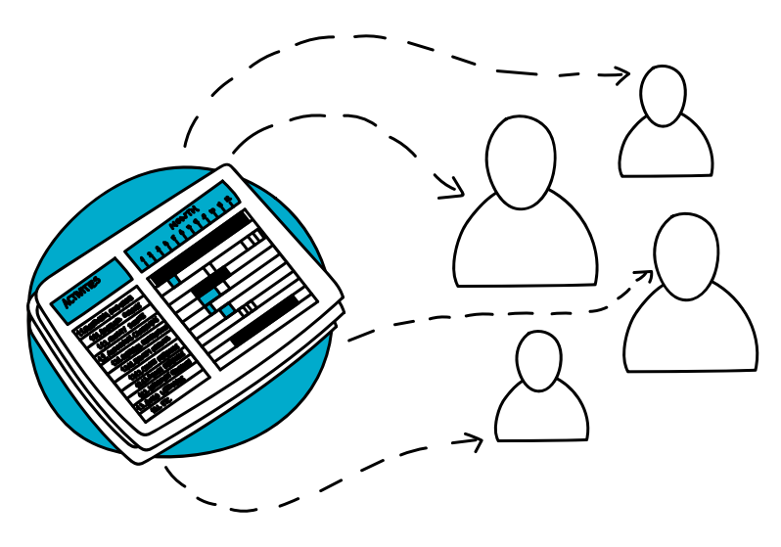
Gantt your project:
Take your WBS, Network Diagram and Critical Path.
Map these onto a calendar.
Remember to make the schedule realistic!

Slide 191
Risk Register
I want to plan a project
by managing risks to its success

Slide 192
Risk Management
Risk is the potential effect of uncertainty on project objectives.
Probability – Risk can be seen as relating to the probability of uncertain future events (as compared to issues which deal with current ones that must be immediately addressed).
Impact – Risk has the potential to impact the project. Most project teams focus on negative risk that has the potential to harm the project (time/calendar, cost/resources, quality, scope, etc.) In general, negative risks are to be avoided.
Positive risk, on the other hand, is less widely acknowledged and understood.
Project teams can assume positive risks if they see a potential opportunity, along with a potential for failure. This is referred to as intelligent risk taking.

Slide 193
Risks are managed through a four-step process:
Risk identification - identifying and documenting all the risks that can affect the project.
Risk assessment - determining the probability that risks will occur and estimating their potential impact, and prioritizing risks.
Risk response planning - deciding what actions are needed to reduce or remove threats, particularly those with high-probability and high-impact.
Risk monitoring and control - responding to risks as they occur and ensuring proper risk management procedures are being followed.

Slide 194
Examples of risks
Political action or interference
Natural disasters
Misallocation of resources
Currency fluctuations
Changing donor mandates or policies
Social unrest
Low staff retention
Lack of necessary skills & expertise
Low capacities/ motivations of participants and/or community partners
Notes:
Did you brainstorm most of the risks that are mentioned on this slide? Raise your hand if you see something on this slide that did not come up during the previous exercise.

Slide 195
categories of project risk
Strategic/commercial
  Failure of suppliers to meet contractual commitments
  Fraud/theft
  Implementing Partners failing to deliver the desired outcome
Economic/financial/market
  Exchange rate fluctuation
  Interest rate instability
  Inflation
  Market developments adversely affect plans.
Legal and regulatory
  New or changed legislation invalidates project assumptions
  Failure to obtain appropriate approval (e.g. planning, consent)
  Unsatisfactory contractual arrangements
Technical/operational/infrastructure
  Inadequate design
  Scope creep & Unclear expectations
Environmental
  Natural disasters & Sudden changes in weather patterns
Organizational/management/human factors
  Poor leadership
  Inadequate authority of key personnel to fulfill roles
  Poor staff selection procedures
  Lack of clarity over roles and responsibilities
  Personality clashes & Lack of operational support
Political
  Change of government or government policies
  War and disorder
  Adverse public opinion/media intervention
  Interference by politicians in development decisions
Project Management Risk
  Lack of planning, risk analysis, contingencies
  Inadequate tracking and control response
  Unrealistic schedules & Poorly managed logistics
  Delays in the approval of project documents

Slide 196
Identify Specific Risks from the Categories
Once general risk categories are identified, the project team should collaborate with key stakeholders to identify specific risks from each of the risk categories.
At a minimum, the team and key stakeholders should start by examining the project-specific and programmatic documents.
Numerous techniques are available to facilitate risk. These include brainstorming, focus groups, scenario planning, and expert interviews.
Three factors :
The cause, or the origin of the risk;
The risk event or situation itself;
The impact of the risk on the project.

Slide 197
Risk Assessment
Risk assessment is the process of quantifying the risks documented in the risk identification stage
  Prioritizing Risks: Using criteria agreed upon by the project team and key stakeholders, risks are ranked according to their probability and impact.
  Identifying Risk Tolerances: Next, the project team needs to work with key stakeholders to identify their risk tolerance levels to identify which risks are acceptable, and which fall outside of acceptable tolerance levels and need to be actively managed

Slide 198
Exercise

Slide 199
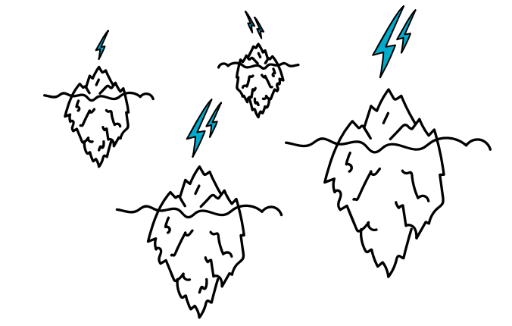
What are the main risks in your projects?
Activity:
Notes:
Our next topic is another of critical importance during the set up phase, but also equally important throughout the whole Project DPro phase model. It is risk. As was said earlier, it is impossible to avoid risk. It is everywhere. Read the quote on the slide.
Reflect on your own experience in project management and describe some of your experiences with risk. Be prepared to share the results of your reflection.

Slide 200
Risk Response Strategies
Avoidance
Do not do (or do in a different way)
Transference
Shifting (or sharing) the risk for some aspect of the project
Mitigation
Acting to reduce the probability and/or impact
Acceptance
Deciding to live with the risk
Notes:
Work through the risk strategies asking the participants what they think is meant by each one and then revealing the definitions.
Once identified, risks should be managed using a combination of the following strategies:
Risk Avoidance means ‘do not do’ (or do in a different way) some portion of the scope that carries high-impact and/or a high probability of risk – if project objectives can still be accomplished. An example is: changing locations if a certain area has problems; or reducing the number of delivered items, such as latrines, if the project is short of building materials.
Risk Transference means shifting the risk (or sharing the risk) for some aspect of project to another party through a contract, insurance or other means. An example is: sub-contracting logistics contracts in an insecure area to private vendors who have more knowledge and experience of the area.
Risk Mitigation means taking specific actions to reduce the probability and/or impact of a potential risk. An example is: instituting a security system that prevents unauthorized access to project building material storage areas.
Risk Acceptance means if a risk is assessed as reasonable, an organization can choose to not take action right now and commit to monitoring the situation to see whether probability and impact remain acceptable. An example is: a community may acknowledge that they face a risk of seasonal mudslides, but choose to live with the probability and consequences of a mudslide rather than attempt to avoid, transfer, or mitigate them.

Slide 201
Exercise

Slide 202
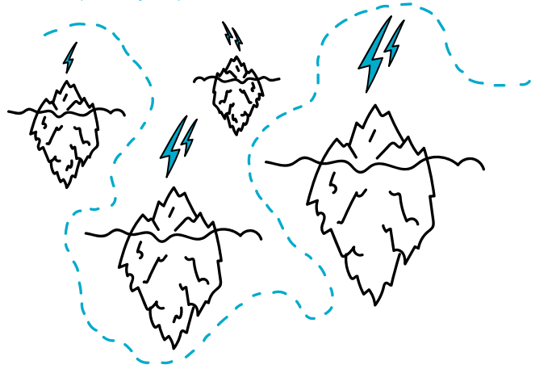

Think of examples of the risk response strategies from your projects.
Activity:
Notes:
Our next topic is another of critical importance during the set up phase, but also equally important throughout the whole Project DPro phase model. It is risk. As was said earlier, it is impossible to avoid risk. It is everywhere. Read the quote on the slide.
Reflect on your own experience in project management and describe some of your experiences with risk. Be prepared to share the results of your reflection.

Slide 203
Example of a Risk Register
Notes:
Once classified, then each risk must be analyzed and prioritized.
There are two key questions to analyze for each risk you identify. 1. What is the probability of the risk actually happening? And 2. What would be the impact of the risk on the project if it did happen?
Based on an assessment of the probability and impact of each identified risk, the project team should prioritize the risks. Ranking is an essential step because you are not likely to have the resources to prepare for every risk and because some potential events are too low in priority to justify planning.
This slide shows a matrix of a combination of risk probability and impact. The cell with the large red X represents the most dangerous combination – high probability and severe impact. The cell with the green x is the lowest potential impact risk combination. You will see on the coming slides that risk impact and probability may also be quantified to add another dimension of measurement that might enhance risk management.

Slide 204
Risk Monitoring and Control
Continually monitor risks to identify any change in their status, or if they turn into an issue.
It is best to hold regular risk reviews to identify actions outstanding, risk probability and impact, remove risks that have passed, and identify new risks.
It is recommended that the risk register be established as early in the life of the project as possible
Regularly scheduled project risk reviews can be used to ensure that project risk is an agenda item at all project management meetings.
If unanticipated risks emerge or a risk's impact is greater than expected, the planned response or risk allocation may not be adequate

Slide 205
Exercise

Slide 206
Complete a risk register for one of your projects.
Risk Description | Probability | Impact | Total | Owner | Actions
End of day 10

Slide 207
Closure Planning
Comprehensive project plans need to include a project closure plan that describes how a project intends to evolve upon completion of the project.
A closure plan may include several scenarios or contingencies that address risks and may also allocate additional resources when it may not be possible to exit entirely and include the specific actions that need to be taken to ensure that the project closure process is as efficient and compliant as possible.
  Evaluations: The type, timeframe, and resources for conducting evaluations.
  Reporting Requirements: When and in what format will reports need to be provided, including financial and narrative reports.
  Closure Activities: Contractual, financial, and administrative activities that ensure that all project elements have been conducted.
  Handover Activities: If the project is being handed over to another international NGO or local organization or entity, ensuring sufficient time and resources throughout the project to ensure an efficient handover

Slide 208
I want to
Implement / Manage a project

Slide 209
Project Implementation
Managing
issues
Managing
people
Managing
the supply chain
Managing
internal controls

Slide 210
Key Outputs
Issue Log
Monitoring Reports
Evaluations
Narrative and Financial Reports
Stage Plans
Updated Risk Plan

Slide 211
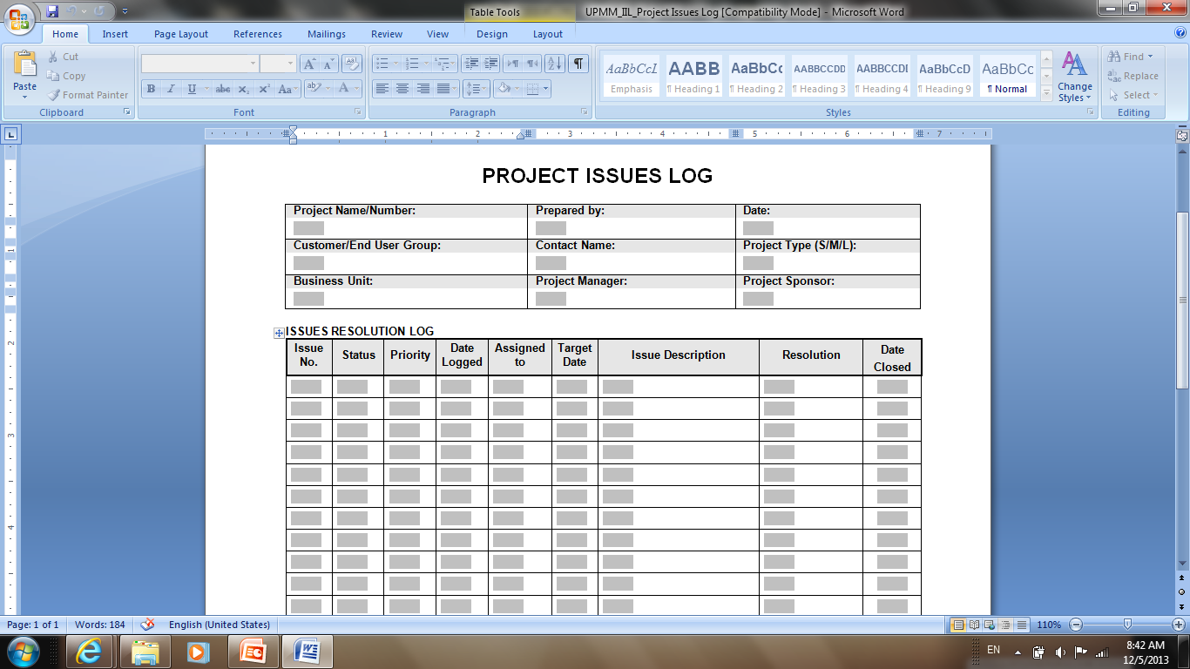
The Issue Log
A project document used to document and monitor elements under discussion or in dispute between project stakeholders.

Slide 212
Key Inputs
Comprehensive Risk Plan
MEAL Plan
Human Resource and Management Plan
Stakeholder Engagement and Communications Plan
Any other subsidiary plans that will be useful

Slide 213
RACI Diagram
Responsible, Accountable, Consulted, Informed
I want to
implement a project
by clarifying the roles of stakeholders

Slide 214
Human Resources Management
Human resource management is both an art and a science.
The art of human resources management depends on the interpersonal and leadership skills of the Project Manager.
Can the project manager motivate stakeholders? Inspire confidence? Manage conflict? Build team morale? The science of human resources management depends on effective planning.
Human resources planning is an integral element of a comprehensive project implementation plan.
The project’s human resource management plan identifies the activities and resources required to manage the project team.

Slide 215
Components of human resources management
Acquiring Project Staff – As part of the function of managing the team, the project team leader must be clear on the systems for identifying staff candidates, interviewing candidates, identifying selection criteria and making final selections of project staff.
Identifying Project Staff Assignments – Project staff assignments are the list of project duties, roles and responsibilities for team members. Staff assignments are often used during the monitoring and controlling process to evaluate individual team members.
Documenting Project Organization Charts – Project charts represent the reporting relationships among the project team.
Developing Project Staff – What skills are needed? What are the training needs? Are there certification requirements? What are the compliance issues?
Conducting Performance Assessments – Performance assessments are the documented formal or informal assessment of the project team members’ performance. After analyzing the information, Project Managers can identify and resolve problems, reduce conflicts, and improve overall team work.
Promoting a Highly Productive Team Environment – As the leader of the project team, the Project Manager must actively work to identify issues and conflicts and work creatively to resolve these issues.

Slide 216
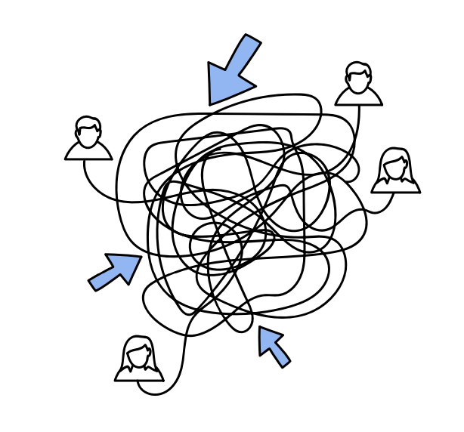
What is it and why should I use it?
Responsible, Accountable, Consulted, and Informed
RACI diagrams are a simple matrix that enables you to identify WHO needs to be involved at different stages and HOW they are involved.

Slide 217
Exercise

Slide 218
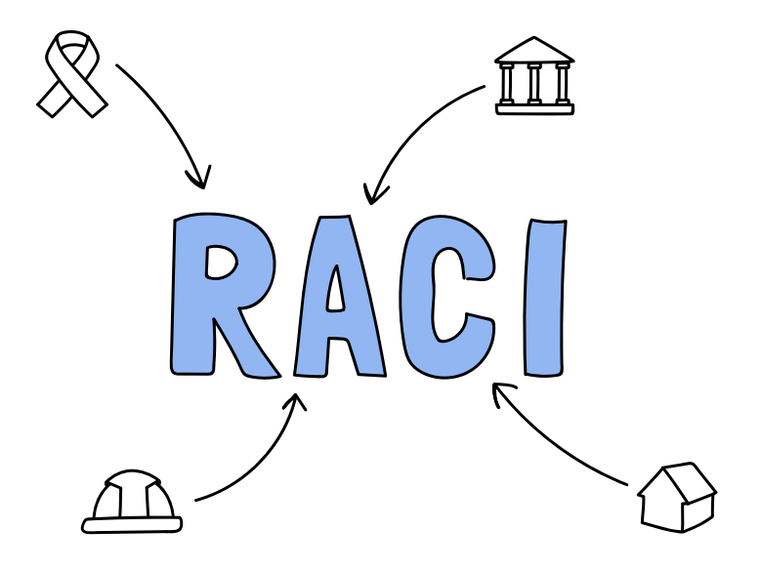
Discuss
In your projects, how do you decide:
Who do they need to consult?
Who is going to do what task?
Who will make sure the task has been done properly?
Who needs to be informed when the task has been completed?

Slide 219
RACI Matrix
Responsible
The person in charge of performing a task
Accountable
Person who must make sure the task is done completely (might be the same as responsible)
Consulted
2-way communication with people who are expected to provide input and opinions
Informed
1-way communication to people who should be notified and kept informed
Task 1
Task 2
Task 3
Task 4
Task 5
Notes:
How do people know what they are supposed to be doing
A tool that we have already mentioned, the RACI, can be especially helpful when identifying and monitoring the roles and responsibilities of stakeholders involved in project planning and implementation. By mapping out the role of key stakeholders in the project, the project team can communicate expectations and establish the scope of engagement of different groups. RACI is also very useful for monitoring the actual roles during implementation. Within the RACI matrix, each of the letters form an acronym that is interpreted as follows: Responsible [R] – This is the person responsible for performing a task. Bear in mind the adage that when nobody is responsible for getting something done, then nothing gets done. Also, a similar situation can occur when too many people are potentially responsible with little to no coordination and oversight to ensure that the task is completed. Another issue to consider is when a person has lots of “R’s”. Are they doing too much? Accountable [A] – This is the person who is held accountable for the task being complete. In general, one person should be accountable for a task being performed. In some projects, especially those with smaller and less complex tasks, the same person may serve in both the Accountable and Responsible roles. Consulted [C] – This is two-way communication -- people whose input is sought and factored as part of the action related to the activity. As the number of parties consulted increases, the speed with which action can be taken decreases. Conversely, too few and improper decisions may be made. One of the challenges of the project team is to ensure that only those who need to be consulted should be included in that column. While many stakeholders believe that they should be in the consulted column, in practice it is preferable to carefully manage those that must be in that column and place the others in the informed column when possible. Informed [I] – This is normally one-way communication -- parties who are notified. If the correct parties aren’t informed in some situations, then incidents can arise from groups wondering what changed. At the same time, if there are lots of people being informed, is it necessary?

Slide 220
Exercise

Slide 221
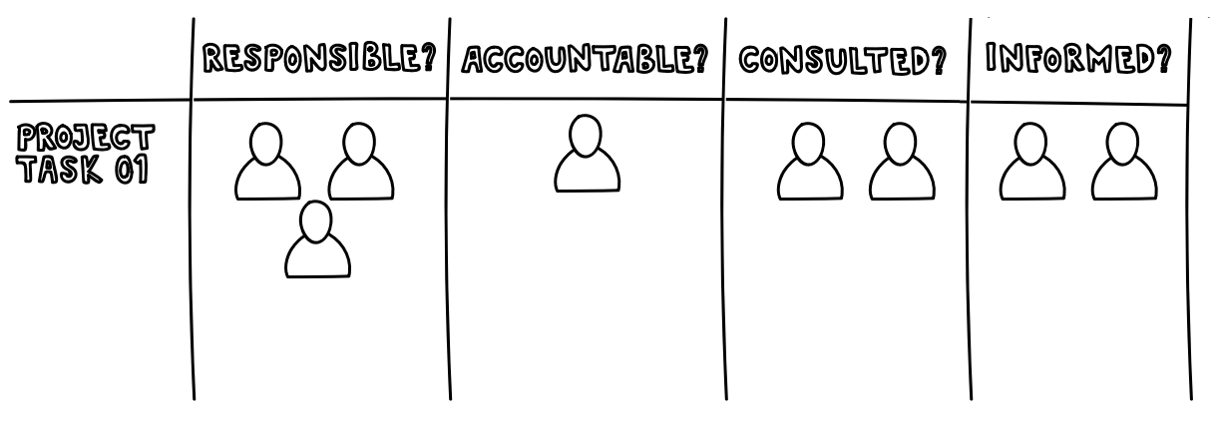
Activity:
Prepare a RACI matrix for one of your projects.

Slide 222
Issue Logs
I want to
implement a project
by identifying, tracking and resolving issues

Slide 223
What is an issue?
An issue is an unresolved decision, situation or problem that will significantly impact the project and that the project team cannot immediately resolve.
Issues management consists of having a process for identifying these problems and managing them until they are resolved. Resolving issues is frequently beyond the authority of the team.
However, even if an issue needs to be escalated to the next level or delegated to another person to resolve, it still needs to be tracked by the project manager.

Slide 224
Collaborative Issue Management
Identifying issues
Resolving issues “on site” whenever possible
Escalating complex issues to the project manager

Slide 225
Managing Issues Process
Issue Identification and Tracking – Identifying outstanding questions, decisions and other problems before they adversely affect the project.
2. Issue Analysis – Understanding the issue sufficiently to consider future consequences of action plans designed to resolve it.
3. Issue Communication – Communicating issues to the right level of the organization to get them resolved. Furthermore, it is important to communicate when and how issues are resolved.
4. Issue Control – The project manager is responsible for establishing an environment where the project team and implementing partners can carry out actions to ensure issues are resolved in a timely and effective manner.

Slide 226
Issue Log

Slide 227
Stakeholder Communications
Status reports
Meetings
Event-driven communications
Critical issues sessions
Training schedules
Roll-out schedules

Slide 228
Monitoring, Evaluation, Accountability, and Learning (MEAL)
During implementation, a substantial amount of monitoring, accountability, and learning will be completed.
The frequency of evaluation will depend on the length of the project, requirements from donors, and complexity of the project.
The MEAL activities during implementation are vital to maintaining and managing the triple constraint triangle.
The project manager needs to work closely with the MEAL team (or focal point) to provide timely and relevant information on the progress of the project as well as incorporate mechanisms that will give stakeholders the opportunity to provide feedback and ensure there are intentional learning processes included into the project

Slide 229
MEAL Six Essential Elements

Slide 230

supply chain management

Slide 231
The Project DPro defines three components in supply chain management:
Procurement Management – including the identification of what materials and services are needed, when they needed, and identifying how it will be acquired and by whom. The procured plan also needs to be integrated with all of the other elements of the project plan to ensure that all procurement decisions are aligned with the project’s budget, calendar, quality and risk parameters.
Logistics Management – including planning, implementing and controlling the efficient, cost-effective flow and storage of raw materials, in-process inventory, finished goods and related information from point of origin to point of consumption for the purpose of conforming to customer requirements.
Asset Management – including the systems whereby things that are of value to a project are monitored, maintained and disposed.

Slide 232
Managing the Supply Chain:
Procurement Management
Procurement planning
Identification of providers
Estimates (price is primary evaluation criteria)
Proposals (complex evaluation criteria) RFP, IFB, RFQ
Selection, negotiation, and award
Defining the items you need to procure;
Defining the process for acquiring those items;
Scheduling the timeframes for delivery
provider selection will be based on a combination of financial and technical considerations.

Slide 233
Managing the Supply Chain:
Logistics Management
Inventory management and Warehousing
Connected to project needs
Minimum stock for lead time
Warehousing
Materials transport
Timely and Cost effective
Appropriate policies are in place
A transport strategy not only depends on the needs of the project; it can also vary from situation to situation.

Slide 234
Managing the Supply Chain:
Assets management
Asset definition
Threshold Cost of $1,000 or more
Thee year life or more
Asset administration
Recording
Labeling
Monitoring
Safeguarding
Disposal
Projects should maintain complete and accurate records of all fixed asset acquisitions.
Project assets should be labeled to facilitate their oversight and control
Asset information should be updated on a regular basis to account for acquisition, adjustment, transfer and disposal information
Establish adequate controls are in place so that fixed assets are properly maintained and safeguarded. These controls will vary depending on the asset and the risk.
Clear processes for asset disposal should be established that include any requirements related to approvals, publicity, donor requirements, and reporting

Slide 235
Managing Internal Controls
Effectiveness and efficiency of operations
Reliability of project outcomes
Compliance with laws and regulations
Protection of physical and intangible assets
Reduce risk of fraud and corruption

Slide 236
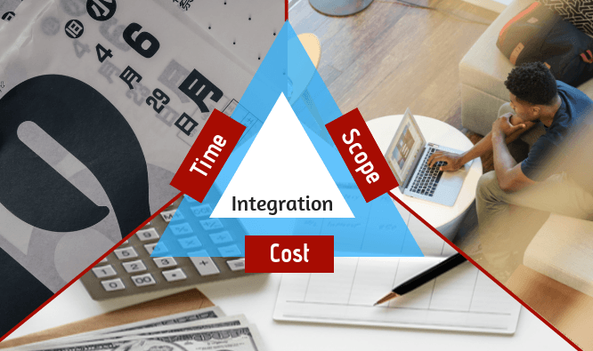
Earned Value Analysis
End of day 11

Slide 237
Earned Value Management – EVM
Earned Value is a best practice that builds upon other best practices, such as:
  Work Breakdown Structure
  Network Diagram
  Project Schedule
  Control Account Plans
  Establishing a Baseline
Earned Value shows cost and schedule efficiency.
Earned Value transcends PM methodologies.

Slide 238
Earned Value Management – EVM
A methodology that combines scope, schedule, and resource measurements to assess project performance and progress.
Measuring progress against baseline.
First released by the U.S. DoD in Dec 1967.
New Old
Acronym Acronym Old Term
PV BCWS Budgeted Cost of Work Scheduled
EV BCWP Budgeted Cost of Work Performed
AC ACWP Actual Cost of Work Performed

Slide 239
Earned Value Acronyms Table (1)
Acronym | Short for | Description | Notes
PV | Planned Value | The authorized budget assigned to scheduled work. | Already known / approved.
BAC aka PMB | Budget at Completion | The sum of all budgets established for the work to be performed. | Budget.
AC | Actual Cost | Total incurred costs. | Actual = Spent.
EV | Earned Value | Value of work performed. Based on % complete. | Incremental.
CV | Cost Variance | A measure of cost performance on a project. | CV = EV – AC
SV | Schedule Variance | A measure of schedule performance on a project. | SV = EV – PV
CPI | Cost Perf. Index | Cost efficiency indicator. | CPI = EV / AC
SPI | Schedule Perf. Index | Schedule efficiency indicator. | SPI = EV / PV

Slide 240
Earned Value Management – EVM
PV
Budget at Completion, BAC
CV=EV–AC
CUMULATIVE VALUES $
AC
SV=EV–PV
EV
Data Date
T I M E
Cost Variance – CV is measured against AC,
Schedule Variance – SV is measured against PV.

Slide 241
Earned Value Acronyms Table (2)
Acronym | Short for | Description | Notes
EAC | Estimate at Completion | Estimated total cost. | Referred to as the ‘latest revised estimate’.
ETC | Estimate to Complete | Expected cost needed to complete remaining works.
VAC | Variance at Completion | Above or below estimated budget
TCPI | To – Complete Performance Index. | Calculated projection of cost performance to be achieved on remaining works to meet a specified Goal. | Ratio of ‘remaining work to the ‘remaining funds’.

Slide 242
Earned Value Management – EVM
Progress at a certain point in time
Finished Work
VAC = BAC – EAC
EV earned
BAC = budget
PV known
AC spent
EAC
Start
ETC
Finish
Project timeline
EAC = AC + ETC
ETC = BAC – EV
EAC = AC + BAC – EV
EAC = AC + bottom-up ETC

Slide 243
Estimate at Completion
1. EAC = AC + ETC
original estimate was flawed.
2. EAC = AC + BAC – EV
variances are thought to be atypical of the future.
3. EAC = BAC / CPI
spending is at the same rate.
4. EAC = AC + BAC – EV
CPI variances are thought to be atypical of the future.
5. EAC = AC + BAC – EV
CPI X SPI when the schedule impacts the ETC. weighing the CPI & SPI (80/20,50/50)

Slide 244
The To–Complete Performance Index
Is the calculated projection of cost performance to be achieved on remaining works to meet a specified goal.
TCPI = BAC – EV
BAC – AC (or EAC – AC)
Presents work remaining
funds remaining

Slide 245
Exercise 1: The Fence Project
Each fence side takes 1day to build,
Each fence side costs $1,000
Today is the end of day 3.
Calculate EV and related variables
having the following information:
Assume the CPI to remain the
same till the project is finished.
 | Calculation | Answer
PV
EV
AC
BAC
CV
CPI
SV
SPI
EAC
ETC
VAC
Fence Side | Status (end of day 3)
Side 1 | done, spent $1,000
Side 2 | done, spent $1,200
Side 3 | 50% done, spent $600
Side 4 | not started yet

Slide 246
Exercise 2
Cost Performance Index – CPI and Schedule Performance Index – SPI can be charted monthly to show project trends.
Based on the chart, what
would you be more
concerned about:
Cost or Schedule?

Slide 247
Exercise 3
You have gathered the following cost measurements for your project:
EV = 120, AC = 115, PV = 135.
Which of the following statements is true?
  A. The project is ahead of schedule and costs are lower than planned.
  B. The project is behind schedule and costs are lower than planned.
  C. The project is behind schedule and costs are higher than planned.
  D. The project is ahead of schedule and costs are higher than planned.

Slide 248
Exercise 4
You have gathered the following cost measurements for your project:
EV = 120, AC = 115, PV = 135, ETC = 100.
What is the CPI and SPI respectively?
  A. CPI = .89 and SPI = 1.04
  B. CPI = .96 and SPI = 1.13
  C. CPI = 1.13 and SPI = .96
  D. CPI = 1.04 and SPI = .89

Slide 249
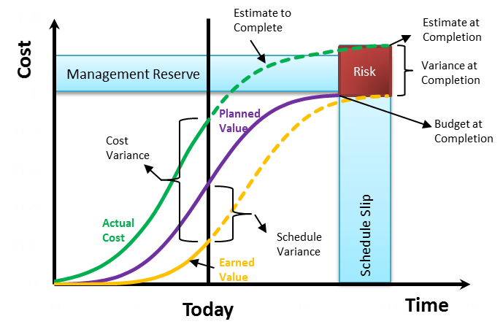
Earned Value Analysis

Slide 250
Results Combinations for Earned Value Analysis

Slide 251
EVA – Example – Planning

Slide 252
EVA – Example – Implementation

Slide 253
EVA – Example – Analysis
According to the schedule performance (SPI), the project is ahead of schedule: 18%.
According to the costs performance (CPI), the project is over budget: 7%.

Slide 254
Project Evaluation
It is the responsibility of the project to achieve its outcomes; however, it is not its responsibility to achieve the goals.
Outcomes are progress towards achieving the goals.

Slide 255
Project Evaluation:
Final Evaluation
Mandated by donor or organization
Specialized teams collect and analyze data
Evaluation questions
Did the project accomplish the desired outcomes?
Was the project relevant, effective, and efficient?
Are the project operations and impact sustainable?
Are the logical framework assumptions valid?

Slide 256
Project Evaluation: Mid-term Evaluation
Similar structure to final evaluation
Opportunity to improve efficiency and impact during project

Slide 257
Project Evaluation: x-post / Sustainable Impact Evaluation
Evaluate project impact at defined period after project completion
Evaluates extent of outcomes realized through participant ownership

Slide 258
integrated change control process that ensures that any project changes are:
a. managed through a formal change management process;
b. analyzed to ensure that implications of those changes are thoroughly thought through;
c. documented to illustrated their complete impact on all the integrated elements of the project
d. communicated to key project stakeholders.

Slide 259
Project Changes: Tolerances and Issue Escalation
Time Tolerance - the amount of time by which the project completion can be later or earlier than the planned date.
Cost Tolerance - the percentage, or a cash amount, by which the project can be over or under the planned budget.
Scope Tolerance - is measured as an agreed variation from the product description, and any potential variation should be documented in the product breakdown structure.
Risk Tolerance - provide a benchmark for which risks you should be escalating to the Project Board.
Quality Tolerance - ranges that define acceptable performance for a product, documented in the product descriptions.
Benefits Tolerance – ranges of acceptable performance of the project at the outcomes level.

Slide 260
Illustrative Process Map for a Project Change Request

Slide 261
iterative planning model
An initial project plan is established when the project is approved.
However, recognizing that the field reality of project implementation can/will vary over time, the details of the project plan are not set out until later.
Instead of establishing a single detailed implementation plan, the projects subscribe to a planning model that includes periodic updates of implementation plans.
In development projects, these periodic plans are usually made on a yearly basis and are called Annual Operating plans.
In an emergency response project, this time frame for updated plans might be significantly shorter.

Slide 262
Project Closure Checklist
I want to
close a project
by ensuring that all obligations have been met

Slide 263
Project Closure
Project closure scenarios
Administrative, financial, and contractual closure
Sustainability planning
Project evaluations
Project reporting
Lessons learned and after-action reviews

Slide 264
Key Inputs
Detailed Implementation and Stage Plan
MEAL Reports (including any lessons learned that have been documented during the project)
Narrative and Financial Reports
Issue Log
Updated Risk Register

Slide 265
Key Outputs
Sustainability Plan
Reports
Final Project Evaluation
Lessons Learned

Slide 266
End of Project Transition Scenarios

Slide 267
Sustainability plan checklist

Slide 268

Project Lessons Learned
I want to
Learn from a project
by ensuring that all lessons are registered

Slide 269
questions asked understand what was planned versus what actually happened:
After Action Review
What did we set out to do?
What did we achieve?
What went really well?
What could have gone better?
What can we learn from this project?

Slide 270
What can go wrong when you close a project?
What went well and why?
SUCESSES | HOW TO ENSURE SUCCESS IN FUTURE
What can be improved and how?
WHAT CAN BE IMPROVED? | RECOMMENDATIONS

Slide 271
Exercise

Slide 272
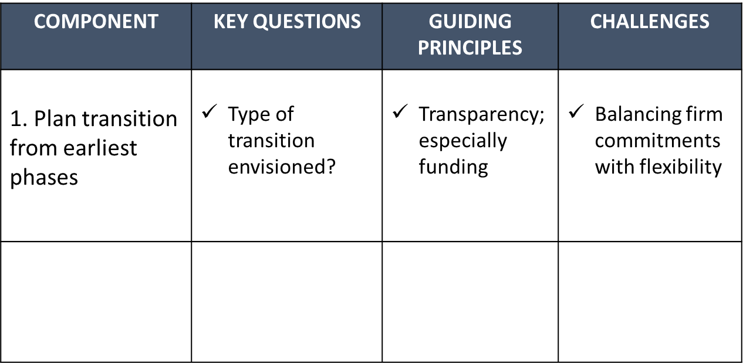
How could a matrix like this help you in the transition phase?

Slide 273
Stakeholder Meeting
Verify that scope has been accomplished
Verify that deliverables have been accepted
Ensure that stakeholders are satisfied
Technical aspects
Overall outcomes

Slide 274
verification of deliverables takes place in a two-step process.
The project implementation team meets to crosscheck work completed against the project implementation plan.
There may be, for example, activities that were delayed early in the project and never performed later.
Meet with the key stakeholders (donors, community groups) to:
Review accomplishments against the project plan, and then get their acceptance documented by some kind of formal acknowledgement or acceptance.
Make sure they are satisfied, not just with the technical aspects of the project, but also with the overall outcomes (this is often as much about perception as it is about the existence of outputs and achievement of outcomes).

Slide 275
Administration, Financial and Contractual Closure
Contract closure
Are all contracts closed out? Suppliers? Sub-contractors? Donors? Others? Implementing organizations?
Has the donor reviewed and accepted project deliverables?
Financial Closure
Has all permitted funding been received from the donor?
Have all receivables (project advances, travel advances, and advances to suppliers) been liquidated or transferred to another project number or accounting code?
Have all payables been paid?
Administrative Closure
Have project personnel been released or reassigned?
Have the project equipment, vehicles, offices been reallocated? Sold? Transferred?
Are project reports and closure documents complete?
Are project archives and/or files up to date?

Slide 276
Celebrate Accomplishments
Recognize team members
Recognize stakeholders
Express appreciation to key individuals and groups

Slide 277
Staff are leaving
No/poor documentation
Lessons do not get documented or learned
Assets are not handed over correctly
Funds can be withheld by donors due to not complying with donor rules
Audits can reveal management/financial issues that had not been picked up
Contracts are not closed appropriately
Money is unspent or unaccounted
What can go wrong when you close a project?

Slide 278
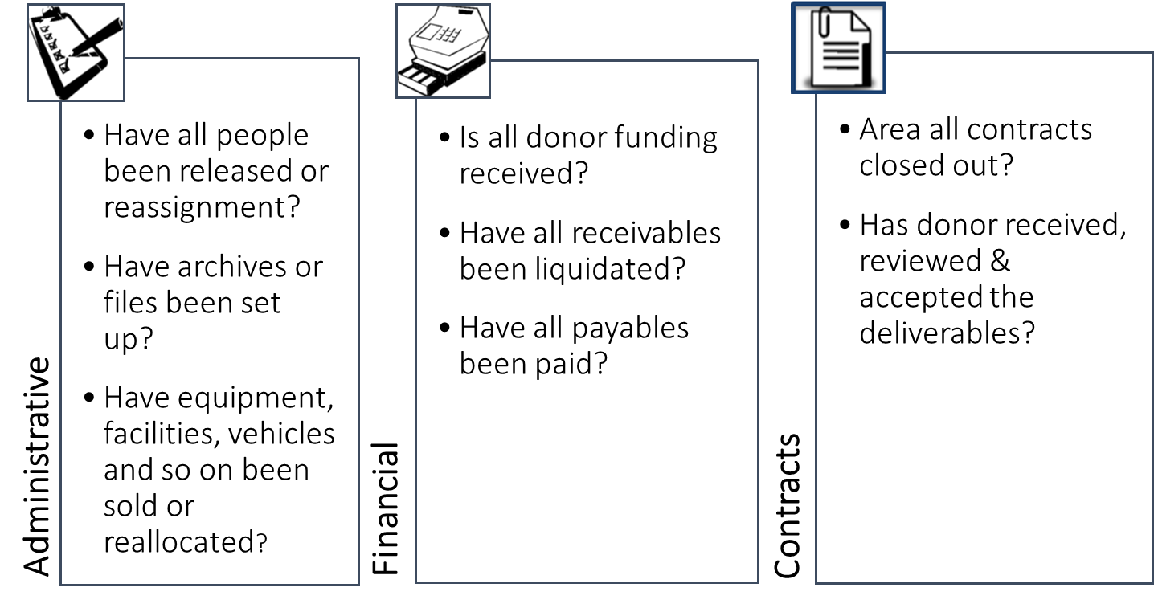
We need some structures/tools to help us manage these risks

Slide 279
Exercise

Slide 280

Activity:
Develop a checklist for closing your projects.
Notes:
What is the critical path in this example?
>> click to reveal
CP is:
The critical path is the series of tasks that determines the minimum amount time required to complete project activities. This sequence of tasks represents the longest path between the project’s start and its end
What is the critical path in the example? Ask participants to put numbers into chat. Answer: 25 days: 14+3+7+1
Ask participants how this would help their projects: answers: better planning, understand impact of changes/delays which tasks to concentrate on

Slide 281
ADAPTING THE PROJECT DPRO
Project Managers should engage with their organizations to discuss the following questions:
  Will a new tool compliment or replace an existing tool?
  How will information from a new tool fit into existing processes?
  Do we need to make changes to existing processes as a result of integrating a new tool or technique?
  Refer to Table 41: Example of Adapting Project Management Tools Page 186

Slide 282
Factors to Consider when Adapting the Project DPro
Program considerations
Systems Considerations
Size, Complexity and Risk Considerations
Learning and Competency Considerations
Performance Considerations

Slide 283





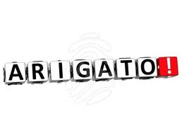




Slide 284


