Slide 1
NATIONAL BANK OF EGYPT JANUARY 2025

Slide 2
Round of introductions
Who is who?
What do you do ?
what do you wish to improve through this course?

Slide 3
Administrative matters
Our schedule
Sundays
Wednesdays
7.30 to 10 pm
Book is incompany units 1 to 5
Five weeks starting January 26h 2025

Slide 4
Grading
Assessment Tool Marks Session(s)
Assessment grade Timing (Session)
Quiz 1 20 4
Quiz 2 20 8
Oral Assessment 20 4
Final Presentation 20 9
Participation 10 1 to 10
Attendance 10 1 to 10

Slide 5
Unit 1: Business Networking
Do you travel for work?
Who do you talk to?

Slide 6
What does the word networking mean exactly?
Do you find it easy to network with complete strangers?

Slide 8
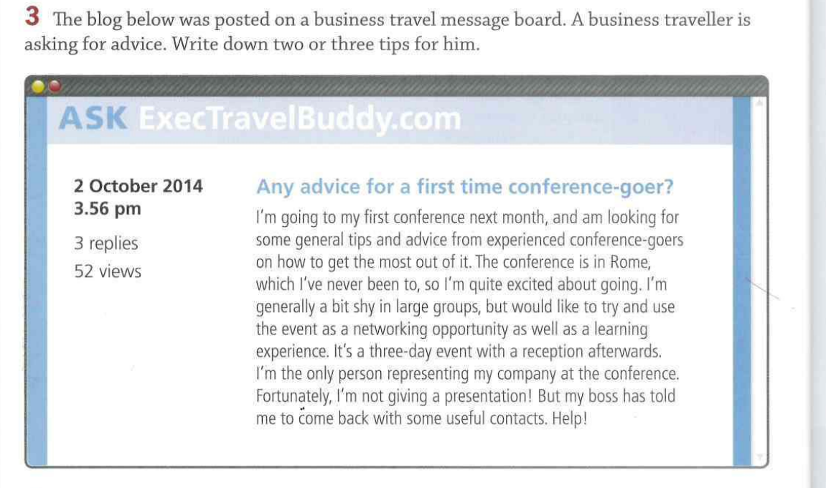

Slide 9
WHAT FACILITIES DO YOU SEARCH FOR WHEN TRAVELING ON BUSINESS?

Slide 11
LANGUAGE MATTERS!!!

Slide 12
How would you approach strangers at a networking event?
When someone asks you 'What do you do?', they're asking 'What's your job?'. You, for example, might answer 'I work for a bank.'
Someone may then ask for more information using one of these questions:
What do you do exactly?
What does that entail?
What are you responsible for?

Slide 13
You can give more information using the following expressions:
Basically, I am a Customer Service Representative.
I am responsible for customer accounts.
I take care of corporate accounts.
I usually answer customers' questions.
I mainly handle claims.
I’m a credit analyst.
So my question to you is - what exactly do you do at work?

Slide 14
Thank you for your great work today!!!
Happy week ahead inshAlla

