Slide 1
UNIT 2
PHONE CALLS IN ENGLISH

Slide 2


Slide 3
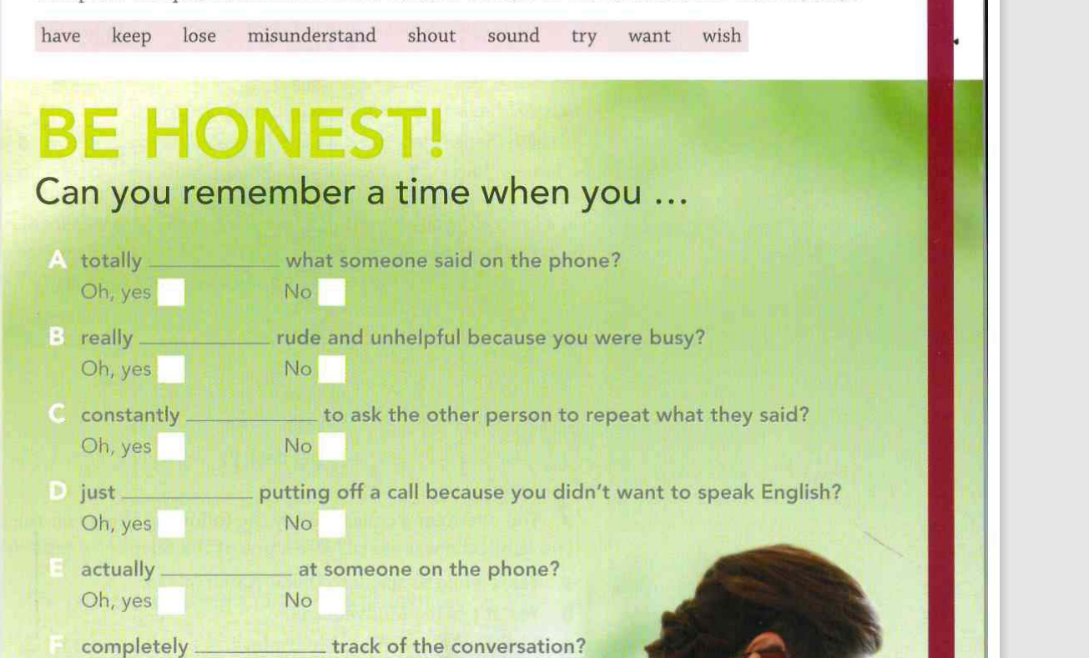

Slide 4
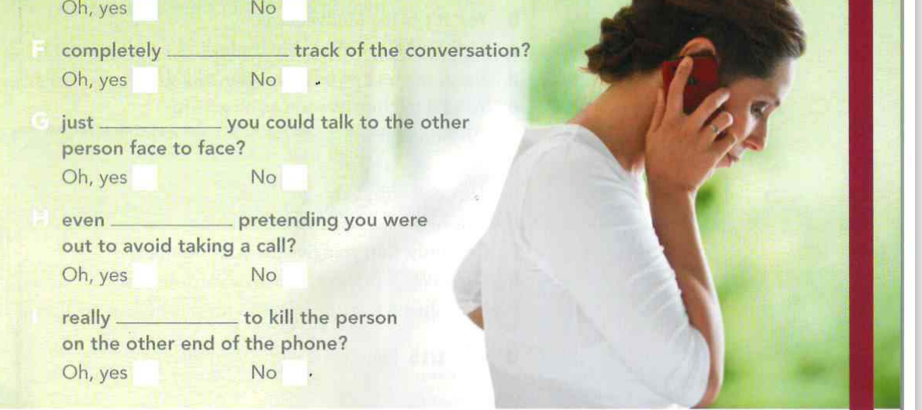

Slide 5
CREATING FULL EXPRESSIONS TO USE ON THE PHONE

Slide 6
