Slide 1
UNIT ONE CONT’ED

Slide 2
PREPOSITIONS AT WORK
WHAT ARE PREPOSITIONS?
https://academicguides.waldenu.edu/writingcenter/grammar/prepositions

Slide 3
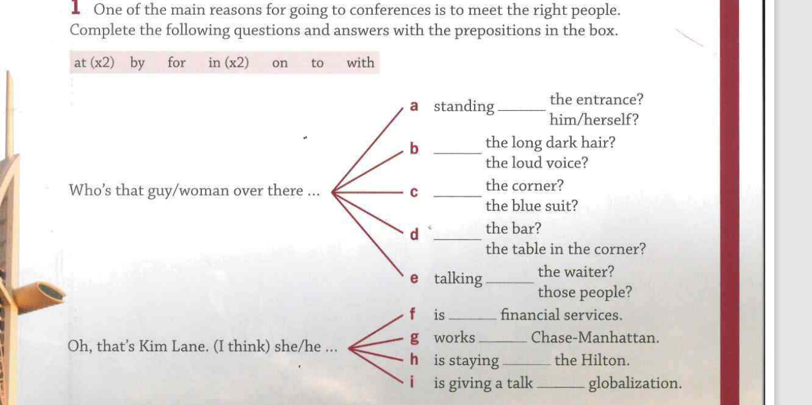

Slide 5
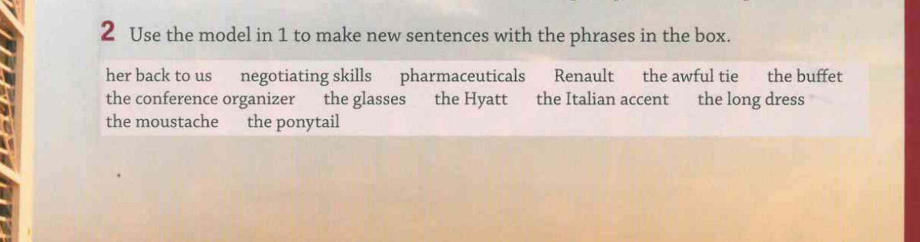

Slide 6
NETWORKING EXPRESSIONS

Slide 7
