Slide 1
Unit 1
Identity

Slide 3
Identity
Meaning: Identity refers to the characteristics, traits, and qualities that define who a person is and make them unique. It can include factors such as culture, personality, beliefs, gender, profession, and social roles.
Part of Speech: Noun
Example: "Her cultural identity is deeply connected to her family's traditions and values."

Slide 4
What aspects of your identity are most important to you, and why?
How has your identity changed as you’ve grown older?
How does your culture or family shape your sense of identity?
Do you think the way others see you matches how you see yourself? Why or why not?
Have you ever felt the need to change a part of your identity to fit in?
Can a person have multiple identities? How do they balance them?

Slide 5
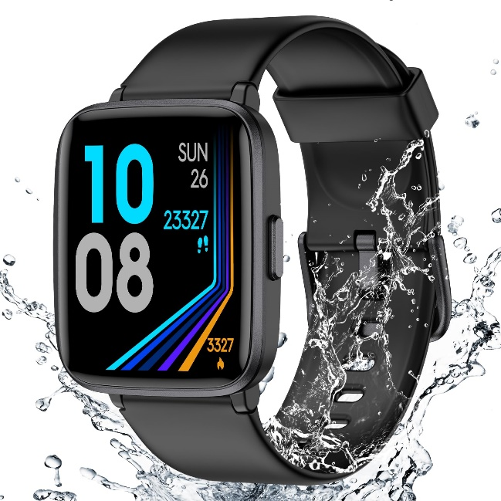
A gadget attached to your wrist
Meaning: A small device (like a smartwatch or fitness tracker) worn on your wrist for convenience or tracking purposes.
Part of Speech: Noun phrase.
Example: "He wore a gadget attached to his wrist to track his heart rate."

Slide 6
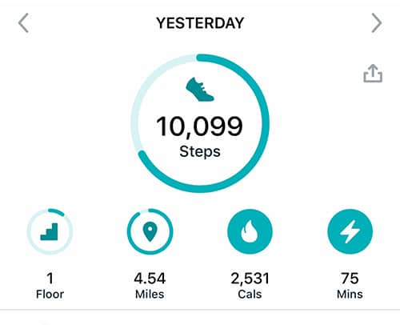
A fitness tracker
Meaning: A device used to monitor physical activities such as steps, heart rate, or sleep patterns.
Part of Speech: Noun.
Example: "My fitness tracker tells me how many steps I take daily."

Slide 7
Rhythms and pulses
Meaning: Patterns of beats or vibrations, often related to music or the body (like a heartbeat).
Part of Speech: Noun phrase.
Example: "The rhythms and pulses of the song made everyone want to dance."

Slide 8
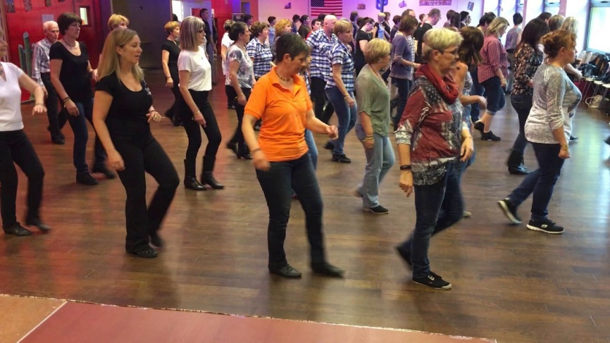
Upbeat music
Meaning: Music that is lively, happy, and energetic.
Part of Speech: Adjective + Noun.
Example: "The gym plays upbeat music to motivate people while exercising."

Slide 9
To feel alert
Meaning: To be awake, focused, and aware of your surroundings.
Part of Speech: Verb phrase.
Example: "After a good night’s sleep, I feel alert and ready to work."

Slide 10
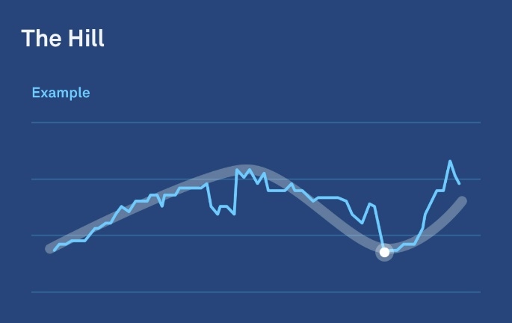
Bio-data
Meaning: Biological information, such as heart rate, sleep patterns, or activity levels.
Part of Speech: Noun.
Example: "The fitness tracker records my bio-data while I sleep."

Slide 11
‘Wearable’ technology
Meaning: Technology designed to be worn on the body, such as smartwatches or fitness trackers.
Part of Speech: Noun phrase.
Example: "Wearable technology helps people stay connected and monitor their health."

Slide 12
To be unique
Meaning: To be one of a kind or different from others.
Part of Speech: Verb phrase.
Example: "Her design was so creative that it made her business card unique."

Slide 13
What is a Noun Phrase?
A noun phrase is a group of words that acts like a noun in a sentence. It includes a noun (the main word) and any words that modify it, such as articles, adjectives, or other phrases.
Structure: Determiner/Adjective + Noun + Modifier (optional)
Examples:
Simple noun phrase: "The book"
"The" (determiner) + "book" (noun)
Expanded noun phrase: "The red book on the table"
"The" (determiner) + "red" (adjective) + "book" (noun) + "on the table" (modifier)

Slide 14
What is a Determiner?
A determiner is a word used before a noun to indicate its quantity, possession, definiteness, or specificity. It helps clarify which noun you are talking about.
Common Types of Determiners:
Articles: "a," "an," "the"
Example: The cat is sleeping.
Quantifiers: "some," "many," "few"
Example: Some people like chocolate.
Demonstratives: "this," "that," "these," "those"
Example: This book is interesting.
Possessives: "my," "your," "his," "her," etc.
Example: Her idea was amazing.

Slide 15
What is a Modifier?
A modifier is a word, phrase, or clause that adds detail or description to another word in the sentence. In the context of a noun or verb phrase, it describes or gives more information about the noun or verb.
Modifiers in Noun Phrases:
Words that describe the noun.
Examples:
Adjective: "The blue car is parked outside."
"blue" describes the car.
Prepositional phrase: "The book on the table is mine."
"on the table" gives additional detail about the book.
Modifiers in Verb Phrases:
Words or phrases that describe how, when, where, or to what extent the action is happening.
Examples:
Adverb: "He runs quickly every morning."
"quickly" modifies the verb "runs."
Prepositional phrase: "She works in the library."
"in the library" tells where she works.

Slide 16
In Summary
A determiner specifies or clarifies the noun (e.g., "the," "my," "some").
A modifier describes or gives more detail about the noun or verb.

Slide 17
What is a Verb Phrase?
A verb phrase is a group of words that includes the main verb and any auxiliary (helping) verbs, along with modifiers or objects.
Structure: Auxiliary Verb(s) + Main Verb + Object/Modifiers (optional)
Examples:
Simple verb phrase: "is running"
"is" (auxiliary verb) + "running" (main verb)
Expanded verb phrase: "has been studying hard"
"has been" (auxiliary verbs) + "studying" (main verb) + "hard" (modifier)

Slide 18
Concept
Meaning: An abstract idea or a general notion.
Part of Speech: Noun
Example: The concept of wearable technology is becoming more popular

Slide 19
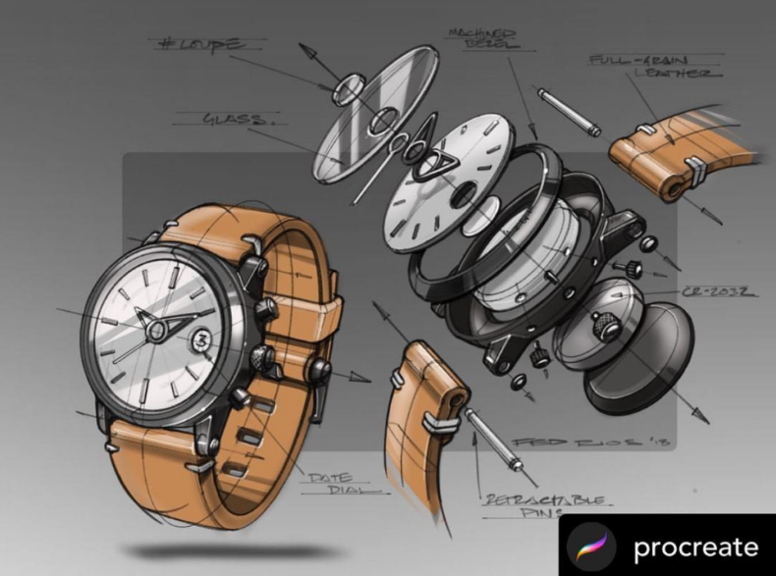
Prototypes
Meaning: The first or early versions of a product used to test a design or idea.
Part of Speech: Noun
Example: The engineers built several prototypes before finalizing the design

Slide 20
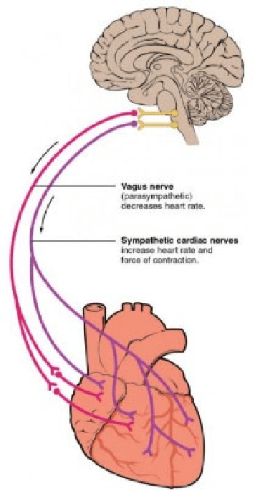
Psychological Mechanism
Meaning: A process or system in the brain or mind that explains behavior or responses.
Part of Speech: Noun phrase
Example: The device uses a psychological mechanism to amplify its effect.

Slide 21
Excite
Meaning: To make someone feel happy, enthusiastic, or energetic.
Part of Speech: Verb
Example: The upbeat rhythm can excite you and make you feel more energetic.

Slide 22
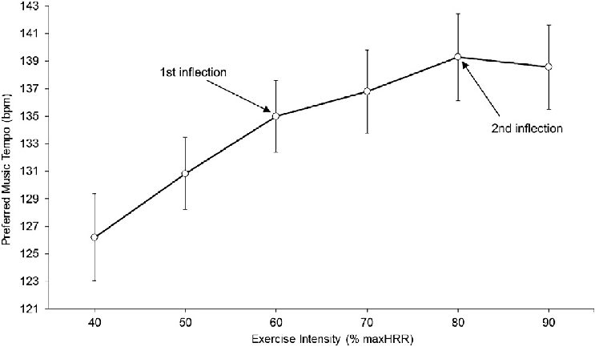
Tempo
Meaning: The speed or pace of a rhythm or activity.
Part of Speech: Noun
Example: The device adjusts the tempo to match your mood.

Slide 23
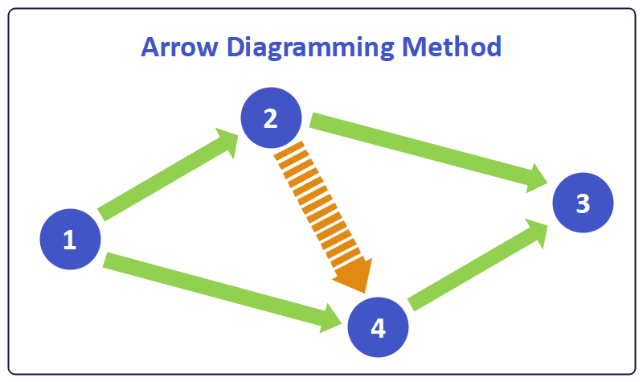
Approach
Meaning: A way or method of dealing with something.
Part of Speech: Noun
Example: The team used a smart approach to design the device.

Slide 24
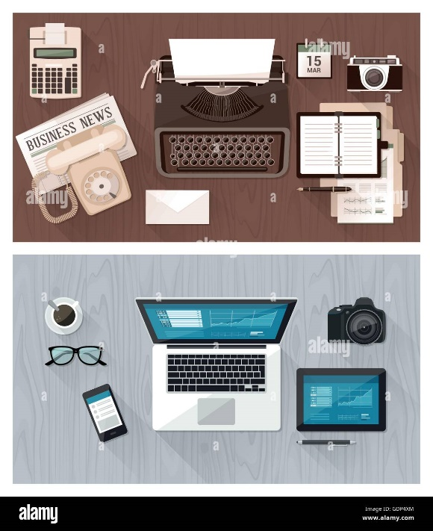
New Breed
Meaning: A new type or category of something.
Part of Speech: Noun phrase
Example: This is a new breed of wearable technology.

Slide 25
Geared
Meaning: Adjusted or designed for a specific purpose.
Part of Speech: Adjective
Example: The device is geared toward improving mood and energy levels.

Slide 26
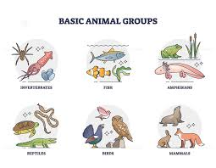
Categorize
Part of Speech: Verb
Meaning: To place something in a particular group or class.
Example: Scientists categorize animals into different groups based on their characteristics.

Slide 27
Confirmed
Part of Speech: Verb
Meaning: To state or show that something is true or correct.
Example: The weather forecast confirmed that it will rain tomorrow.

Slide 28
Consequences
Part of Speech: Noun
Meaning: Results or effects of an action or decision, especially negative ones.
Example: Ignoring your health can lead to serious consequences.

Slide 29
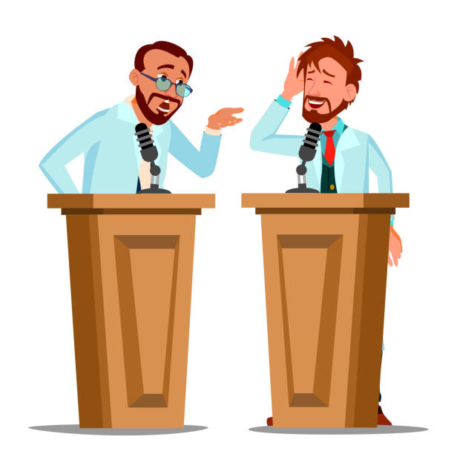
Debate
Part of Speech: Noun/Verb
Meaning: A formal discussion on a particular topic where opposing arguments are presented.
Example: The students had a debate about the benefits of online learning.

Slide 30
Define
Part of Speech: Verb
Meaning: To explain the meaning of a word or concept.
Example: The teacher asked the students to define the term "climate change."

Slide 31
Desirable
Part of Speech: Adjective
Meaning: Worth having or seeking; attractive or advantageous.
Example: A good work-life balance is a desirable goal for many people.

Slide 32
Mature
Part of Speech: Adjective/Verb
Meaning: Fully developed, either physically, mentally, or emotionally.
Example: She is very mature for her age and handles responsibilities well.

Slide 33
Tensions
Part of Speech: Noun
Meaning: Mental or emotional strain; stress or conflict between people.
Example: Tensions between the two teams were high before the final match.

Slide 34
Occupation
Part of Speech: Noun
Meaning: A person's job or profession.
Example: Her occupation as a teacher allows her to work with children every day.

Slide 35
Complex
Part of Speech: Adjective
Meaning: Made up of many different and connected parts; not simple.
Example: The instructions were too complex for the young child to follow.

Slide 36
Solidify
Part of Speech: Verb
Meaning: To make something stronger or more certain.
Example: They held weekly meetings to solidify their plans for the project.

Slide 37
Ascribed
Part of Speech: Adjective (or Verb when referring to the act of ascribing)
Meaning: Believed to be caused by or belonging to something.
Example: His success is often ascribed to his strong work ethic.

Slide 38
Ethnicity
Part of Speech: Noun
Meaning: The fact of belonging to a particular group with a shared culture, language, or nationality.
Example: The city is known for its diversity, with residents from many different ethnicities.

Slide 39
Affiliation
Part of Speech: Noun
Meaning: A connection or association with a group or organization.
Example: He has a strong affiliation with the university's alumni network.

Slide 40
Proficient
Part of Speech: Adjective
Meaning: Skilled or competent in doing something.
Example: She is proficient in both French and Spanish.

Slide 41
Rivalry
Part of Speech: Noun
Meaning: Competition or conflict between two opposing sides.
Example: The rivalry between the two schools has lasted for decades.

Slide 42
Arise
Part of Speech: Verb
Meaning: To happen or occur, especially as a result of something.
Example: Problems can arise if the instructions are not clear.

Slide 43
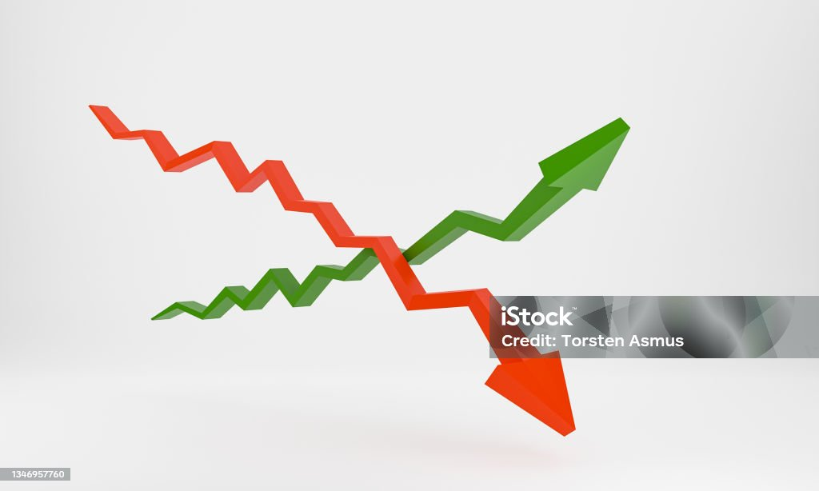

Slide 44
Correlation (n)
Meaning: A relationship or connection between two things.
Example: There is a strong correlation between exercise and good health.

Slide 45
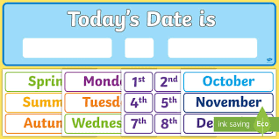

Slide 46
Current (adj)
Meaning: Happening now; at the present time.
Example: The current weather is sunny and warm

Slide 48
Frustrated (adj)
Meaning: Upset, distressed, or annoyed at a person or situation. Example: She felt frustrated when her computer stopped working.

Slide 50
Modest (adj)
Meaning: Not arrogant or vain; being quiet about one’s abilities or achievements.
Example: He was modest about his success and didn’t brag.

Slide 51
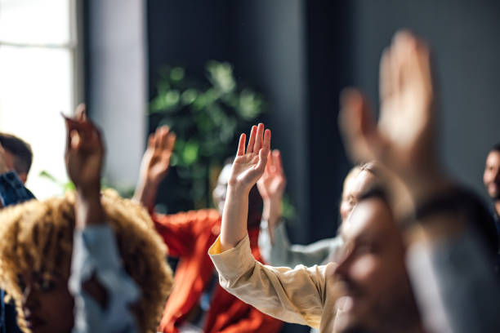

Slide 52
Participant (n)
Meaning: A person who takes part in a study or research.
Example: Each participant completed a survey after the experiment.

Slide 53
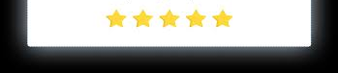

Slide 54
Rate (v)
Meaning: To judge something or someone according to a scale; to grade.
Example: The movie was rated five stars by the audience.

Slide 56
Suggest (v)
Meaning: To say that something is possible or likely; to imply. Example: The teacher suggested that we read the book carefully.

Slide 58
Tend to (v)
Meaning: To be likely to happen; to be likely to do something. Example: People who exercise regularly tend to feel happier.

Slide 60
Perseverance (n)
Meaning: The ability to keep going and not give up, even when facing challenges.
Example: Her perseverance helped her finish the marathon.

Slide 61
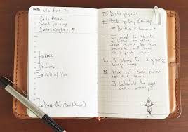

Slide 62
Conscientiousness (n)
Meaning: The quality of being careful, organized, and responsible. Example: Conscientiousness is an important trait for completing tasks successfully.

Slide 63
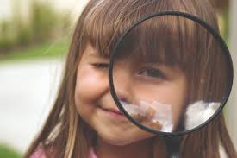

Slide 64
Scope (n)
Meaning: The range or extent of something.
Example: The scope of the project includes both research and implementation.

Slide 66
Conclude (v)
Meaning: To reach a decision or opinion after considering information.
Example: After reviewing the data, the scientist concluded that the hypothesis was correct.

Slide 68
Implications (n)
Meaning: The possible effects or consequences of something. Example: The new policy has serious implications for small businesses.

Slide 69
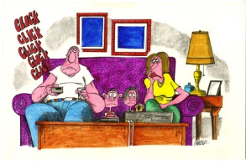

Slide 70
Procrastinating
Part of Speech: Verb
Meaning: Delaying or postponing something that needs to be done, often unnecessarily.
Example Sentence: Instead of procrastinating on her homework, she decided to finish it right after school so she could relax later.

Slide 71
"Other" as Adjective or Noun
Adjective Example: I prefer the other book.
Refers to a different item.
Noun Example: I like this book better than the others.
Refers to remaining or different items.

Slide 72
"Another" as Determiner or Pronoun
Determiner Example: I'd like another book.
Followed by a noun, meaning "an additional one."
Pronoun Example: May I have another?
Stands alone, meaning "an additional one."

Slide 73
Reciprocal Pronouns
Each Other: For two people. Example: The two students exchanged papers with each other.
One Another: For three or more people. Example: The children gave gifts to one another.

Slide 74
Recap
Term | Type | Examples
Other | Adjective, Noun | I prefer the other book; the others
Another | Determiner, Pronoun | Another book; May I have another?
Each Other | Reciprocal Pronoun | Exchanged papers with each other
One Another | Reciprocal Pronoun | Gave gifts to one another

Slide 75
Other" as an Adjective or Noun
"Other" as an Adjective:
When "other" is used as an adjective, it describes or modifies a noun. It refers to something different from what has already been mentioned.
Example: I prefer the other book. Here, "other" is describing which book you prefer, indicating a different book than the one previously mentioned.
"Other" as a Noun:
When "other" is used as a noun, it stands on its own without a noun following it, and refers to the remaining items or people.
Example: I like this book better than the others. Here, "others" refers to the remaining books that are not the one being discussed.

Slide 76
"Another" as a Determiner or Pronoun
Another" as a Determiner:
"Another" is a determiner when it is followed by a singular noun. It refers to an additional one of the same kind.
Example: I would like another coffee. Here, "another" is referring to one more coffee (additional and same as the first one).
"Another" as a Pronoun:
"Another" is a pronoun when it stands alone (without a noun). It refers to an additional item.
Example: I would like another. In this case, "another" stands alone, referring to an additional coffee, but the noun is implied.

Slide 77
Extroverted
Part of Speech: Adjective
Meaning: Describing someone who is outgoing, sociable, and energized by being around others.
Example: She is an extroverted person who loves attending social events.

Slide 78
Feeling
Part of Speech: Noun, Adjective
Meaning (Noun): An emotional state or reaction.
Example: His feelings were hurt when he was excluded from the group.
Meaning (Adjective): Describing someone who makes decisions based on emotions and empathy rather than logic.
Example: She is a very feeling person, always thinking about how her actions affect others.

Slide 79
Introverted
Part of Speech: Adjective
Meaning: Describing someone who is more focused on their inner thoughts and feelings rather than seeking external stimulation; often enjoys spending time alone.
Example: As an introverted person, he prefers reading a book in a quiet corner over attending a party.

Slide 80
Intuitive
Part of Speech: Adjective
Meaning: Describing someone who tends to understand things instinctively, without needing to use conscious reasoning.
Example: Her intuitive sense of how people feel helps her to be a great counselor.

Slide 81
Judging
Part of Speech: Adjective
Meaning: Describing someone who prefers a structured and planned approach to life, enjoys making decisions and sticking to a plan.
Example: A judging personality prefers to have everything organized and on schedule.

Slide 82
Perceiving
Part of Speech: Adjective
Meaning: Describing someone who is flexible and spontaneous, enjoys keeping options open rather than making firm decisions immediately.
Example: A perceiving individual likes to adapt to the situation rather than following a strict plan.

Slide 83
Sensing
Part of Speech: Adjective
Meaning: Describing someone who focuses on the present and uses their senses to observe and understand the world around them, often relying on facts and details.
Example: A sensing person enjoys paying attention to details and prefers to live in the moment.

Slide 84
Thinking
Part of Speech: Noun, Adjective
Meaning (Noun): The process of using one's mind to consider or reason about something.
Example: His thinking on the matter was deeply influenced by logic and data.
Meaning (Adjective): Describing someone who makes decisions based on logical analysis and objective reasoning.
Example: A thinking personality will make decisions based on facts rather than emotions.

Slide 85
Reflexive pronouns
Reflexive pronouns are used when the subject and the object of a sentence are the same person or thing. They end in -self (singular) or -selves (plural)
Here are the reflexive pronouns:
I → myself
You (singular) → yourself
He → himself
She → herself
It → itself
We → ourselves
You (plural) → yourselves
They → themselves

Slide 86
Uses of Reflexive Pronouns
To show that the subject and object are the same:
"She looked at herself in the mirror."
"They enjoyed themselves at the party."
For emphasis (intensifying the subject or object):
"I did it myself!"
"He himself told me the news."
To indicate that someone does something alone or without help:
"I can do it myself."
"We built the house ourselves."

Slide 87
When we say the subject and the object are the same, we mean that the person or thing performing the action (the subject) is also the one receiving the action (the object).
For example:
"She washed herself."
The subject, "She," is doing the action of washing.
The object, "herself," is also "She," meaning she is washing herself.
So, the action is being done by the same person who is affected by it. The reflexive pronoun (like herself, myself, themselves) shows that the person or thing doing the action is both the subject and the object in the sentence.

Slide 88
The three key parts of any good piece of writing
They are the introduction, the body paragraphs, and the conclusion.
Introduction: This is where you grab the reader’s attention and tell them what your writing is about. It’s like saying ‘hello’ and inviting them to read more.
Body Paragraphs: This is the main part of your writing. You explain your ideas, give examples, or share reasons.
Conclusion: This is the ending. You summarize your main ideas and leave the reader with something to think about.

