Slide 1
Kick-off Meeting
EL Department 2025

Slide 2
Kick-off Meeting Agenda
Amideast Educational Experience
EL & PST Programs
EL Journey Map
Communication Channels
Reports & Certificates
Measuring Course Success
Questions
EL Department 2025

Slide 3
Amideast Educational Experience
A leading American non-profit organization engaged in international education, training and development activities in the Middle East and North Africa.
Founded
in 1951
11 MENA Countries
USD 66 MM
Annual Portfolio
20
Offices
1,200 Staff

Slide 4
Induction
English Language and Training Programs Department
MAKING A DIFFERENCE

Slide 5
2. AMIDEAST and EL Programs
EL provides a variety of English Language development courses to make sure we match the different needs of students:
General English Courses: Focuses on the 4 main skills (Reading, Writing, Speaking and Listening). The General English is divided into 5 stages (Beginner, Elementary, Pre-Intermediate, Intermediate, Upper-Intermediate) and each stage includes 4 levels.
Conversation Courses: Provides intensive focus on the Speaking and Listening skills. The Conversation levels are 6 (Conversation Intermediate 1&2, Conversation Upper-Intermediate 1&2, Conversation Advanced 1&2)
EL Department 2025

Slide 6
2. AMIDEAST and EL Programs
Business English Courses:
English for the Workplace Program is a course offered to develop English language proficiency in the workplace. The program focuses on the practical everyday communication often used in the workplace at different levels of proficiency. It applies a task-based approach and tackles a wide range of real workplace challenges for employees in majority of business fields.
The Program is divided into four stages: Pre-Intermediate, Intermediate, Upper Intermediate and advanced. Each stage is divided into four levels that consist of a combined 30 hours of training, which include:
Classroom instructional hours using the textbook In Company 3.0 and supplementary materials.
A one-day workshop covering a business skill that is relevant to the needs of the class
EL Department 2025

Slide 7
CEFR Levels
Common European Framework of Reference
Levels | Guided Learning hours to achieve each level from the level below
C2 | 300-400
C1 | 200-300
B2 | 180-260
B1 | 160-240
A2 | 100-150
A1 | 90-100

Slide 8
2. AMIDEAST and EL Programs
We offer three different modalities which are Face-to-Face, Online and Hubrid:
Face-to-Face/Hybrid Modality: - Provided at AMIDEAST premises. - Duration: 5 Weeks, 2 sessions per week. - Total number of hours: 30 hours (25 Face-to-Face Sessions & 5 Asynchronous & Assessments). - Number of hours per session: 2.5 hours.
EL Department 2025

Slide 9
2. AMIDEAST and EL Programs
We offer two different modalities which are Face-to-Face and Online:
Online Modality: - Provided through Zoom Meetings. - Duration: 5 Weeks, 2 sessions per week. - Total number of hours: 30 hours (25 Online Sessions & 5 Assessments & Assignments). - Number of hours per session: 2.5 hours.
EL Department 2025

Slide 10
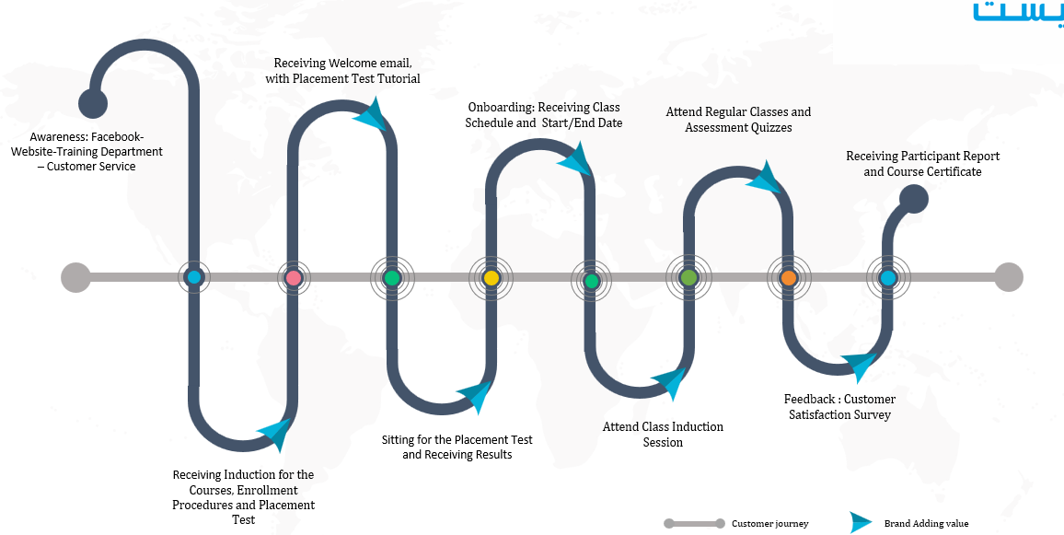
3. Your Journey Map
EL Department 2025

Slide 11
4. Communication:
Communication via emails is our main channel
Heidi Aly - Programs Specialist : haly@amideast.org
Mobile: 01096564441
Dr. Nehad El Leithy – Programs Manager: nleithy@amideast.org
Mobile: 01068130666
EL Department 2025

Slide 12
Communication:
Learning Management System (LMS):
Amideast LMS (https://AMIDEASTonline.org) is used by all students whether enrolled in a F2F or Online course. It provides students with the tools necessary to participate in the asynchronous portion of the course hours. Please join using this code( ------------) Asynchronous learning is a type of online education that does not require real-time interaction and is taken through AMIDEAST LMS (AmideastOnline).
Tools provided on LMS: - Quiz taking (Written and oral)
- Accessing material - Session Recordings
EL Department 2025

Slide 13
5. Reporting & Certificate:
Certificate is handed on course last session based on 70% attendance rate & total grade pass rate.
Final report is sent 4 working days after last day of the term including attendance and final score percentage.
Attendance & Participation/10 | Quiz 1 - Listening/ 10 | Quiz 2 - Listening/10 | Quiz 1 -Speaking/10 | Quiz 2 - Speaking/10 | Asyncronous Tasks/20 | Final Project/30 | Total/100
EL Department 2025

Slide 14
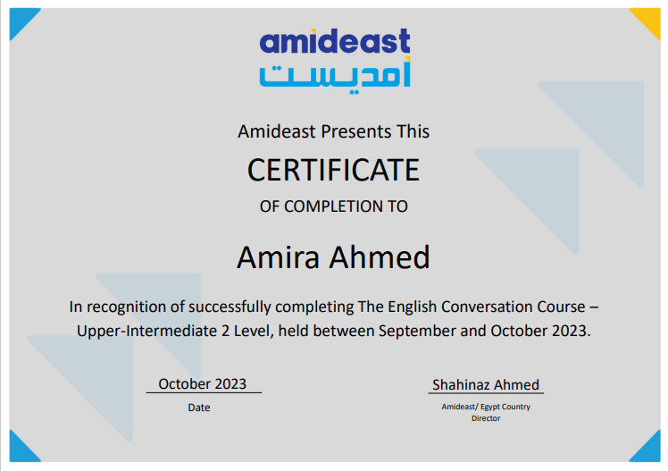
Certificates
Certificates are issued by the end of each round and are sent as a soft copy through an email.
EL Department 2025

Slide 15
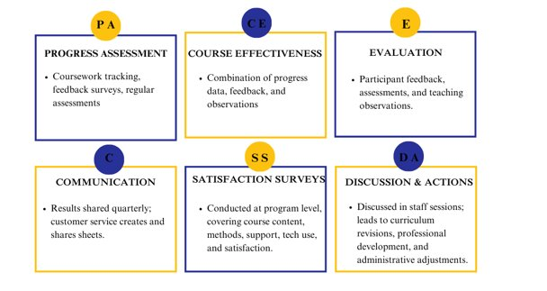
6. Measuring Course Success
EL Department 2025

Slide 16
9. Questions
EL Department 2025

Slide 17
Thank you for choosing Amideast!
EL Department 2025

