Slide 1
Intermediate 1 – Unit 1

Slide 2
Introductions ☺
- Step 1 : Take a few minutes and create your own questions. ( only 5 questions)
- Step 2 : I’ll divide you into breakout rooms to ask your partner the questions you have written.
- Step 3 : Return to the main session and tell the class about your partner by summarizing the notes you took.

Slide 3
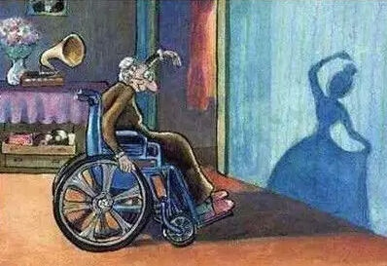
Look at the picture
1. What is the old woman doing?
2. What happened to her ?
3. What was she smiling about?
4. What had she done before her accident?
5. Why has she given up on her dream?
6. How does she spend her days?

Slide 4


Slide 5
Present Tenses | Structure | Example | Signal words
Present simple: something that usually happens ( a fixed action) | Subject ( I, You, We, They ) + V₁ Subject ( He, She, It ) + VERB – S / ES / IES | I start my day at 9:00 am She starts her day at 9:00 am | Everyday Every week Usually sometimes
Present continuous : Something happening now | Subject + (are-is-am) + verb + ing | I am going to work now. She is travelling to Cairo at the moment We are eating lunch right now! | At the moment Now Tonight
Present perfect: Recently finished action, permanent actions, achievements | Subject (I, you, we, they) + have + p.p Subject ( he, she, it) + has + p.p | Julie has cooked dinner. Let's go and eat Dan has broken his arm. | For a long time Since July Before /Recently Never/ever/Just/ already/ yet/

Slide 6
Past Tenses | Structure | Example | Signal words
Past simple: some time in the past and has ended | Subject + V2 or irregular | I lived in Texas last year. She taught history two years ago. | yesterday Last week Two days ago At 8:00/ In 1997
Past continuous : actions were in progress at a special time in the past repeated actions (with always, constantly, forever) | Subject + ( was/were) + verb + ing | Andrew was always coming to eat. While we were sitting at the breakfast table, the telephone rang. | While. as long as, at, all day yesterday, all morning
Past perfect : before/up to a certain time in the past | Had + past participle( 3rd) | After the flight attendants had completed the safety demonstration, the plane took off. | Already, before, for, just Never, not yet, once until that day

Slide 7
Let’s try this….
On Sunday Ron and Lisa ______________ (play) game cards.
Last year I _______________(spend) my holiday in Ireland.
I ______ just ____________(finish) my master’s degree.
She ____________(live) in China before she moved to Thailand.
The students ____________(have) lunch in the canteen right now.
Yesterday at six I _______________(prepare) dinner.
You ____________(buy) 4 cars so far.
Julie didn't arrive until after I__________(leave)
One night we ____________(learn) some new dances.
My dad___________(wash) his car tonight.
While we________ (study) English, the lights went out.
Martin ___________(go) for a walk every morning.

Slide 8
Answers
On Sunday Ron and Lisa play game cards.
Last year I spent my holiday in Ireland.
I have just finished my master’s degree.
She had lived in China before she moved to Thailand.
The students are having lunch in the canteen right now.
Yesterday at six I was preparing dinner.
You have bought 4 cars so far.
Julie didn't arrive until after I had left.
One night we learned some new dances.
My dad is washing his car tonight.
While we were studying English, the lights went out.
Martin goes for a walk every morning.

Slide 9
With a partner ….
Create a story made up of 5-6 sentences using 2 different verb tenses.
Use at least 3 of these verbs ( apply the tenses you chose)
Conduct
Abandon
Collide
Bribe
Devote
Improvise
Negotiate

Slide 10

Quiz Time !! (CD 2)
In which country do men and women live the longest?
Japan b. Germany c. The U.S
In which year did the world population reach 7 billion?
1999 b.2005 c.2012
If you are standing on the equator, how many hours of daylight do you have?
a.12 b. 16 c.24
Where does most of the world’s oil come from?
Russia b. Saudi Arabia c. The U.S
Which of the seven wonders of the world is still standing?
a. The Lighthouse of Alexandria b. The Pyramids of Egypt c. The Colossus of Rhodes

Slide 11
Why didn’t dinosaurs attack humans?
Because they were vegetarian
Because they became extinct before humans.
Because they didn’t run fast enough.
Where was the Titanic sailing to when it sank?
Southampton b. Rio de Janeiro c. New York
How long has it Hawaii been a U.S state?
Since 1952 b. Since 1959 c. Since 1963
How many people have won the Nobel peace prize since it started in 1901?
58 b.94 c. 103
How long have people been using the Internet?
Since 1969 b. Since 1976 c. Since 1984
Which language is spoken by the most people in the world?
Spanish b. Chinese c. English
In which country were women first given the vote?
a. Canada b. Paraguay c. New Zealand

Slide 12
In groups…
Go back to the quiz….
Group A: will take the first set of questions while Group B will take the second set of questions
Identify the verbs and their tenses in each question

Slide 13
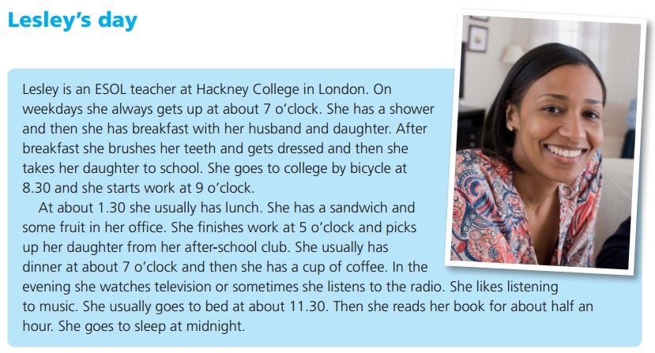

Slide 14
Who does she have breakfast with?
What time does Lesley get up?
Does she have a shower in the morning?
How does she go to college?
What relative does she pick up after work?
Where does she have lunch?
Has Lesley got any hobbies after work?
What time does she go to bed?

Slide 15
Talking about you…
What time ______ you usually get up on weekends?
What time ______ you get up this morning?
How long _______ it usually take you to get from home to school?
How long _______ you known the teacher?
What ______ you doing before you started class?
What ______ ( not) you like doing in English class?
Which school subjects _____ ( not) you like when you were younger?
Which other foreign languages ______ you studied?
What presents ________ you given on your last birthday?

Slide 16
Answers
What time do you usually get up on weekends?
What time did you get up this morning?
How long does it usually take you to get from home to school?
How long have you known the teacher?
What were you doing before you started class?
What don’t you like doing in English class?
Which school subjects didn’t you like when you were younger?
Which other foreign languages have you studied?
What presents were you given on your last birthday?

Slide 17
With a partner….
Interview your partner using the previous questions about their daily routine.

Slide 18
Listen to :Correct the information in the sentences (CD 3)
1. Chichen Itza is in Costa Rica.
2. Shakespeare didn’t write a poem.
3. Vegetarians eat meat.
4.The internet doesn’t provide much information.
5.The world is getting colder.
6.John F. Kennedy was travelling by plane when he was killed.
7.Brazil has never won the World Cup.
8. The 2012 summer Olympics were held in Tokyo
Try it with a partner use intonation

Slide 19
Is it “is” or “has” ( CD 4)
Who’s making that noise?
She’s done really well.
My sister’s a teacher.
Who’s been to Thailand?
He’s leaving early.
What’s produced in your country ?
So.. What’s the tense?

Slide 20


Slide 21
Exercise :Complete putting your own Auxiliary verbs
Tell me,____ you coming to the party?
They ______ finished the job.
What_____ you do every Sunday?
I _______ like to watch TV. There is a good film on.
She _______ not want to stay at home. She wants to go out with her friends.
He ________ called me twice this morning.
What _______ she do in her free time?
Where ________ they go yesterday?
She _____ always wanted to meet him.
What ______ they doing when you came in?

