Slide 1
Intermediate 1 – unit 2

Slide 2
Let’s see if you guys were paying attention…
Put the verb in passive, present, or continuous
“ Can I help you?” No, the manager _________ ( help) me now.
A lot of manufactured goods ____ ( make) in Asia.
A large percentage of the food we buy ______ ( import).
My son ___________(talk) on the phone right now.
The banking industry in the U.S. ____________ ( situate) in New York.
He usually ___________(drive) to work.
______ the tip _______ ( include) in the bill?
Jessica __________(watch) a lot of TV, it isn’t healthy.
Basketball players _____________ (pay) far too much money.
What book _______ you _______(read) these days?

Slide 3
Answers
“ Can I help you?” No, the manager is helping me now.
A lot of manufactured goods are made in Asia.
A large percentage of the food we buy is imported.
My son is talking on the phone right now.
The banking industry in the U.S. is situated in New York.
He usually drives to work.
Is the tip Included in the bill?
Jessica watches a lot of TV, it isn’t healthy.
Basketball players are paid far too much money.
What book are you reading these days?

Slide 4
Let’s correct the wrong sentences:
I’m not wanting an ice cream
Are you understanding what I’m saying?
I’m enjoying the class. It’s great.
I’m thinking you’re really nice.
What are you thinking about?
I’m not believing you. You’re telling lies.
I’m knowing you’re not agreeing with me.
She’s having a lot of money.

Slide 5
Answers
I don’t want an ice cream
Do you understand what I’m saying?
I’m enjoying the class. It’s great. (correct)
I think you’re really nice.
What are you thinking about? (correct)
I don’t believe you. You’re telling lies.
I know you disagree with me.
She has a lot of money.

Slide 6
Try this with a partner …
Jobs to choose from
Accountant
Human resources manager (HR)
Chief executive officer ( CEO)
Personal Assistant (PA)
Information Technology Manager ( IT)
Sales Director
Job description | Current project
Is responsible for dunning the whole company | Buying new hardware
Making appointments and arrangements | Making bookings for a conference
Negotiates prices and contracts | Visiting new customers in China
Runs an IT support team | Recruiting new staff
Is in charge of budget and cash flow | Discussing plans and targets with the Board
Deals with employees | Preparing a financial report

Slide 7
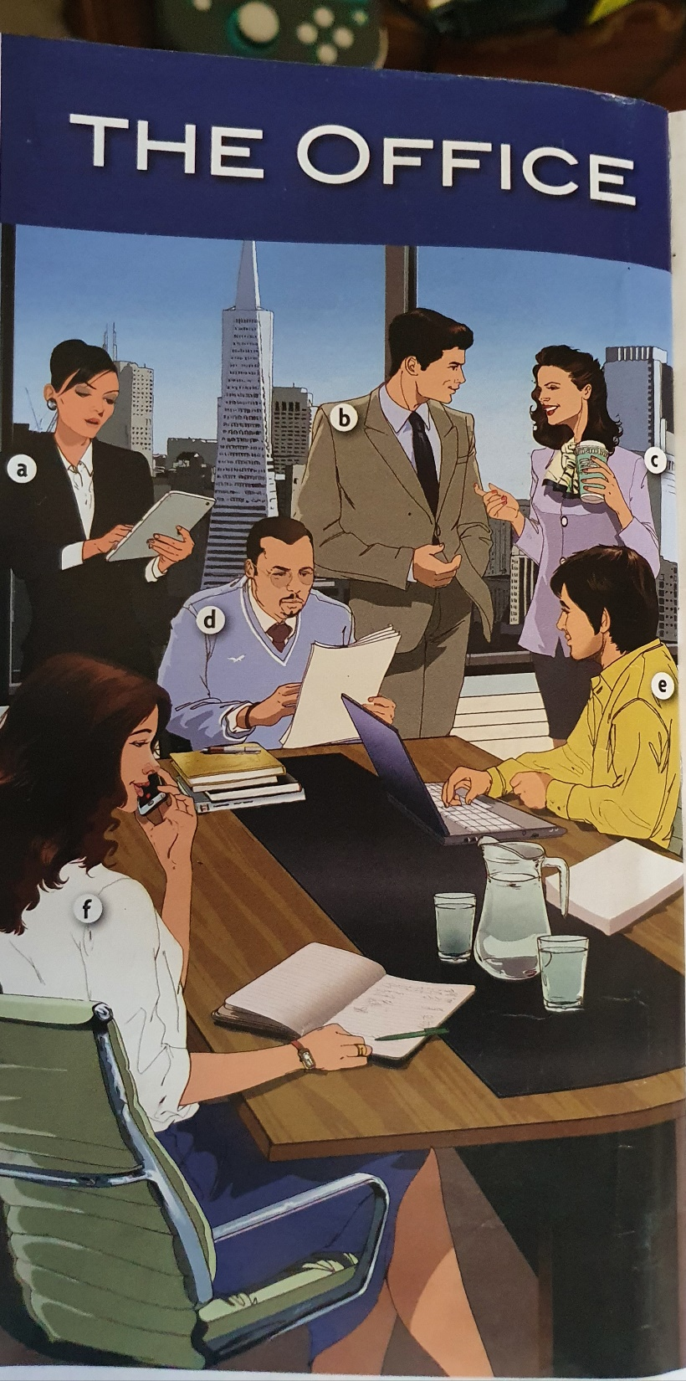

Names | Occupation
Nate | Accountant
Alex | Human resources manager (HR)
Anna | Chief executive officer ( CEO)
Jenny | Personal Assistant (PA)
Matthew | Information Technology Manager ( IT)
Christina | Sales Director
What can you remember about
each member?

Slide 8
If you could change your job:
-What job would you rather have?
-How much would your compensation be?
- Give reason.
Tell the class

Slide 9
Who earns an annual salary of..?
$60,000
$115,000
Occupation
Doctor
Basketball player
CEO
Nurse
Teacher
Supermarket cashier
Police officer
Pilot
Lawyer
Farmer
$200,000
$30,000
1 million
$750,000
$ 50,000
$180,000
$20,000
$70,000

Slide 10
Part 1: Listen to complete
Which jobs do they discuss?
Which salaries do they agree on?
3. Complete the sentences.
They think a doctor earns either $_______ or $ ________
They think either a _______ or a ______earns $ 750,000.
They think a ______ earns about $115,000.
4. What comment do they make about…?
. Doctors . Basketball players .CEOs . Pilots
Part 2: Listen Answer the remaining questions
Who do they think are the lowest earners?
How much do they think farmers earn?
Do they agree about a teacher’s and police officer’s salary?
What is the woman’s final point?

Slide 11
Which of these things do you think successful people do everyday? Choose as many as you want..
Get up late
Exercise
Make to-do lists
Work all the time
Follow the same routine
Take breaks
Stay up late at night

Slide 12
8 unusual things successful people do every day
I shift my day. I’m most creative and productive early in the morning. I used to lose this time in rush of getting the kids out the door and getting ready for work, and then I found myself trying to remember the great idea I had as I was putting on my make up.
So now I go to sleep earlier and wake up earlier – I’m up by 4am- which gives me a few hours of super-productive time before the craziness of the day starts.
Sally Krawcheck. CEO of Ellevate
2.When a topic intrigues me I become almost obsessed. If I don’t fully indulge my desire to search for information, my work suffers. So even though a lot of people feel it’s most productive to have a predictable schedule, I try to vary my daily routine. This approach may not work for everyone, but it definitely works for me.
Dr. Marla Gottschalk, Industrial & Organizational Psychologist.
3. I ride my bike to work because it creates a stress-free time. I get my best ideas on my bike, especially in the morning on way in to the office. Unlike driving, it creates a space for me to be creative. Riding is relaxing, and it gives me time to decompress on my way home.
- Tania Bruke, President of Trek Travel

Slide 13
4. I hand write three thank-you cards every day on the train ride to work.
That’s totally old-fashioned, I know, but how do you feel about your email volume?
If you’re like me, even getting a thank you email can be annoying.
When my staff and customers get my cards, it makes them happy, and it improved my relationships with them, But most importantly it always puts me in a good mood. You can’t be upset and gratefully the same time!
Dave Kerpen, CEO of likeable local.
5. We have a very casual “ jeans and t-shirt” environment at my company, but I still never leave for work without ironing my t-shirt. Yes, I iron my t-shirts.
I use this simple routine to help me remember that every company needs a leader. Even in a super-casual environment., the boss should look his best!
Edward Wimmer, co-founder of Road ID
6. I write for hours everyday, and I also spend a lot of time talking with stressed-out CEOs. Those things are important, but they tire me out. If I’m exhausted by noon, I can’t help the people who rely on me in the afternoon.
So I take a break every day and poke around YouTube, listening to old songs I love and new ones I haven’t heard. Then I post a new song everyday, usually jazz or rock or funk.
Ten minutes spent indulging my inner DJ refuels me.
-Liz Ryan, founder and CEO of Human Workplace

Slide 14
7. Every day I wear the same outfit and eat the same dinner. As an entrepreneur I have to make hundreds of little decisions everyday, so I try to eliminate any decisions I don’t have to make.
For example, I only own five white t-shirts. In the morning I never need to think about what I’ll wear: it’s going to be a white t-shirt. I also only own two pairs of pants.
I do the same thing with meals. I have the same dinner six times a week. That way, I don’t have to think about what to buy or cook. The fewer decisions you have to make, the better decisions you can make.
Leo Widrich , co- founder of Buffer
8. I update my journal to help me keep track of priorities. Journaling is easy. First, identify what’s important in the various roles you play: at work, as a parent, as a spouse, and as a friend. Then track how you’re doing. I use colors to indicate how I’m doing. If I feel great about something, it’s green. Yellow, it’s so-so. Terrible, it’s red.
The key is to determine why something goes from green to yellow or red. If that happens, I think about why I had an off day, and what I can do differently next time.
- Joel Basgall, co-founder and CEO of Geneca

Slide 15
In groups:
Group A will reread 1-4
Group B will reread 5-8 to answer the following questions
Why does Sally Krawcheck get up early?
What is Marla Gottschalk’s strategy for success?
What are two reasons that Tania Burke likes to ride her bike to work?
Why does Dave Kerpen write thank you cards?
What does Edward Wimmer do before work everyday? Why?
How does Liz Ryan stay energized ?
What are two unusual things that Leo Widrich does everyday?
How does Joe Basgall keep track of his priorities?

Slide 16
What do you think? Which one of your Entrepreneurs would probably say…..?
At the end of the day, I evaluate my own performance.
For me, it’s not productive to follow the same routine every day.
I find traffic really stressful.
I don’t think very clearly at night.
It’s important to show people that you appreciate them.
Taking a break in the middle of the day gives me energy.
A manager should set a good example for his or her employees.
I’m very predictable.

Slide 17
Tell the class
Do you do any of the things that theses entrepreneurs do ? Which things?
Do you think people’s strategies for success would work well for you? Why or why not?
Do you know anyone with an unusual daily routine? What do they do?

